Slide 1
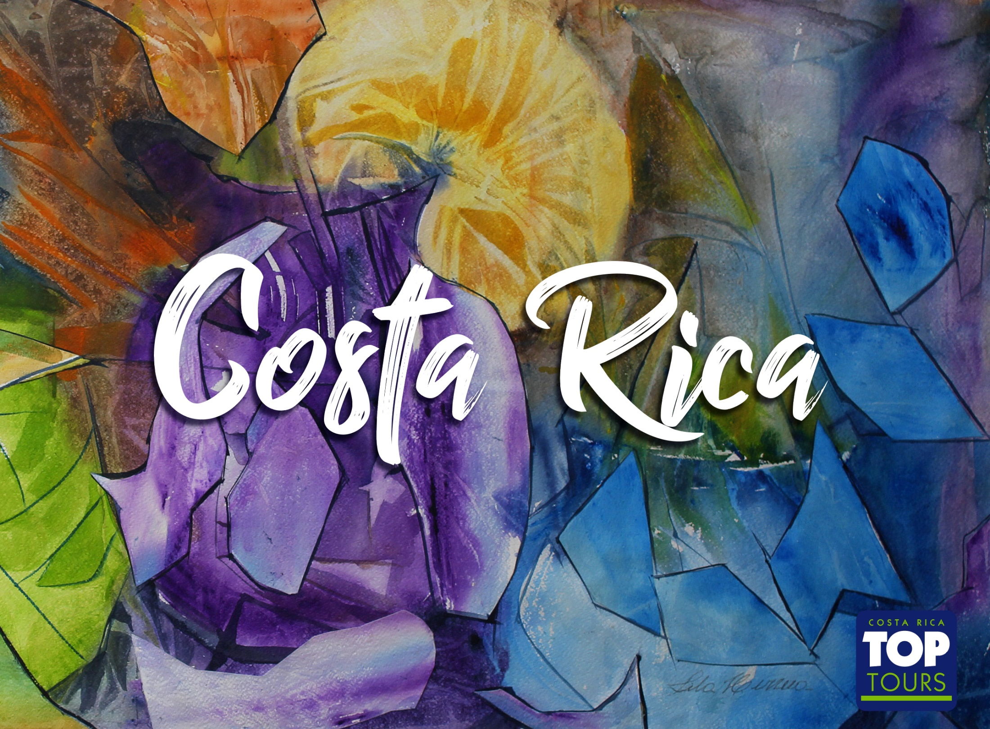

Slide 2
COSTA RICA
Costa Rica covers an area of 20,000.00 square miles. It is located on the southern tip of Central America, between the Pacific Ocean and the Caribbean which allows it to be a privileged spot. The average temperature fluctuates between 20 ºC (68 ºF) - 26 ºC (79 ºF) degrees all year around. The "green season" runs from May until November; Dry season, the equivalent of summer, starts in November ending in April.
The population is 5,000,000 of mostly white race, descendants from the Spaniards who arrived during the XVI century. There are 2 minority groups: one whose origin is Jamaica 50.000 people, and few tribes of native Indians about 10,000.
The religion is Catholic.
Currency is the "colon".
There are no particular requirements to enter the country; the passport is the only document you will need and it must be valid at least 6 months from the date of entry in Costa Rica.
No inoculations are required.
Voltage: The electric current in Costa Rica is 110 volts and 60 cycles.
To make a phone call to Costa Rica you dial 00-506 followed by the number you are calling.
Due to its position, it has flora and fauna found in both Northern and Southern hemispheres. There are 760 species of birds (more than the US and Canada combined), 900 species of plants, 1200 species of orchids, and ten percent of the world's butterflies. This tiny nation has the international standing in the conservation community for its commitment to preservation of forest and wildlife

Slide 3

General Facts
Government: Presidential Democracy.
Division: 7 provinces.
Capital: San José.
Population: 5.000.00.
Official language: Spanish.
Official religion: Catholic.
Currency: Colón (¢).
Electricity: 110 Voltios.
Dry season : Second half November – April (dry).
Green season: May – First half November (rainy).

Slide 4

General Facts
More than 600 Species of plantas
230 Species of animals
760 Species of birds
More than1300 Species de trees
More than800 Species of ferns
More than1000 Species of orchids
25.58%
6% of the world’s Biodiversity
25.58% of the Territory is protected

Slide 5
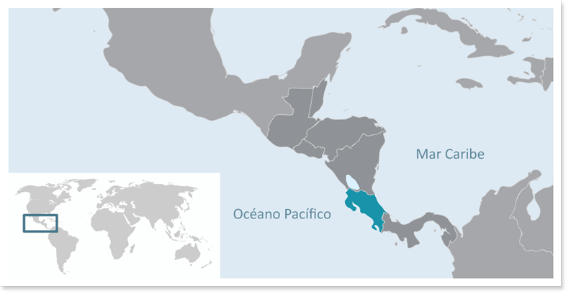
Location
Central America
Limits:
North: Nicaragua.
South: Panamá.
West: Pacific Ocean.
East: Caribbean Sea, Atlantic Ocean.

Slide 6

Entrance requirements:
Passport valid for at least 6 months from your date of entry
Please check if clients require the Yellow Fever Vaccine to enter the country: Countries that require Yellow Fever Vaccine
Please check if you require a visa to enter Costa Rica using the following link https://migracion.go.cr/Paginas/Visas.aspx

Slide 7

International Airports:
Juan Santamaría International Airport
Daniel Oduber International Airport

Slide 8
Departure from Poland to Costa Rica
DAY ONE
Welcome to Costa Rica at Juan Santamaria International Airport. Participants will be welcomed by our representatives.
Meet & Assistance (Immigration & Customs)
Private transfer to Gran Hotel Costa Rica Curio Collection by Hilton
11 miles – 17.70 kilometers

Slide 9
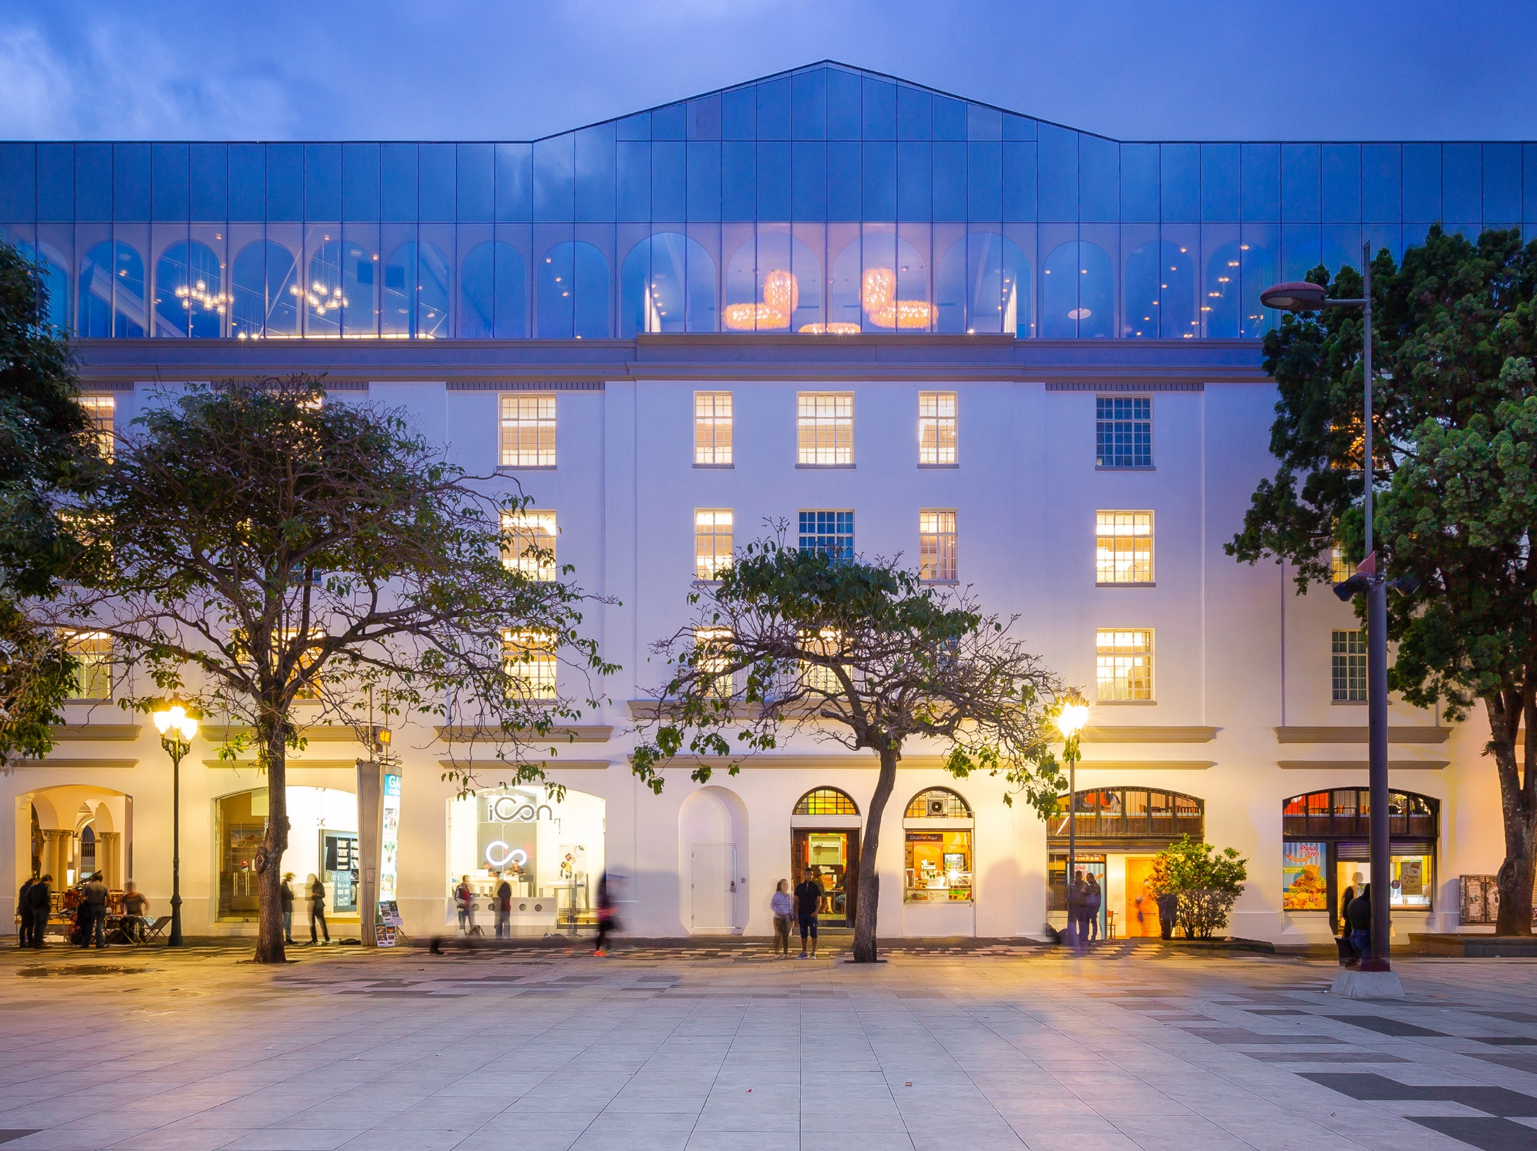

Slide 10
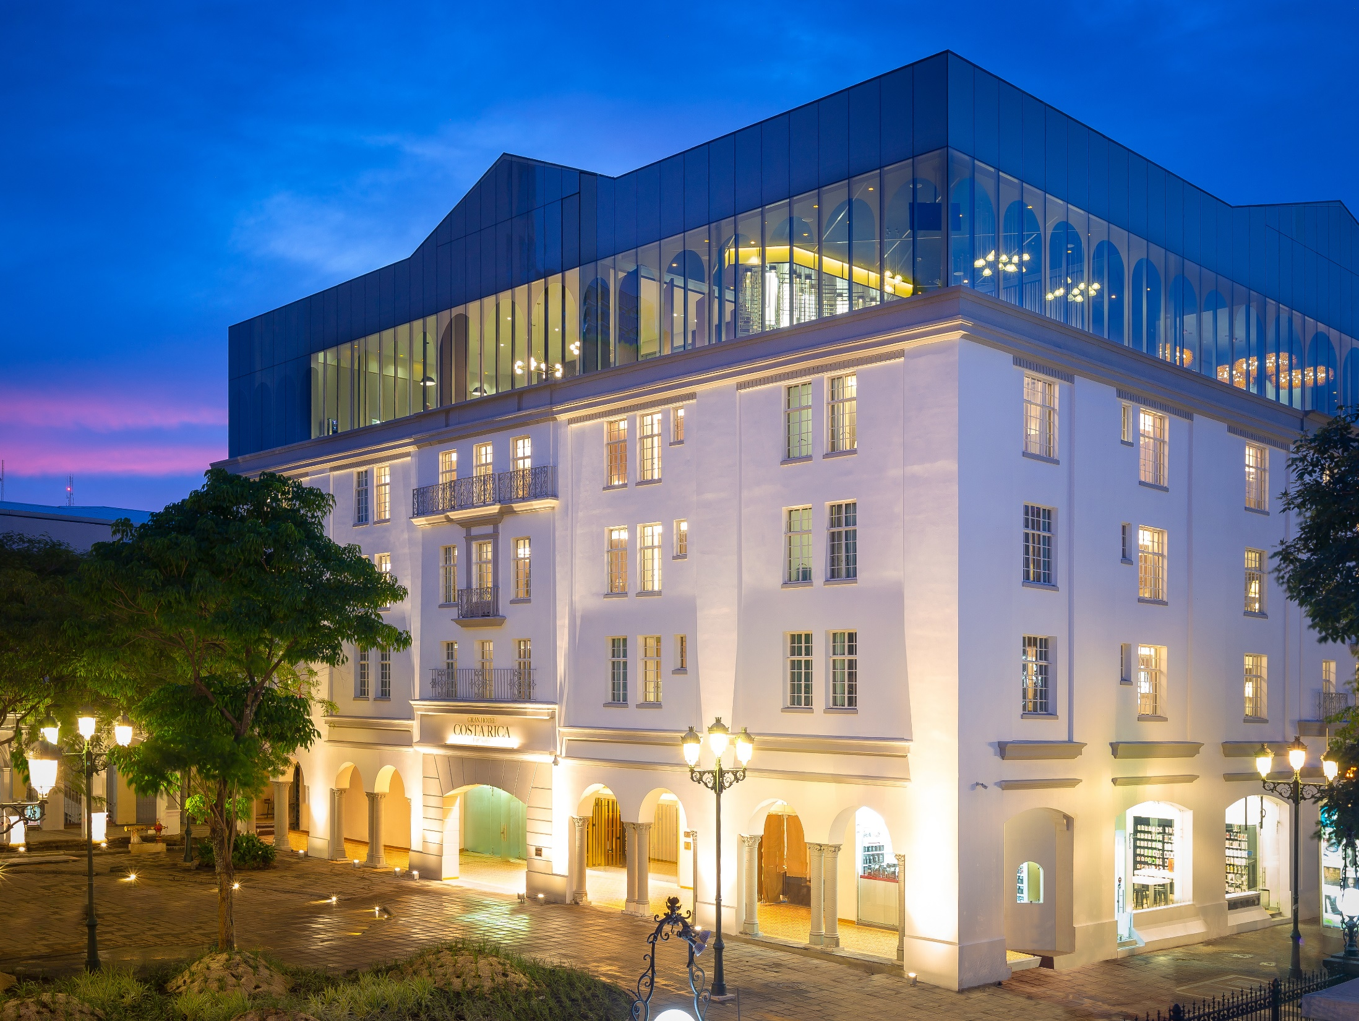

Slide 11
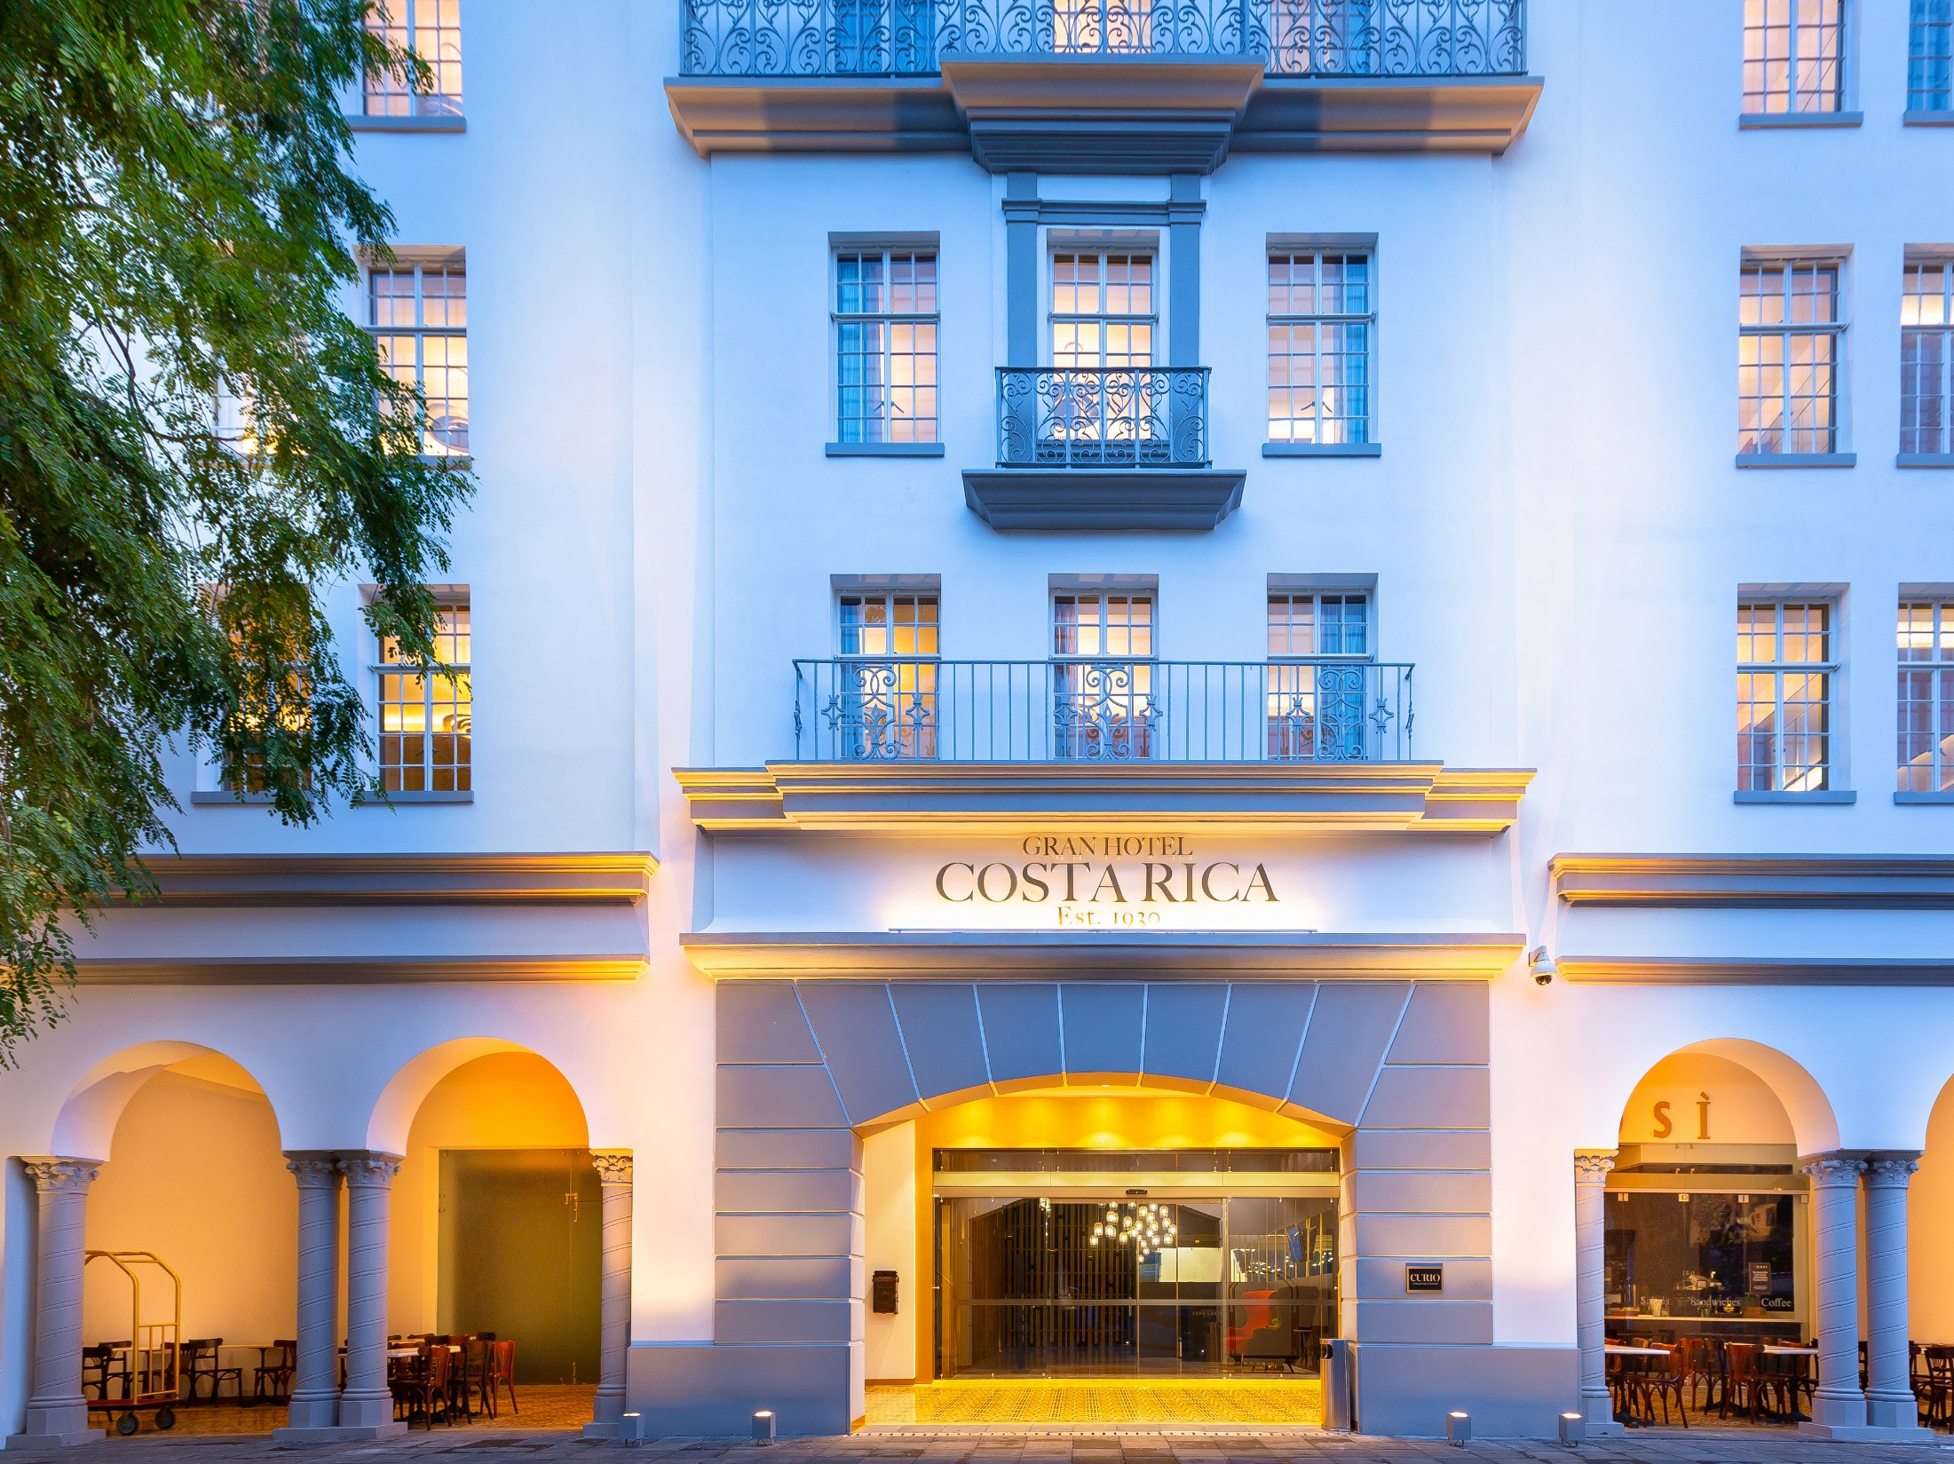

Slide 12
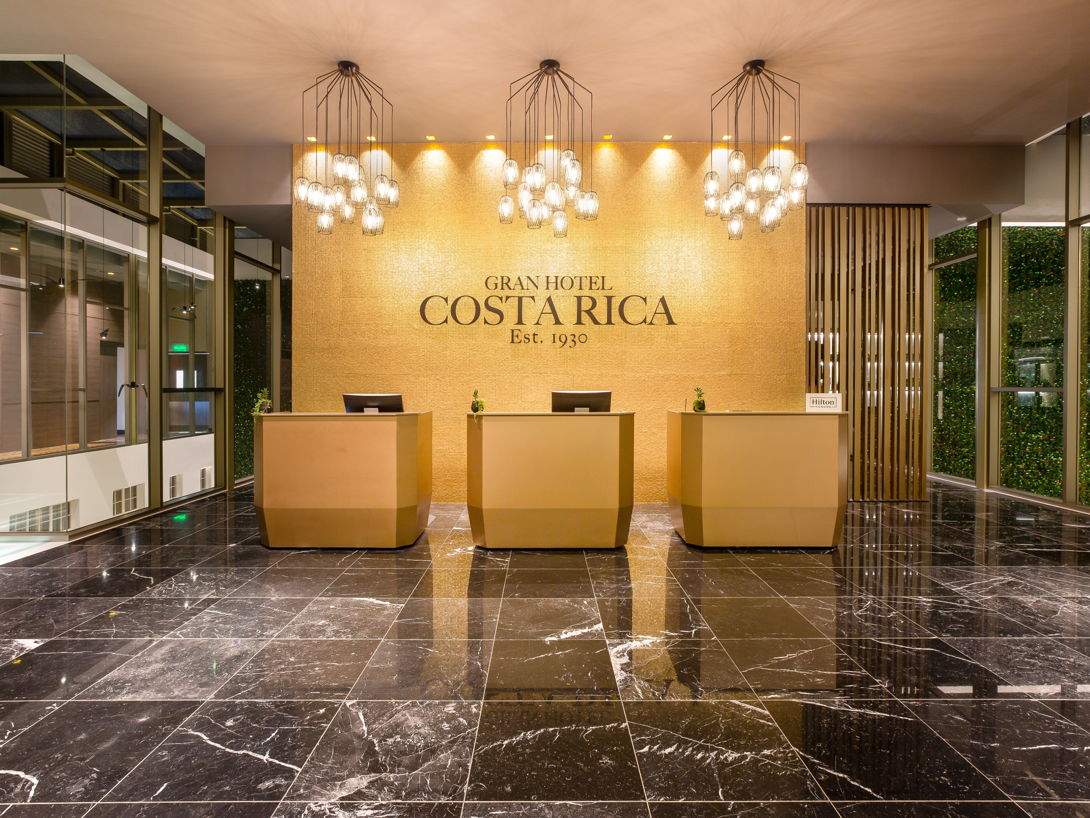

Slide 13
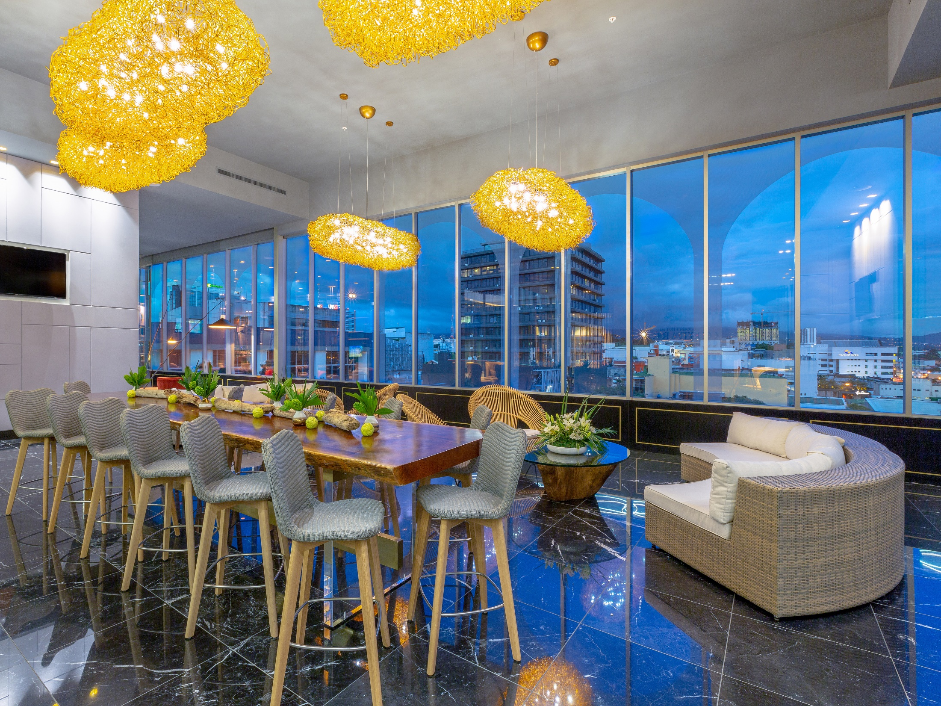

Slide 14


Slide 15
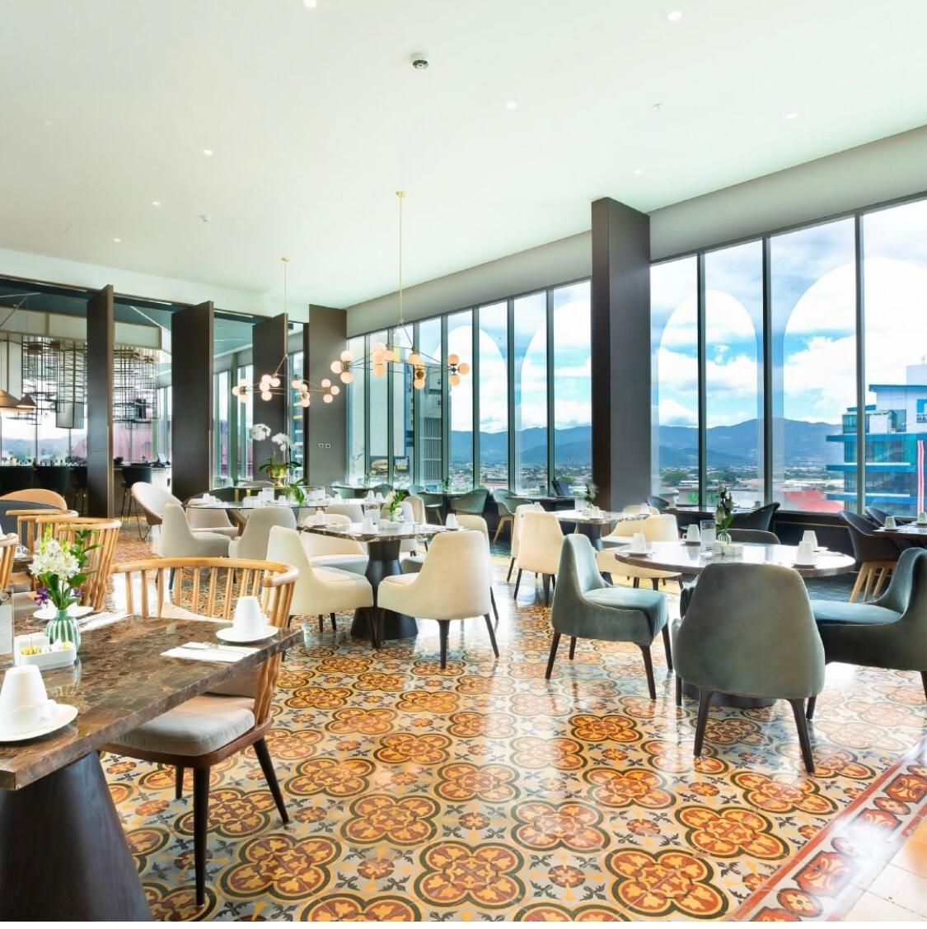
18:30 hrs Dinner at Restaurant “Cultura 5”
Accommodation at Gran Hotel Curio by Hilton

Slide 16
SAN JOSE – PACUARE – SAN JOSE
DAY TWO
Breakfast Gran Hotel Curio Collection By Hilton
07:45 hrs - Departure time
The Pacuare River is one of the most spectacular treasures among the rivers of Costa Rica. The Pacuare River is considered one of the top five rafting rivers in the world for its natural beauty and spectacular rapids. Its waterfalls, great forests and animal life make this trip an ideal combination to get to know our tropical rainforest. Located on the Atlantic slope, this river borders the Talamanca mountain range, home of the native Cabecar people and wildlife unique in the world. Departing from San Jose, we will travel through the impressive Braulio Carrillo National Park passing through its cloud forests and variety of waterfalls, crossing the continental divide to the Caribbean sector of the country. Once prepared for the activity, we move to our private entrance located in the heart of the tropical rainforest. During the next 4 hours, we will travel 25 kilometers enjoying a day of intense emotions running famous rapids such as Cimarron, Alto and Bajo Huacas and Dos Montañas.

Slide 17
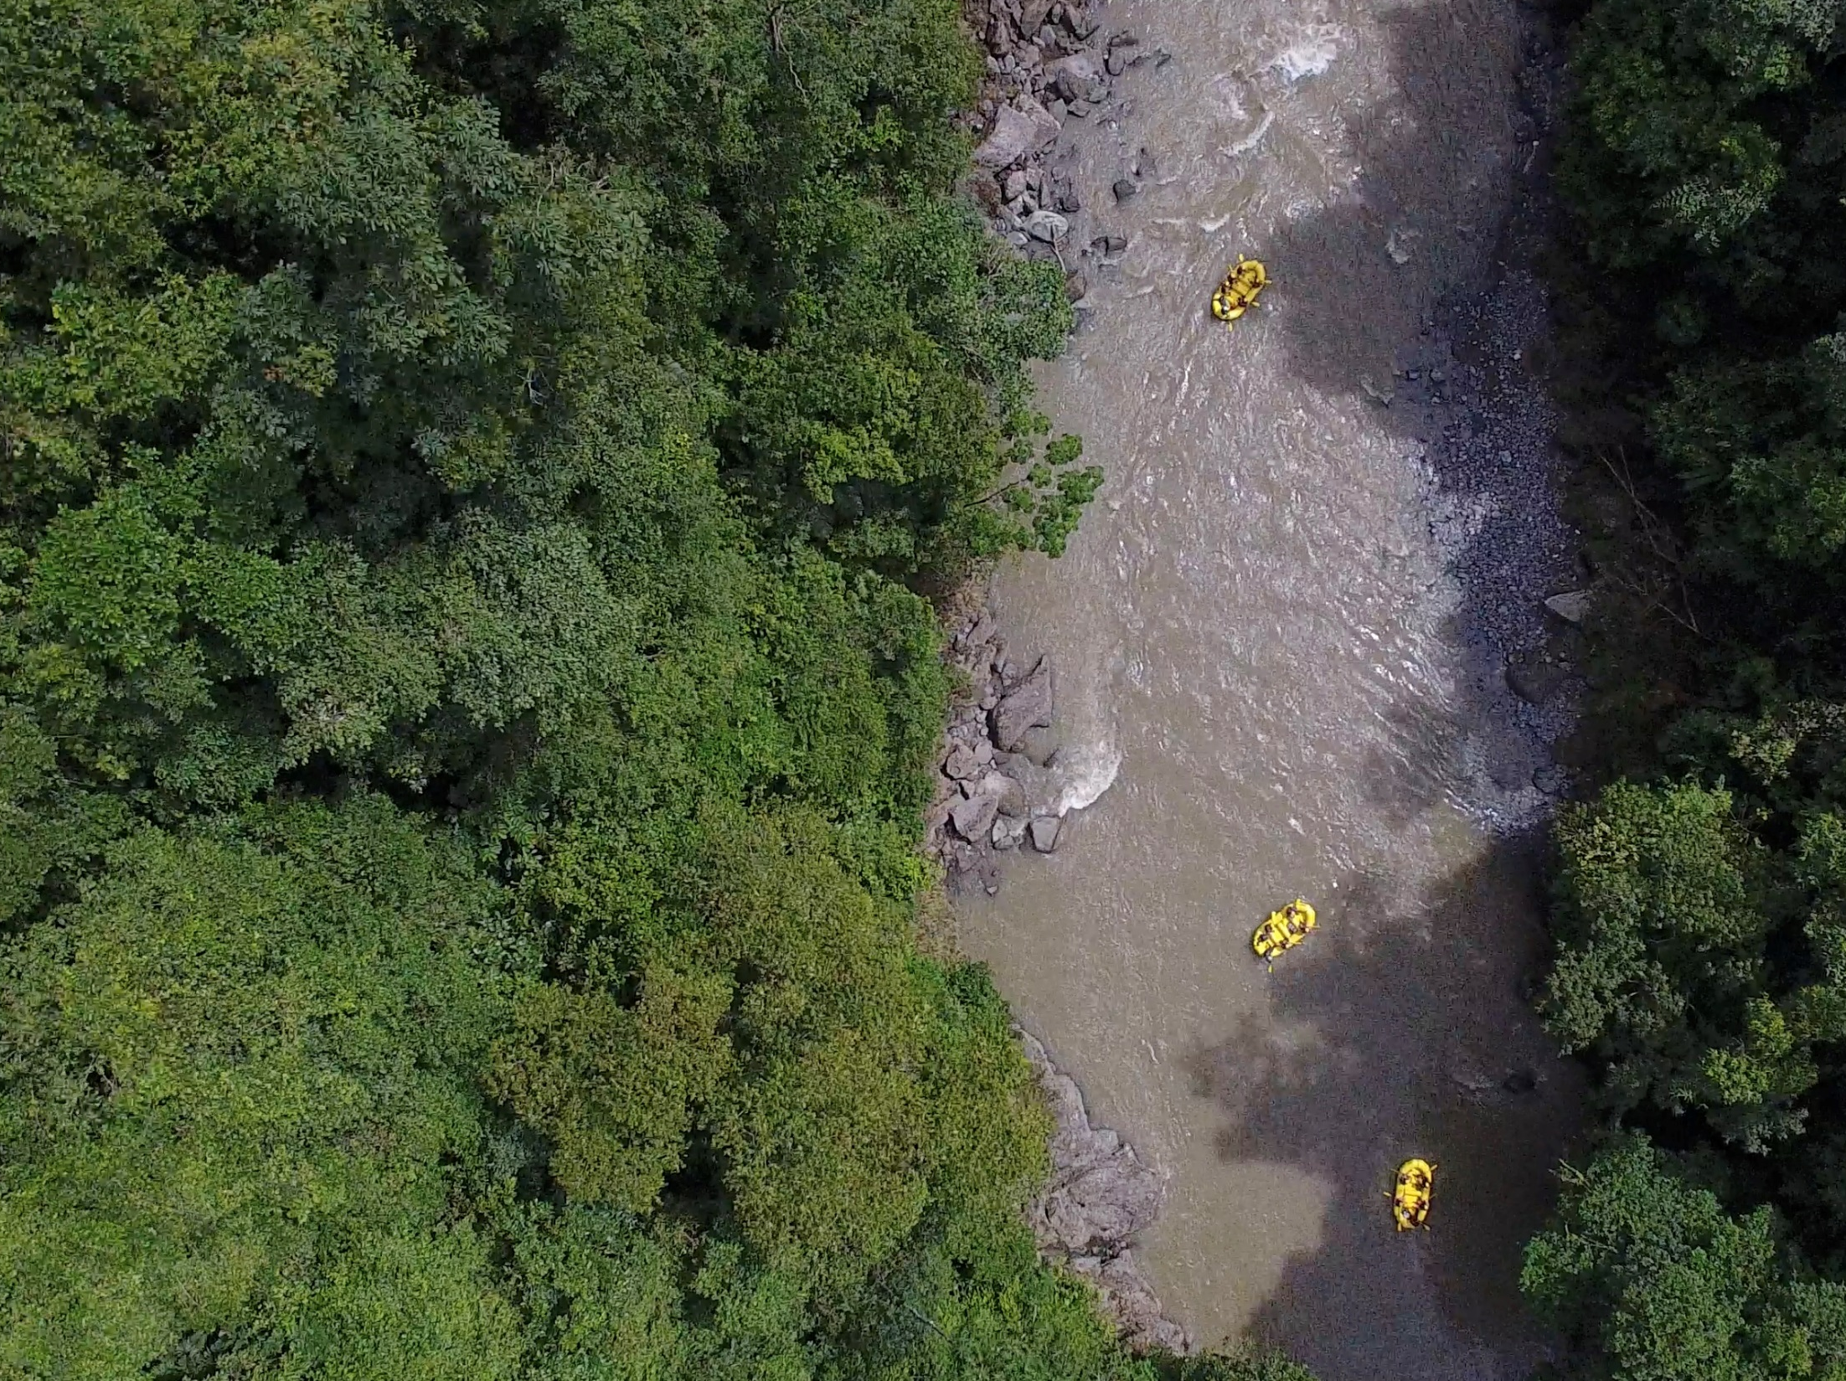

Slide 18
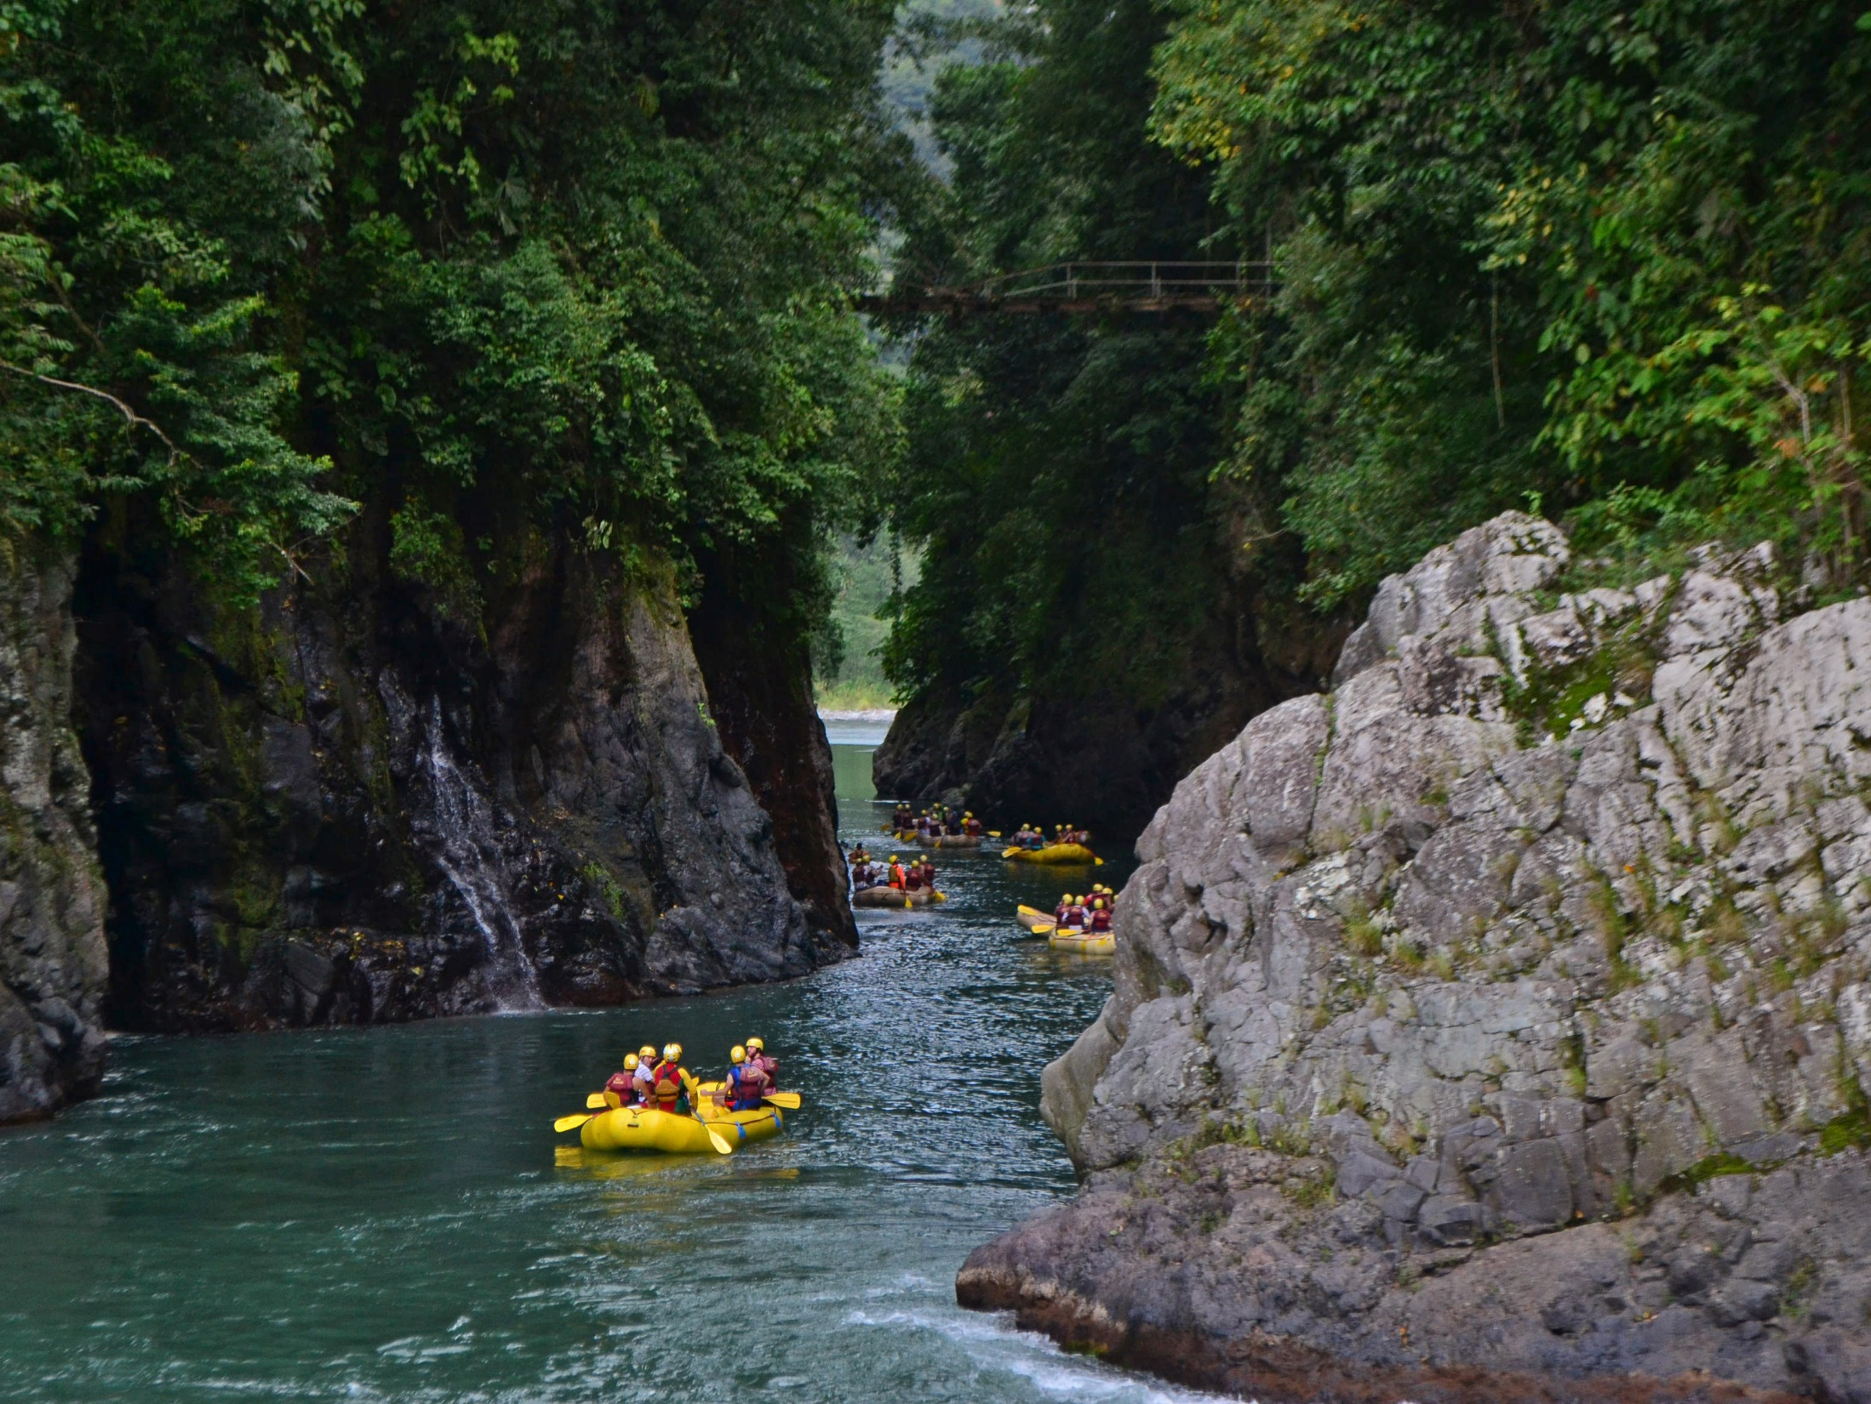

Slide 19
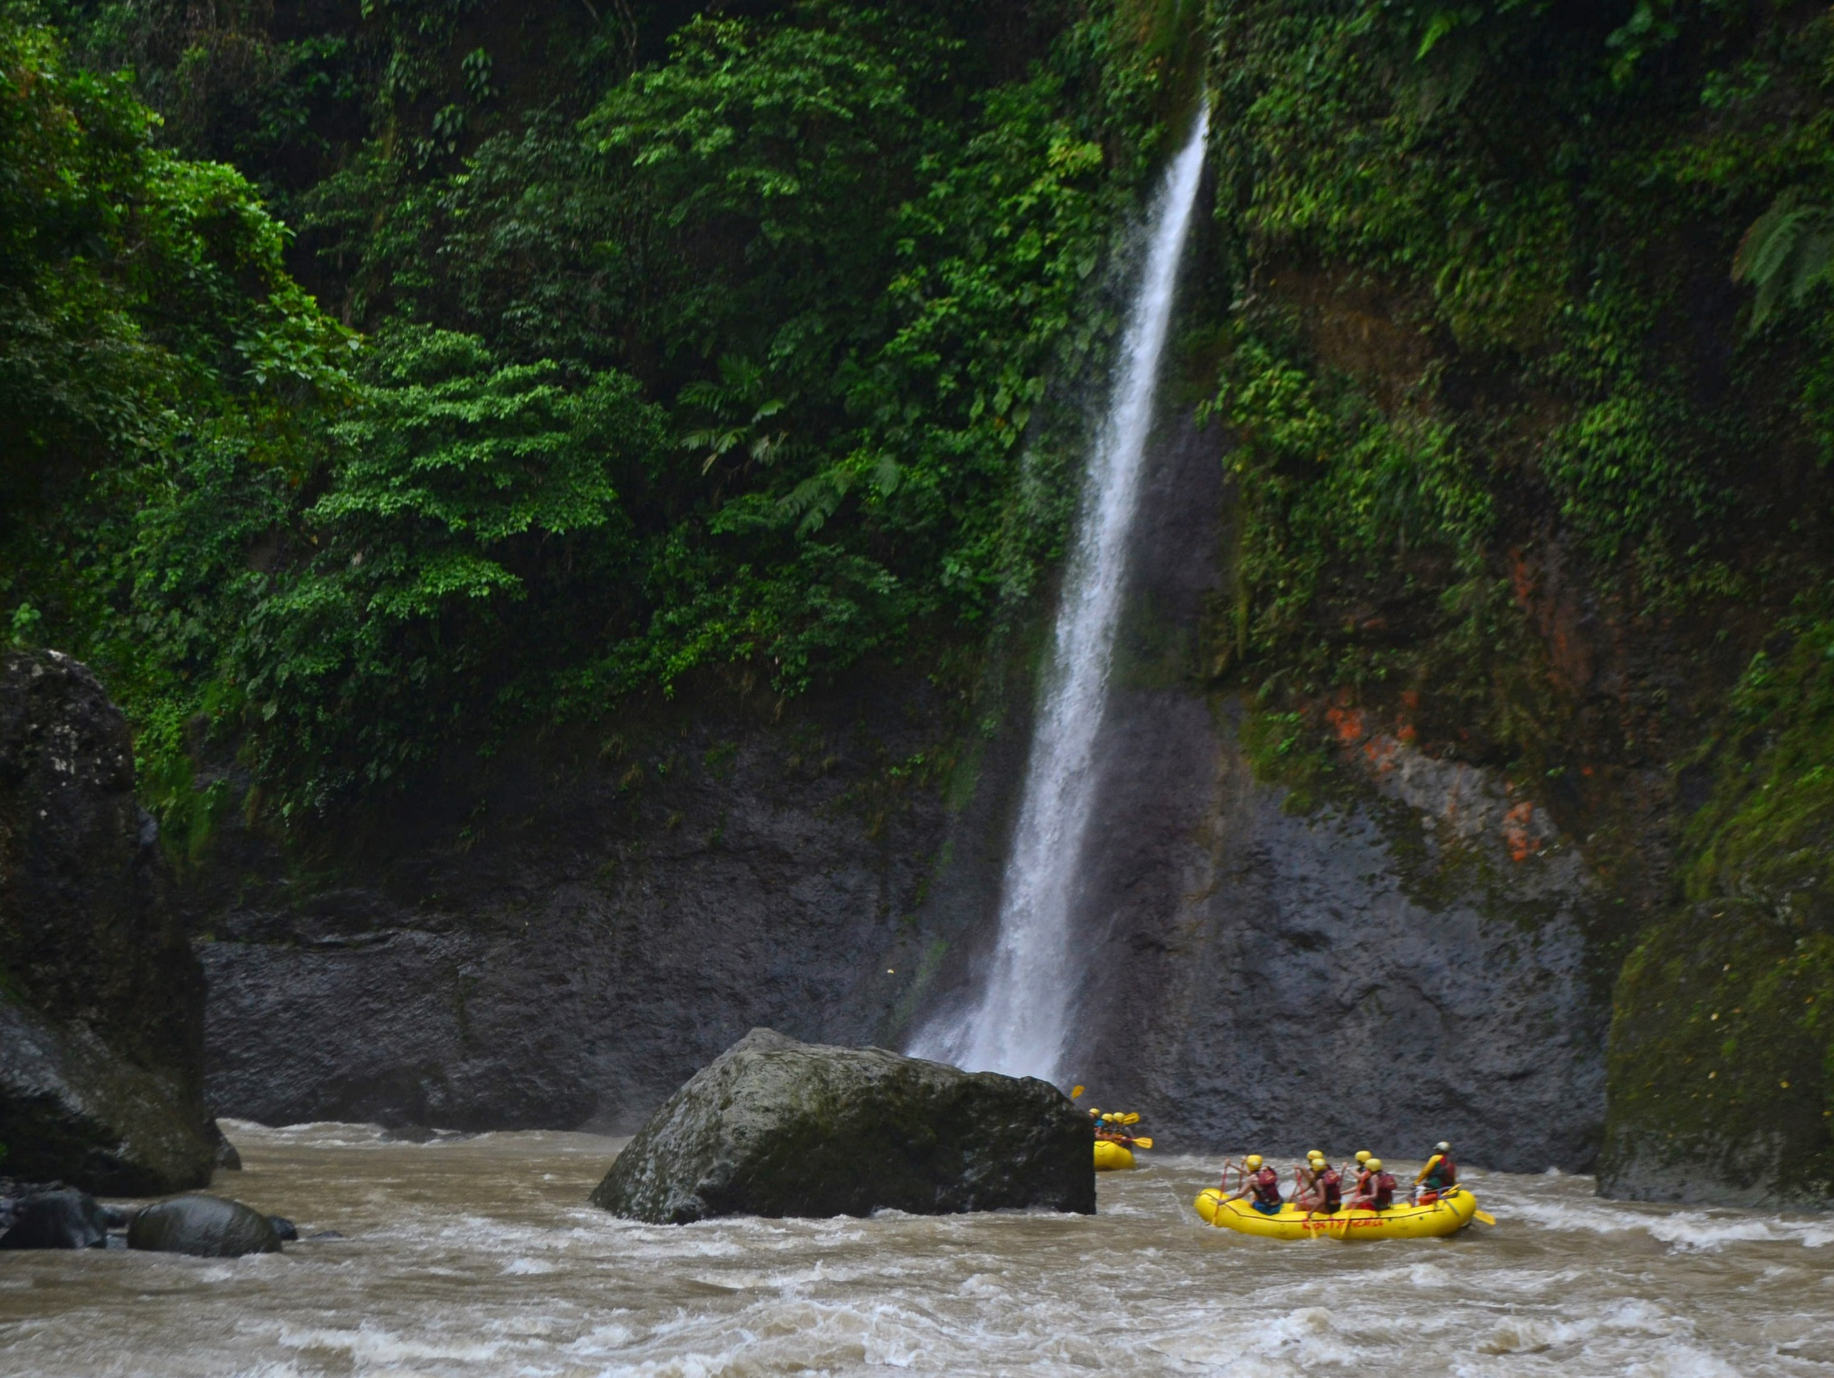

Slide 20
SAN JOSE – PACUARE – SAN JOSE
This day we will have a light lunch at the edge of the Pacuare River, it will be quite an adventure.
15:30 hrs. Return from Cairo to Gran Hotel Costa Rica Curio Collection by Hilton. 2 hours - 107 kilometers
19:00 hrs. Transfer from Gran Hotel Costa Rica Curio Collection by Hilton. To Ram Luna Restaurant. In 1967, an old lookout point in the hills of Aserrí, 6,000 feet above sea level and overlooking the capital city of San José and the volcanic Cordillera Central, gave birth to the Mirador Ram Luna Restaurant. The restaurant is located just 9 miles south of San Jose. Every Wednesday and Thursday night, Mirador Ram Luna Restaurant is adorned with marimba and cimarrona music, traditional Costa Rican dances, amidst typical Costa Rican cuisine including delicious recipes. You will have the opportunity to savor a variety of traditional Costa Rican dishes.

Slide 21
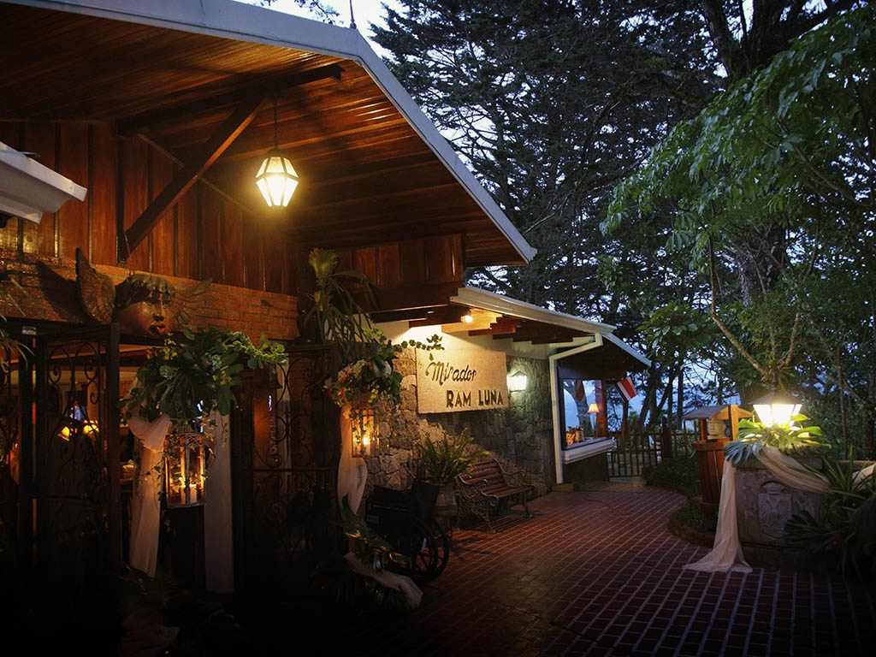

Slide 22
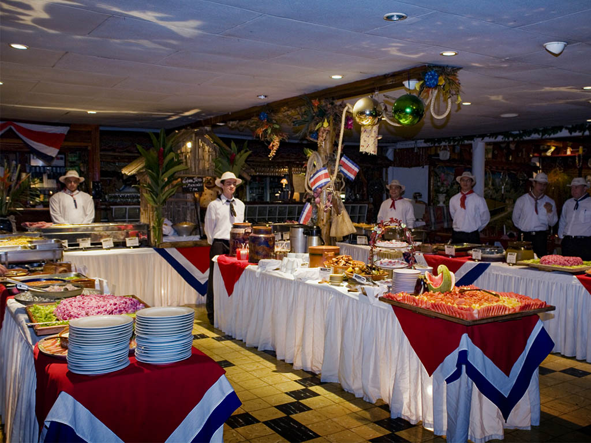

Slide 23
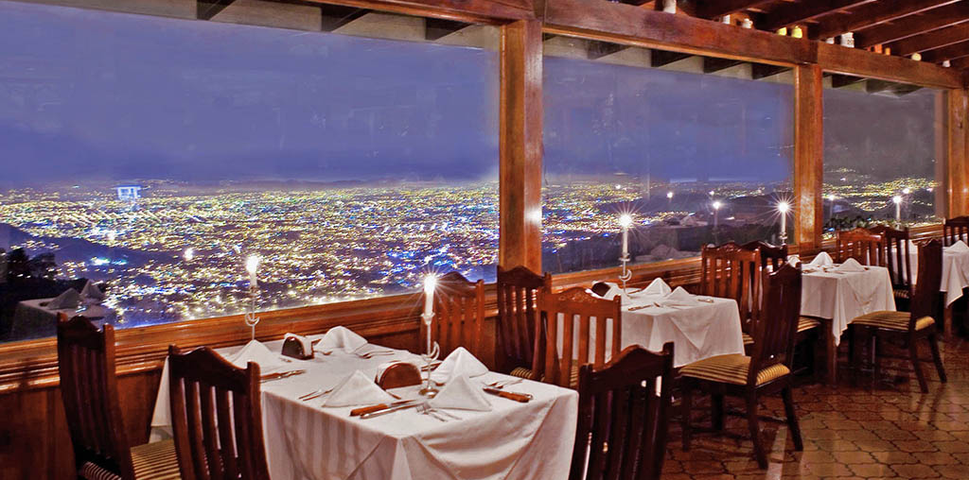
19:30 hrs. Dinner at Ram Luna Restaurant

Slide 24
SAN JOSE – ARENAL
DAY THREE
Breakfast Gran Hotel Curio Collection By Hilton
08:00 hrs - Departure time Doka Estate Coffee Plantation
Enjoy the fresh mountain air while learning about a 70 year history of coffee growing. Doka Estate is a private property, located in the foothills of the Poas Volcano. When you visit Doka Estate your tour will begin in the beautiful coffee plantations, continuing through the 96 year old coffee mill where you will observe the pulping and fermentation process of our golden bean; then passing through the sun-drying patios. Afterwards you will enjoy the different roasts of the coffee in the roasting room. The harvest season is the most beautiful, aromatic and colorful time of the year; however, you will experience the true magic of coffee throughout the year. Come and share with us this fascinating encounter, in the country that produces the highest coffee harvest per person in the world. Enjoy the natural splendor of this tropical paradise and at the same time, take the opportunity to get to know a richness unknown to many. Possibility to talk with the farmers who work in the coffee plantation.

Slide 25
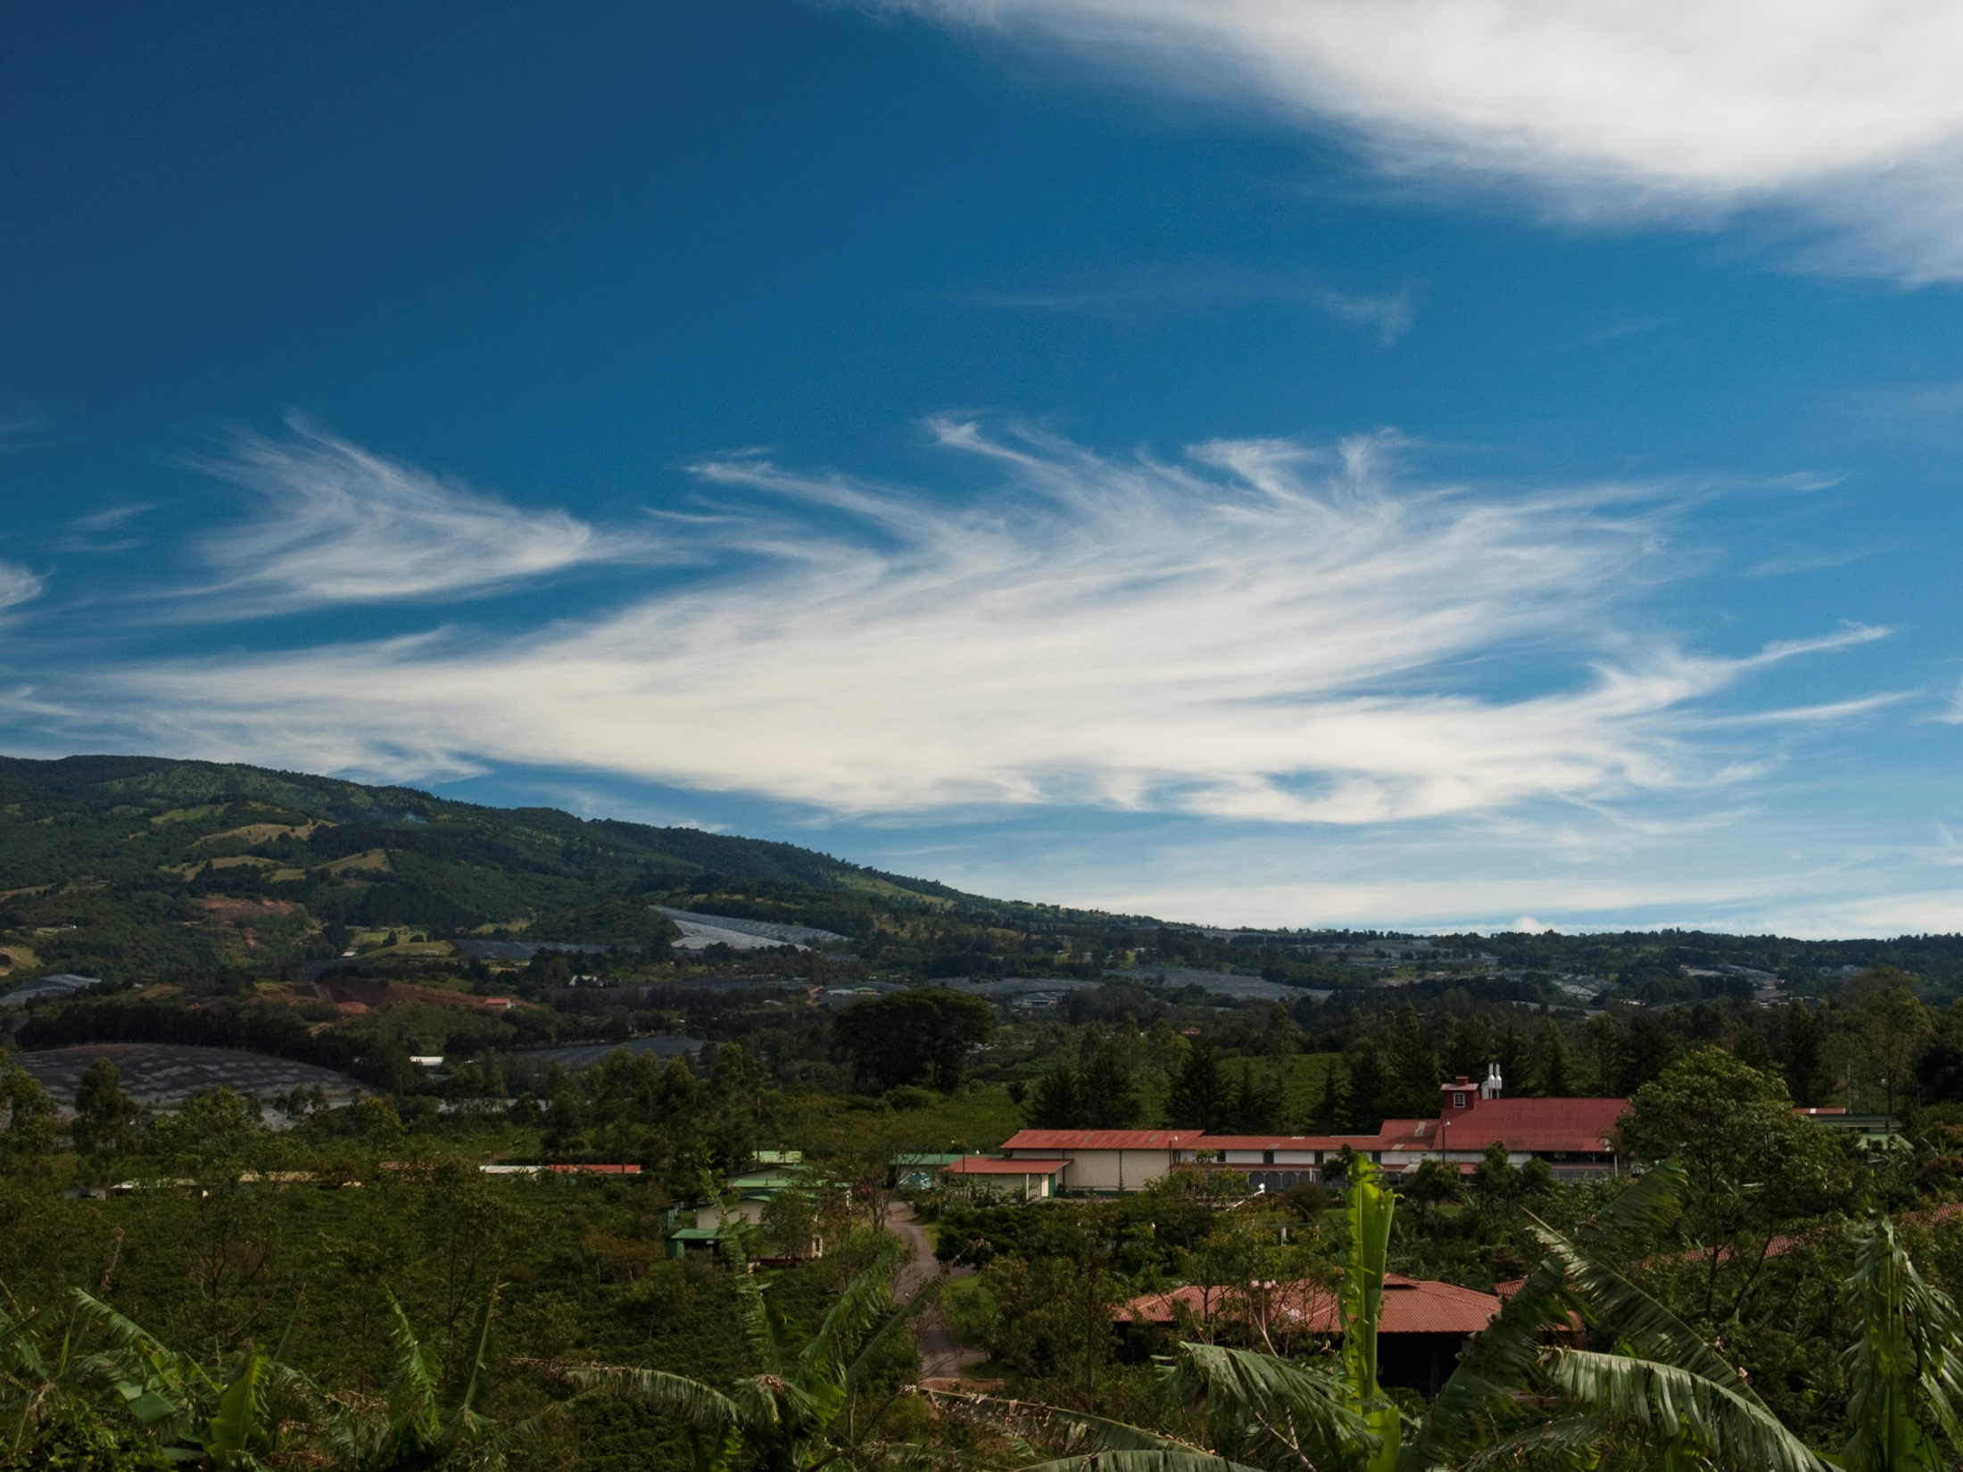

Slide 26
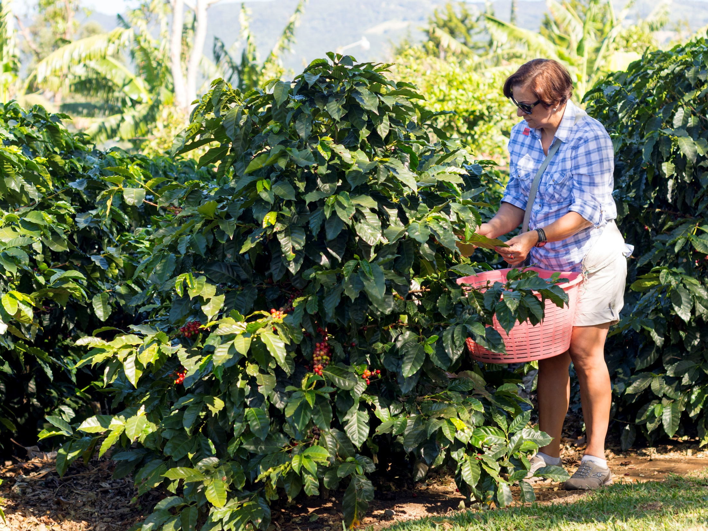

Slide 27
We will continue our journey to the Poas Volcano, located in the north-eastern part of Alajuela, next to San José, in the so-called Central Valley. Poas is a volcano that is over 2,700 meters high. This is one of the most impressive volcanoes in Costa Rica, with breathtaking tropical scenery. The land in this sector is ideal for the cultivation of crops and is an area of considerable potential for hydrological and geothermal energy. In the park it is possible to identify four main habitats, although high altitude forest predominates, with pygmy vegetation, cloud forest and areas with little or no vegetation can also be found. The flora of this area includes but is not limited to cedar and cypress trees. Some of the park's resident animals include marmots, bats, quetzals and toucans, among the most common.

Slide 28
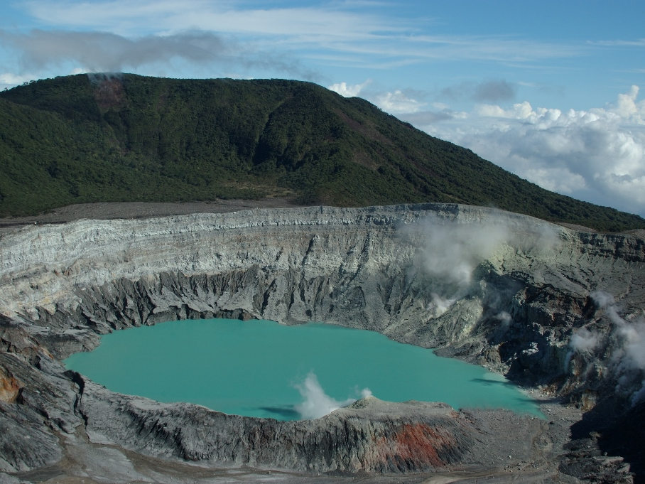

Slide 29
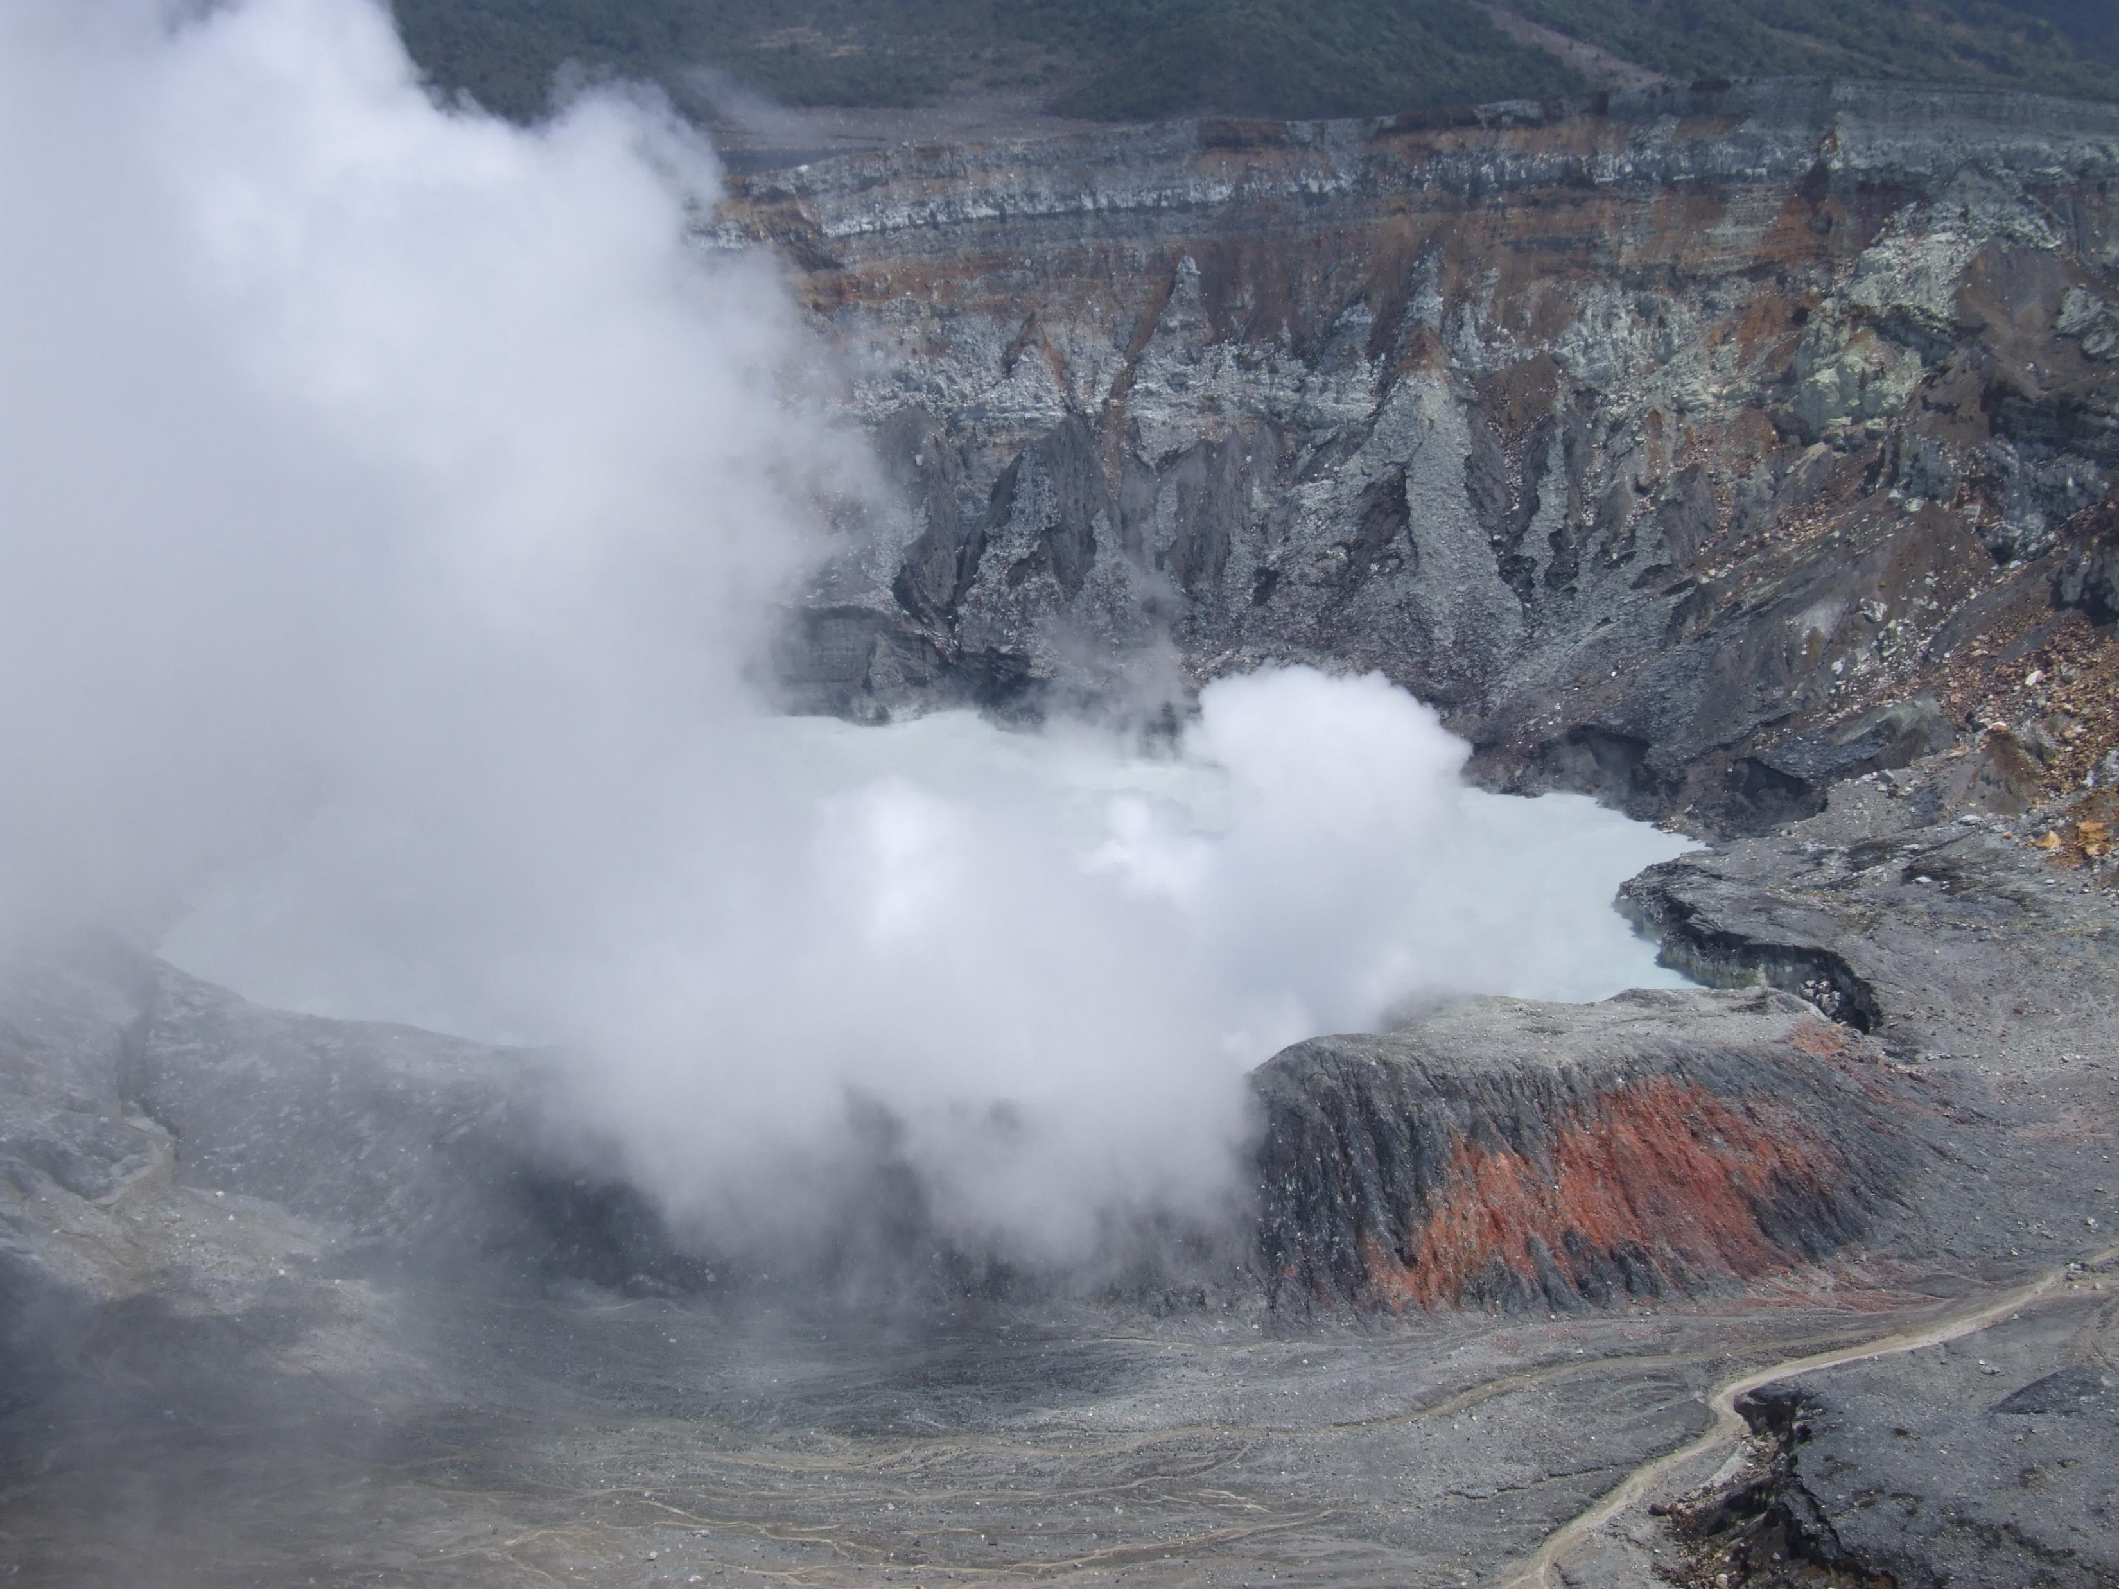

Slide 30
Continuing towards the Caribbean zone, we will stop to discover the La Paz Waterfall Gardens, a natural park, where we will walk through spectacular trails that will lead us to the Magia Blanca Waterfall (the largest and most spectacular in the area). In the park we will also visit one of the largest butterfly observatories in the country, which contains a fascinating collection of these tropical jewels and the impressive hummingbird gallery

Slide 31
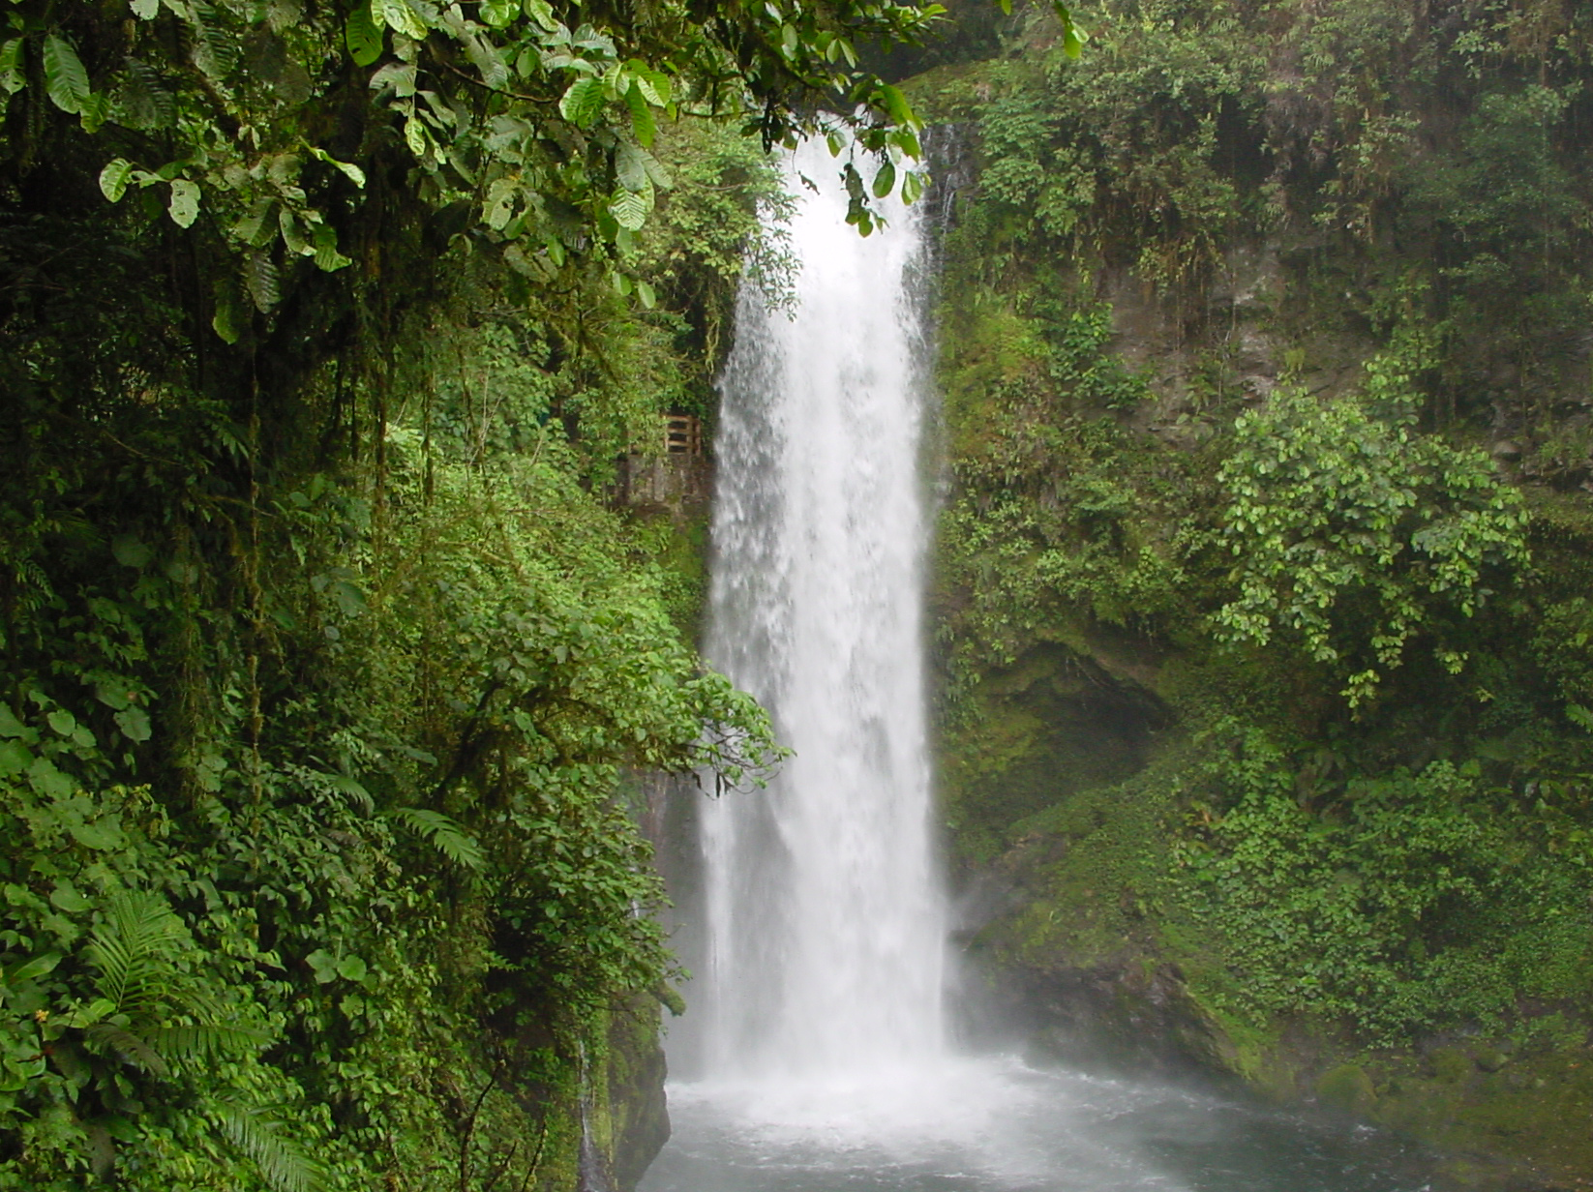

Slide 33
SAN JOSE – ARENAL
Arenal
On the way you can admire panoramic views and from a few kilometers before arriving to La Fortuna, if time permits we will admire the majestic Arenal Volcano active since 1968.
The constant energy of the active volcano, the warmth of the hot springs rivers and the tropical forest surroundings provide an incomparable experience in Costa Rica's renowned jewel. This extraordinary environment, combined with exceptional service, warm smiles and outstanding facilities, ensure guests a relaxing and unforgettable Experiences.

Slide 34
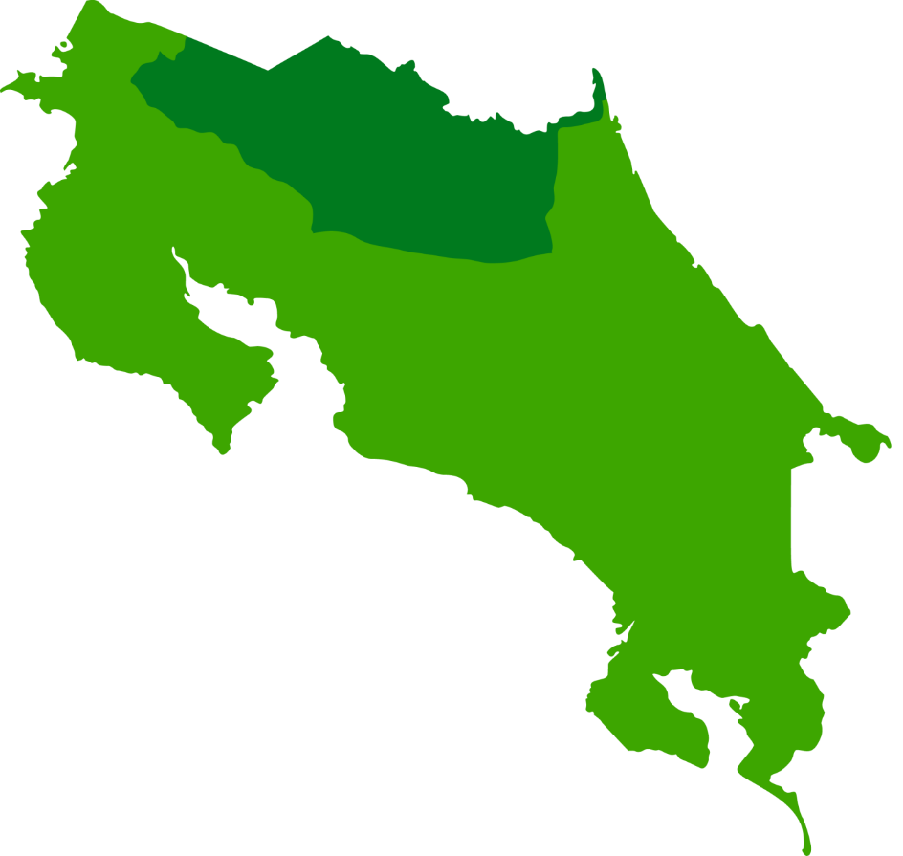
Montaña
La Fortuna - Arenal

Slide 35
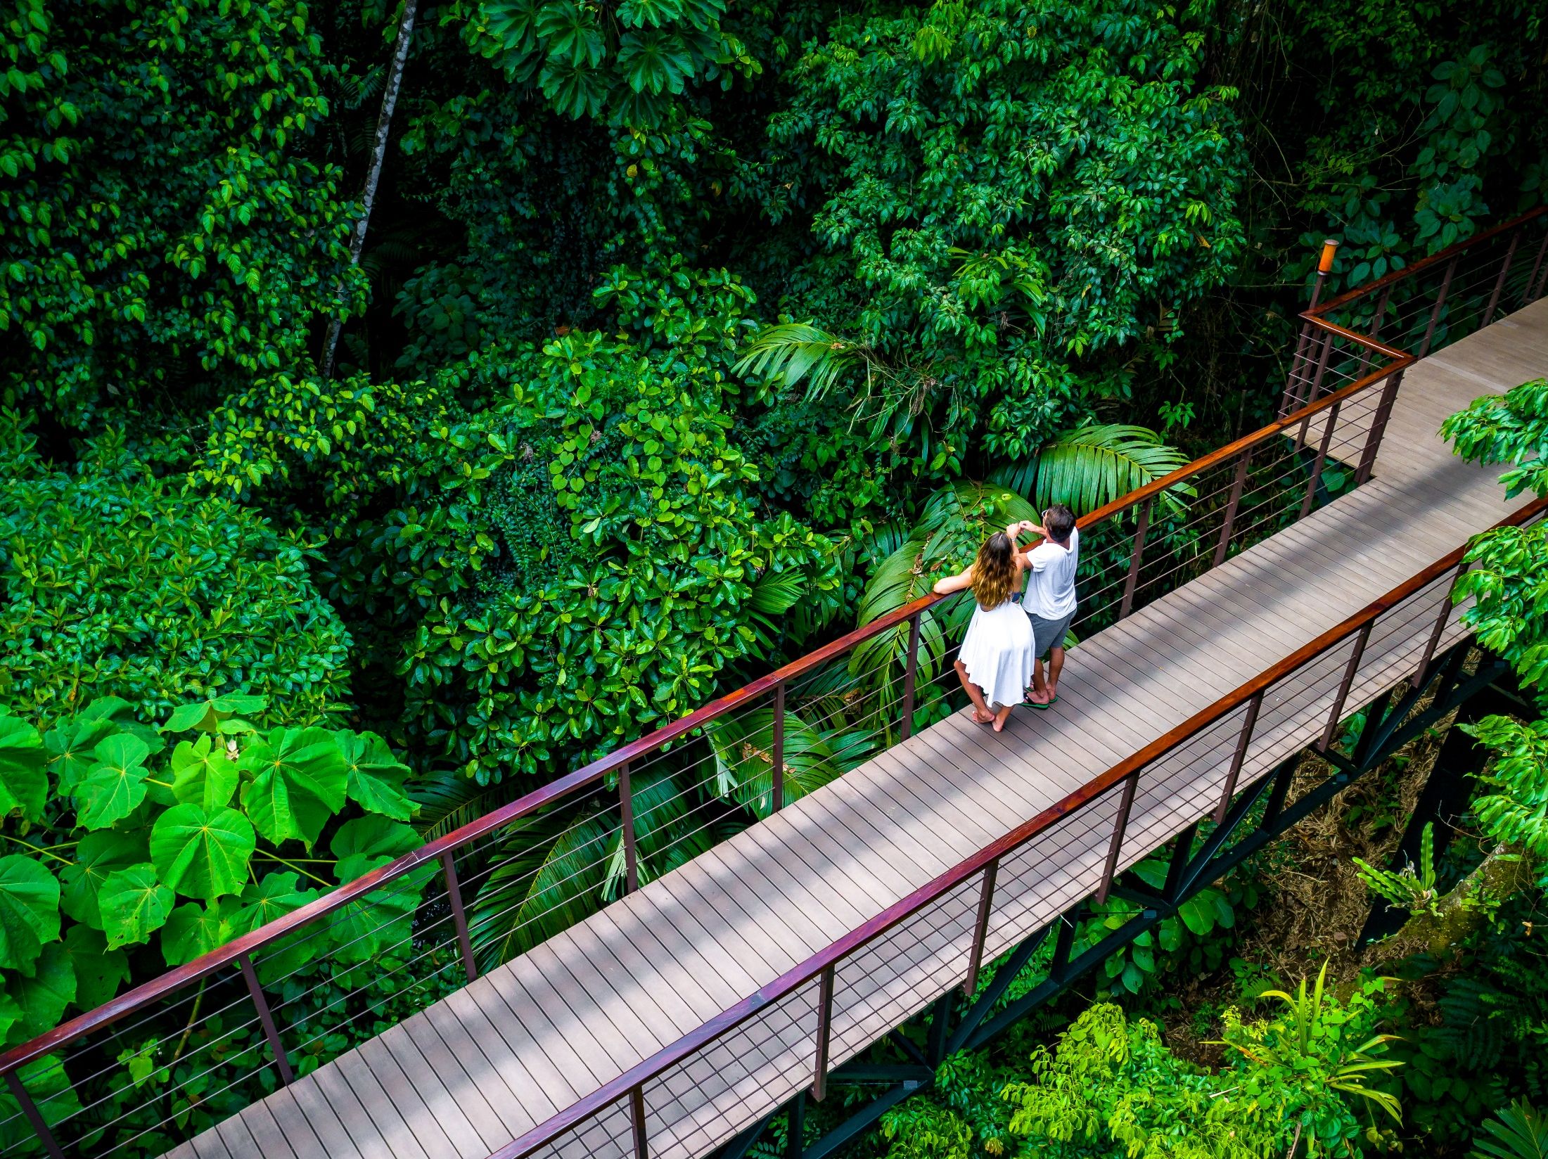
Hotel Arenal Nayara
La Fortuna, Arenal

Slide 36
Hotel Arenal Nayara
Arenal Nayara Hotel
Nayara Resort Spa and Garden located 7 km west of La Fortuna San Carlos, is a hidden hideaway in the heart of Arenal Volcano National Park, has been recognized as one of the best resorts in the world by Travel & Leisure, Conde Nast Traveler and Trip Advisor. The cordial hospitality, impeccable service, luxurious rooms, fine cuisine, exceptional spa and amazing ecological adventures, make the hotel the first destination in Costa Rica.
The experience at Nayara promises the discerning and adventurous traveler the perfect combination of luxury and exploration. Go for the adventure of a lifetime in the wonderful natural surroundings of the Arenal Volcano or discover the ecological heart of Costa Rica strolling through our tropical gardens and pristine rainforests. Escape to luxury, enjoying personalized service and "pure life" hospitality, either from a private terrace overlooking the volcano, the interiors are of a luxurious room or the hot springs of an outdoor Jacuzzi.
It has the categories of rooms: the Casita Deluxe and the Villa Rainforest

Slide 37
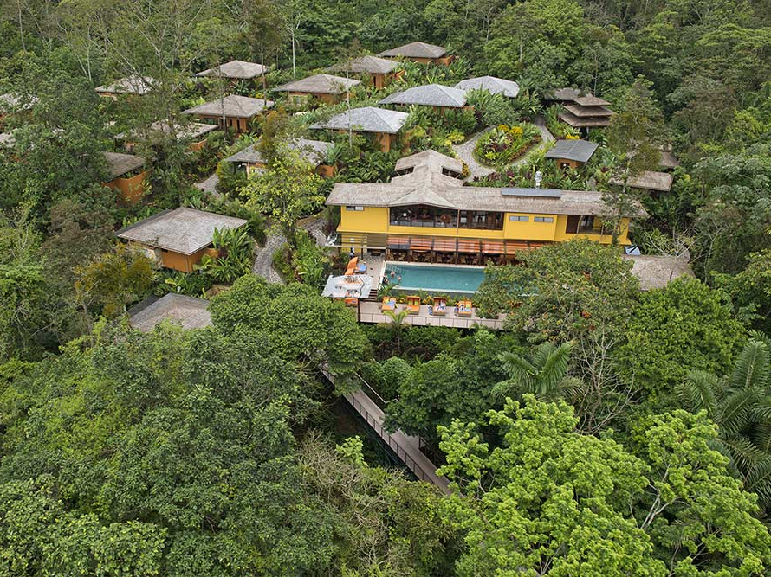

Slide 38
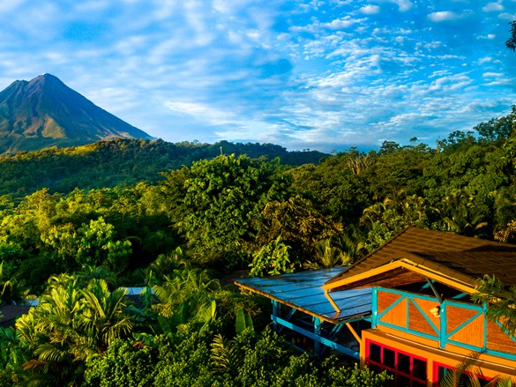

Slide 39
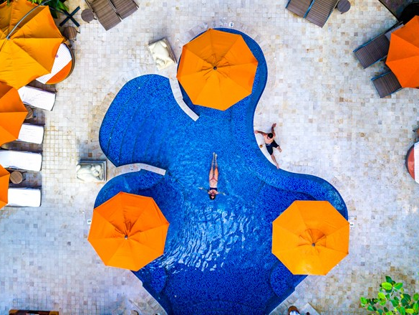

Slide 40
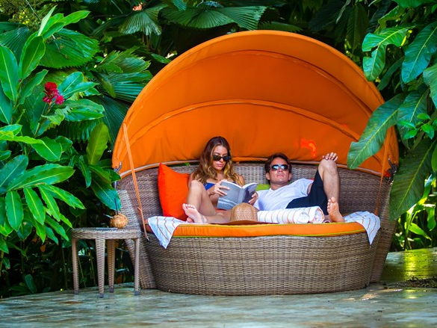

Slide 41
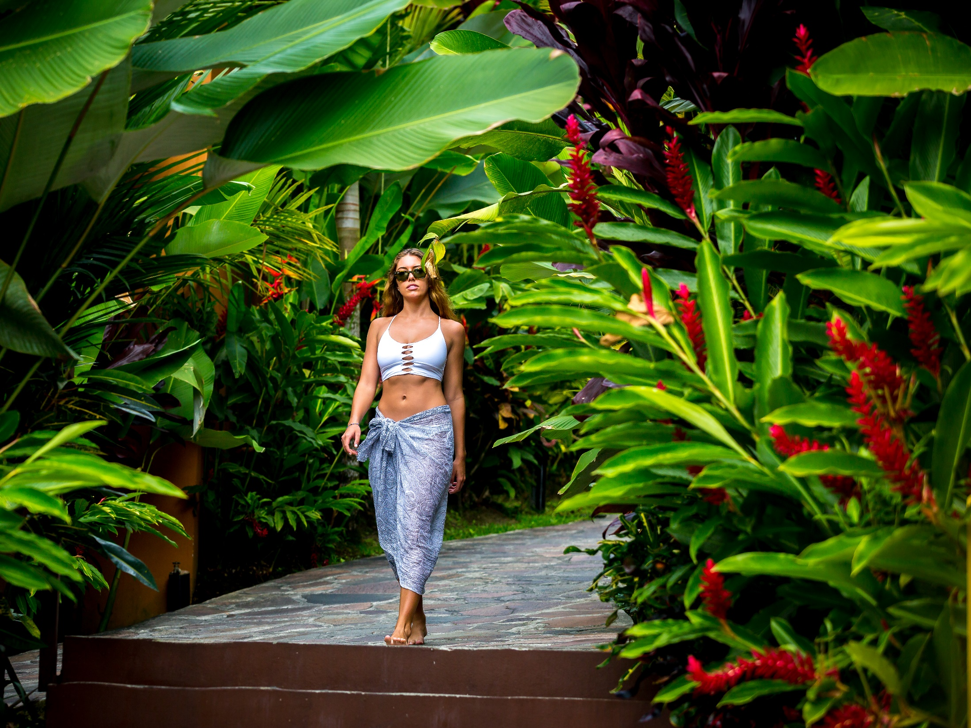

Slide 42
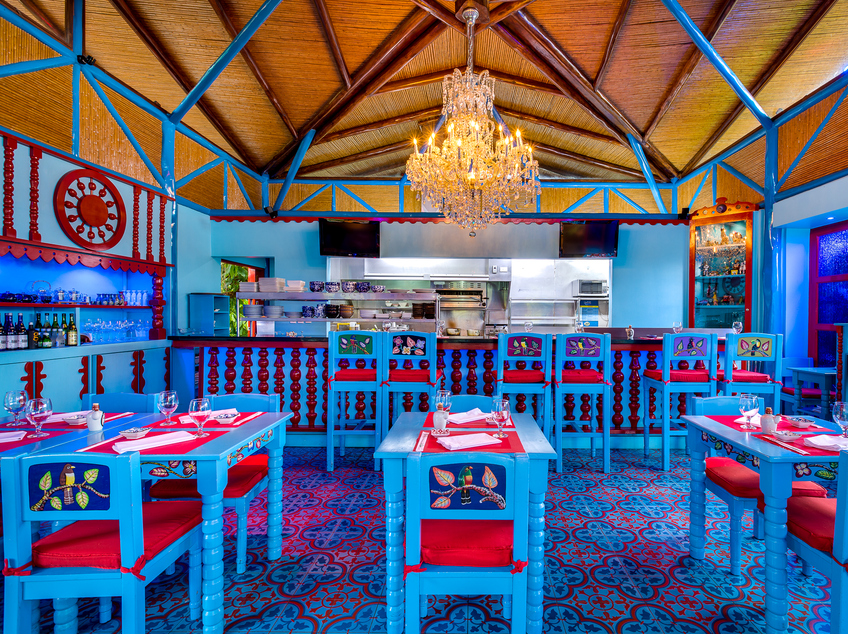

Slide 43
ARENAL AREA
DAY FOUR
Breakfast at the Hotel.
08:30 hrs. Departure to Pure Trek Adventure
We will pick you up and whisk you off to our canyon, about a 20-minute drive outside La Fortuna. Then transfer to 4×4 trucks for an exciting short drive to our ranch house to gear up. Then you are off for a morning of exciting and exhilarating waterfall rappelling, a canyon wall, Monkey drop (zip line & rappel), and rock climb all in our spectacular rainforest canyon.

Slide 44
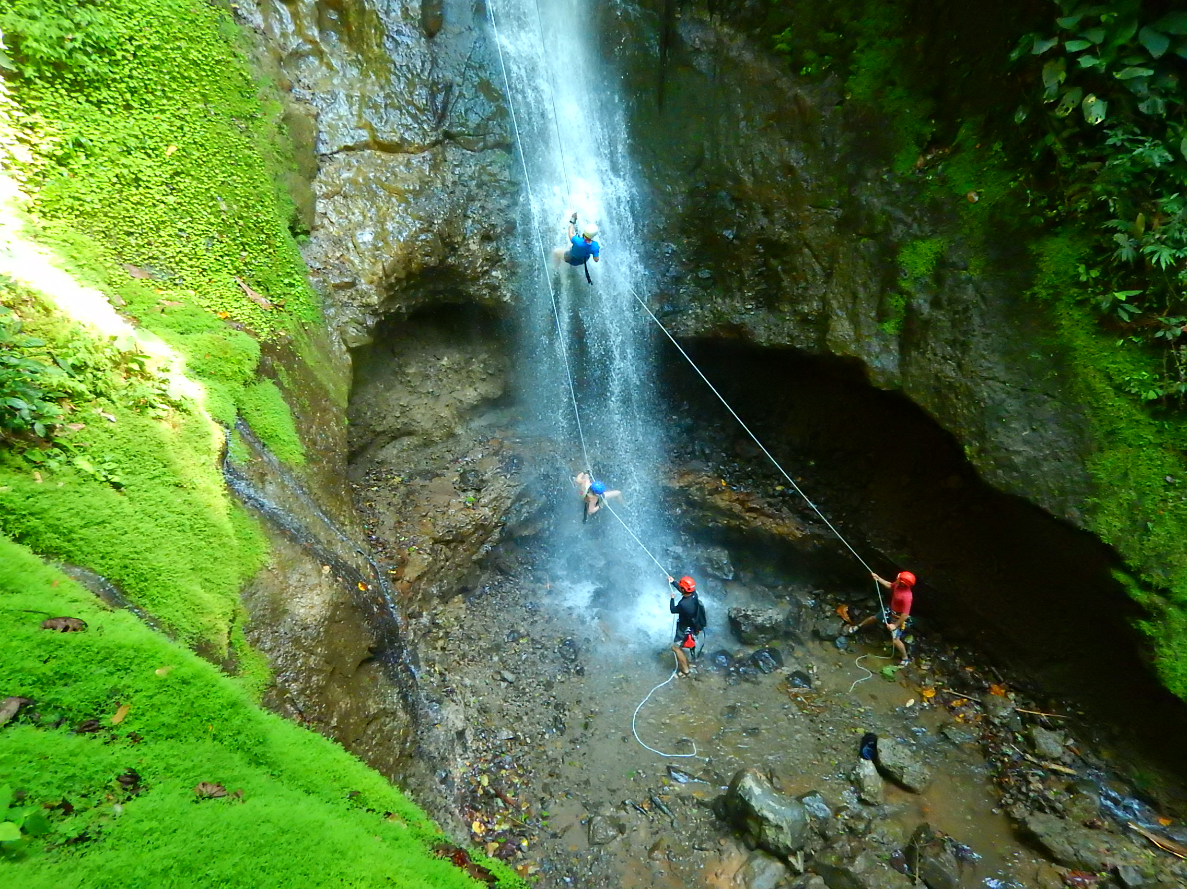

Slide 45
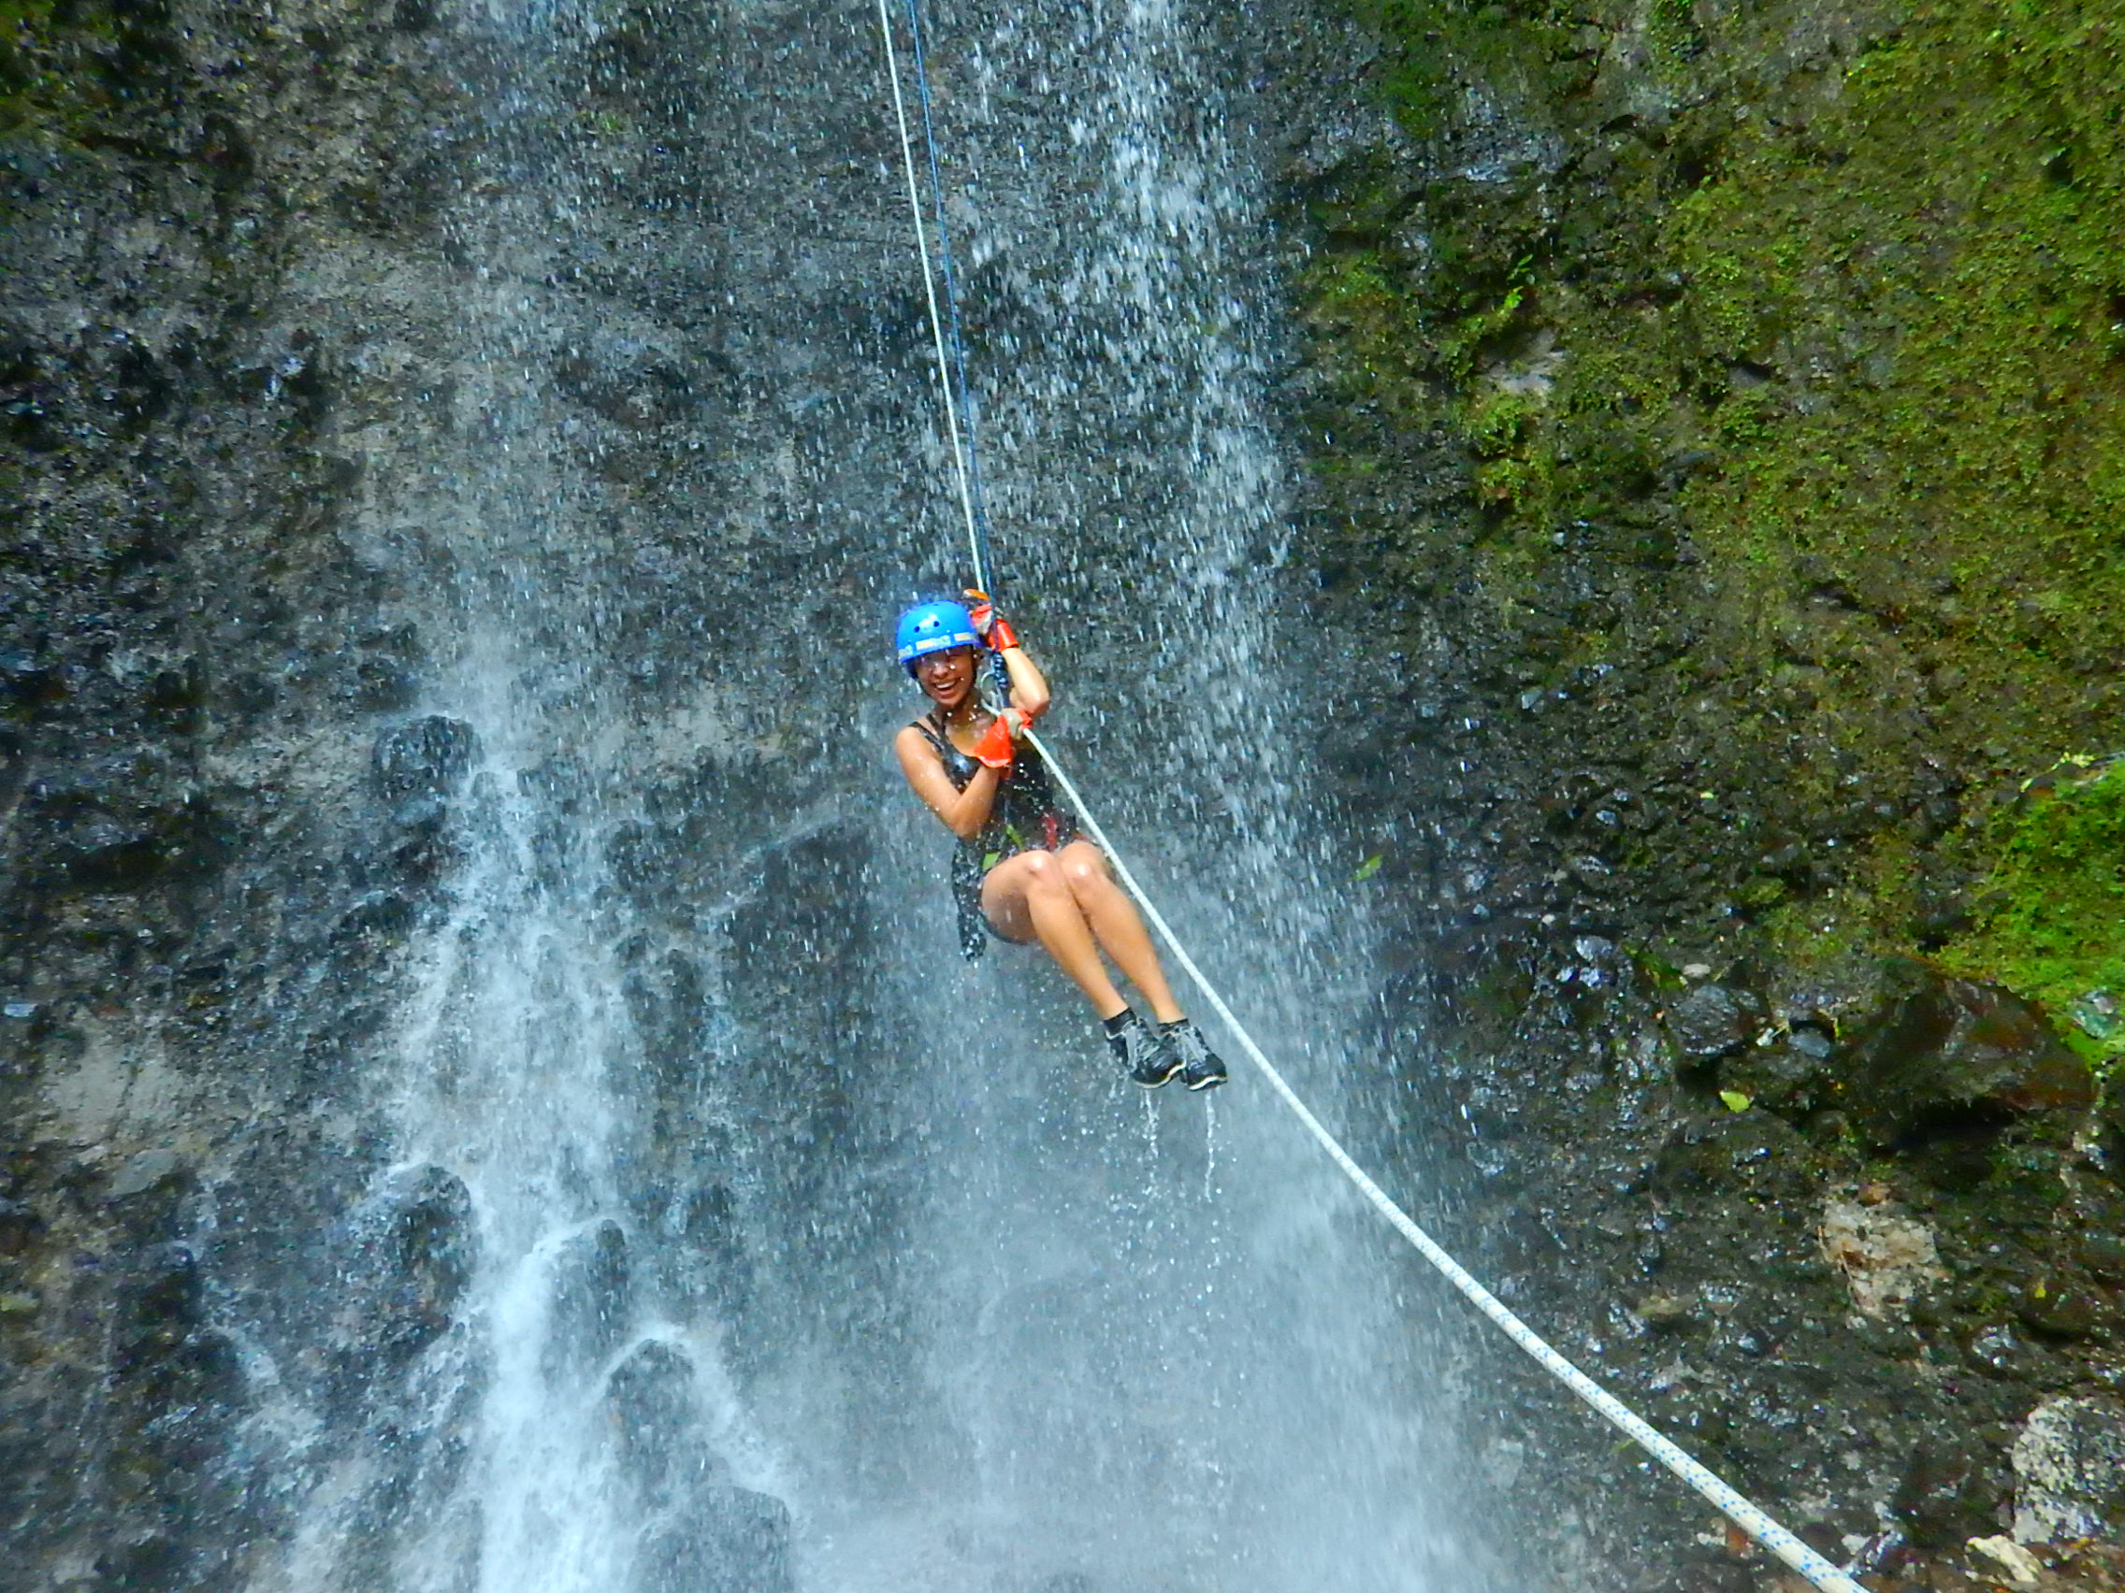

Slide 46
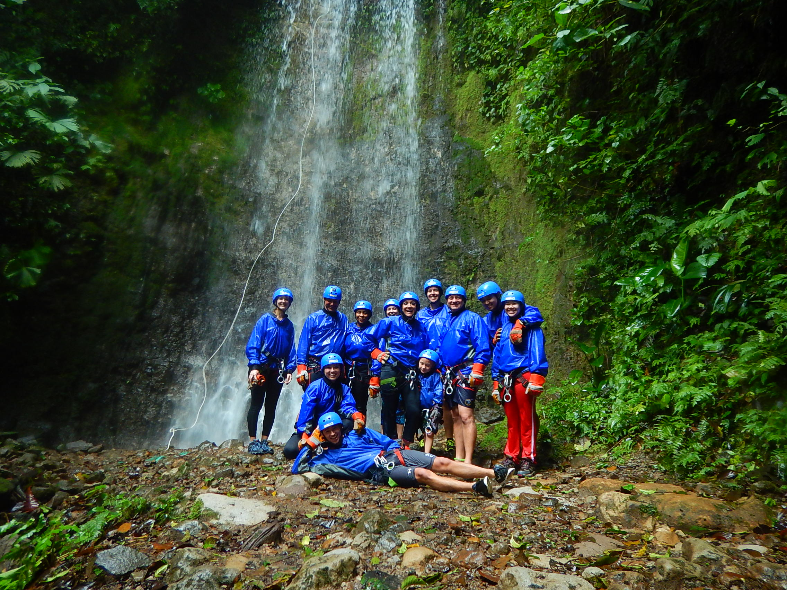

Slide 47
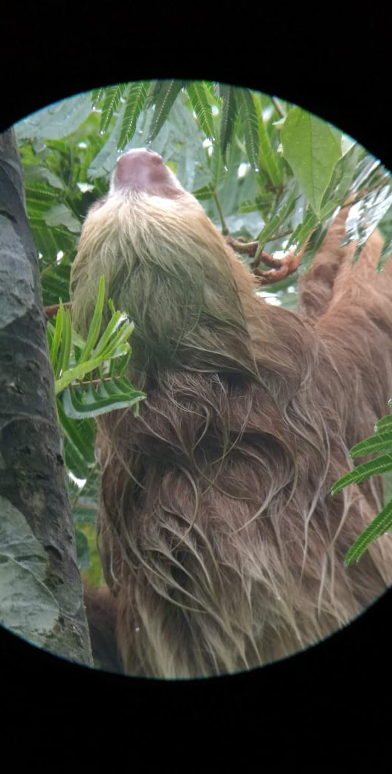
The sloth watching trail in Arenal is located 600 meters from the central park in La Fortuna Costa Rica, we have about 20 hectares area and a trail of approximately 2 km long.
Our guided hiking tour last one hour and a half, with the help of an expert guide you can get to see from 4 to 6 sloths in their own habitat, different species of birds, sometimes snakes, insects and frogs.

Slide 48
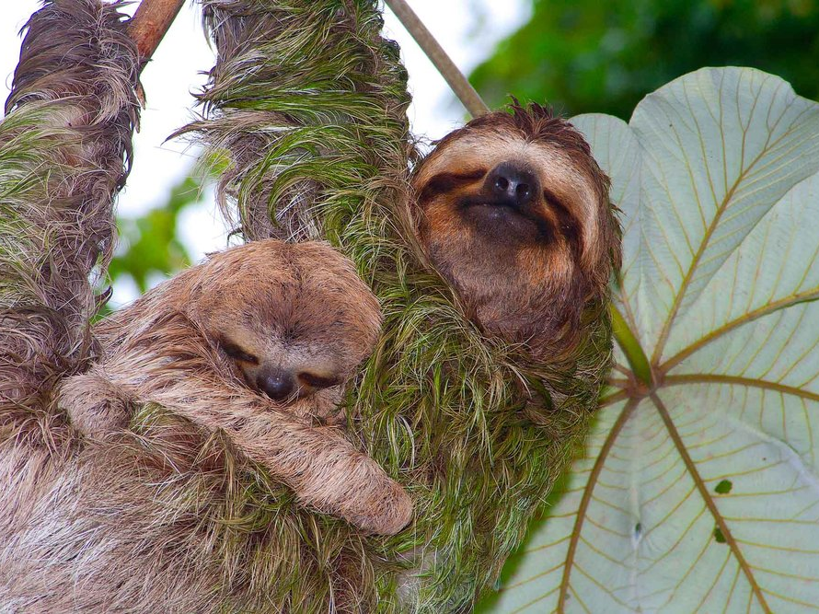

Slide 49
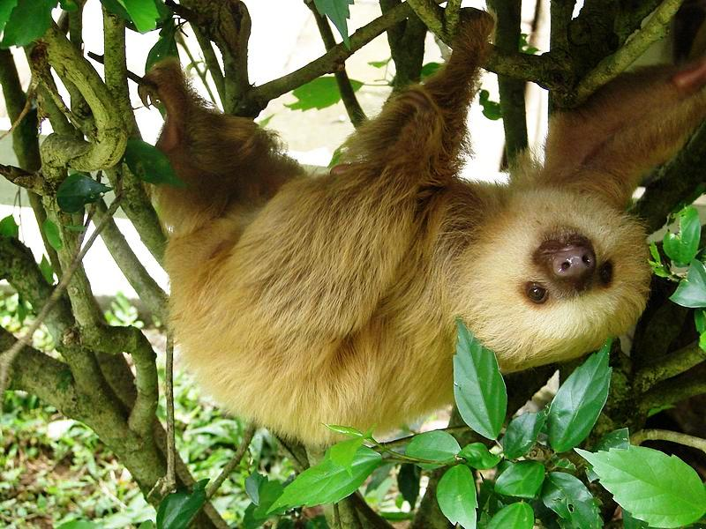

Slide 50
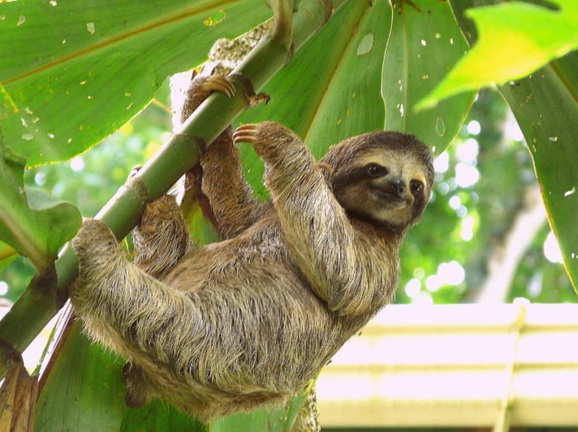

Slide 51
ARENAL AREA
DAY FIVE
09:30 hrs. Departure to Sky Adventure
The Arenal Reserve is a tourism service, being complex inside the tropical rain forest, it offers adventure tours, bird watching, forest hiking, research and diverse entertainment for all ages. Placed in a unique transition area between the rain forest and the Monteverde Cloud Forest you will find the Arenal Reserve. Experience the most spectacular views of the Arenal Volcano & Lake from the sky Tram or the sky Trek (zip lines).
Sky Tram is a 15 minute aerial tram tour through the rain forest to the “Miguel Angel” observatory, where you will have spectacular views of the Arenal Volcano & Lake, and the Tilarán mountain range.
Sky Trek is a 3280 feet long zip line system that gives you the opportunity to enjoy the rain forest and its beautiful views in a fun, easy and safe ride.

Slide 52
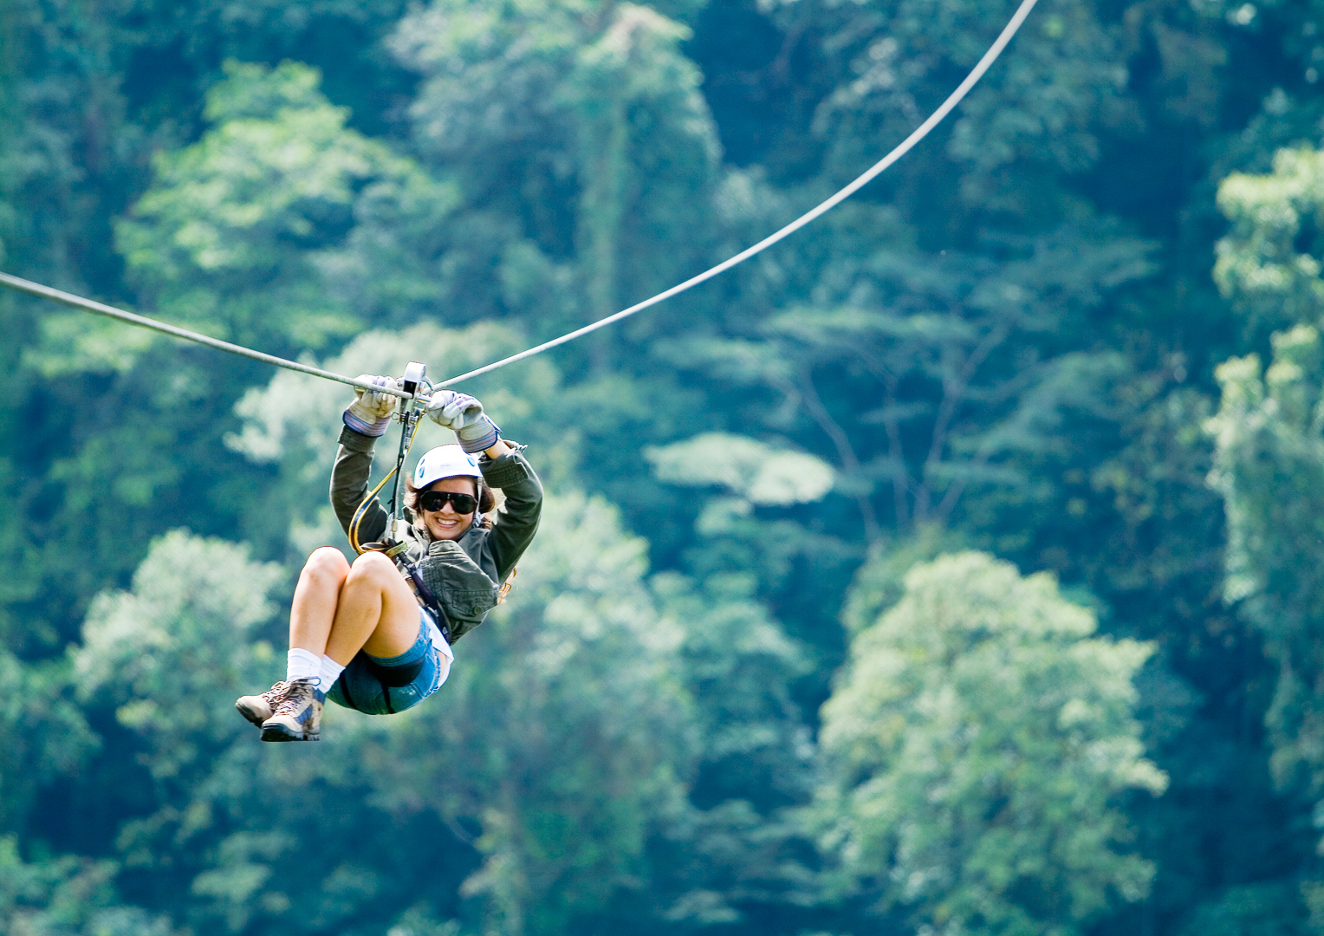
Sky Adventures
La Fortuna, Alajuela

Slide 53
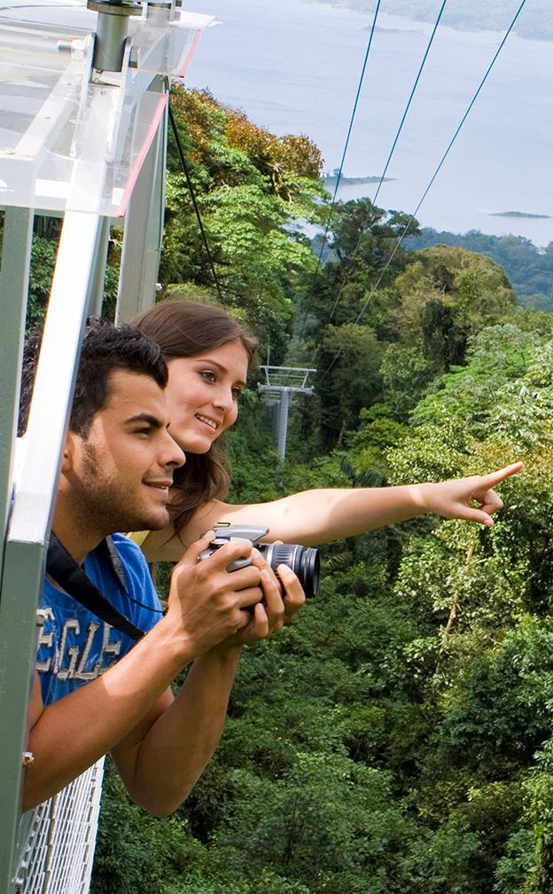
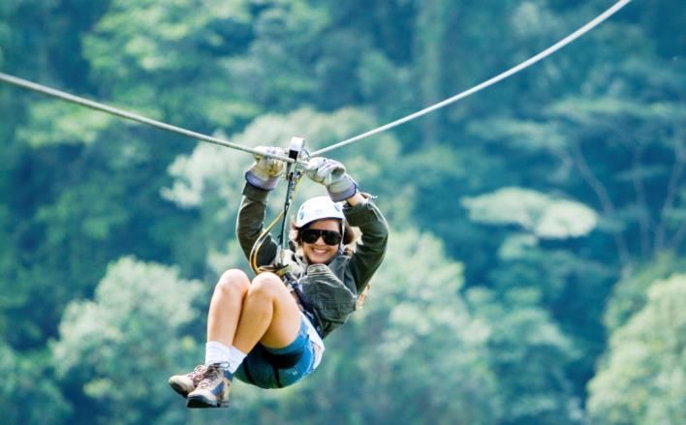
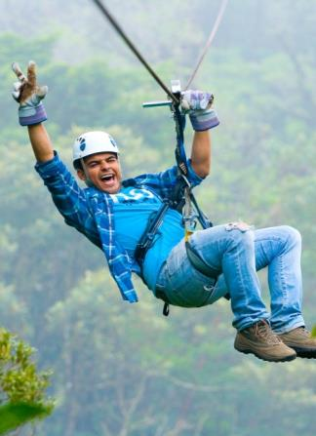
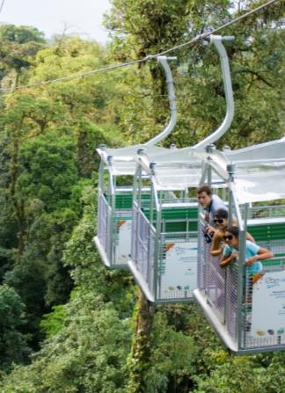
Sky Adventures Arenal

Slide 54
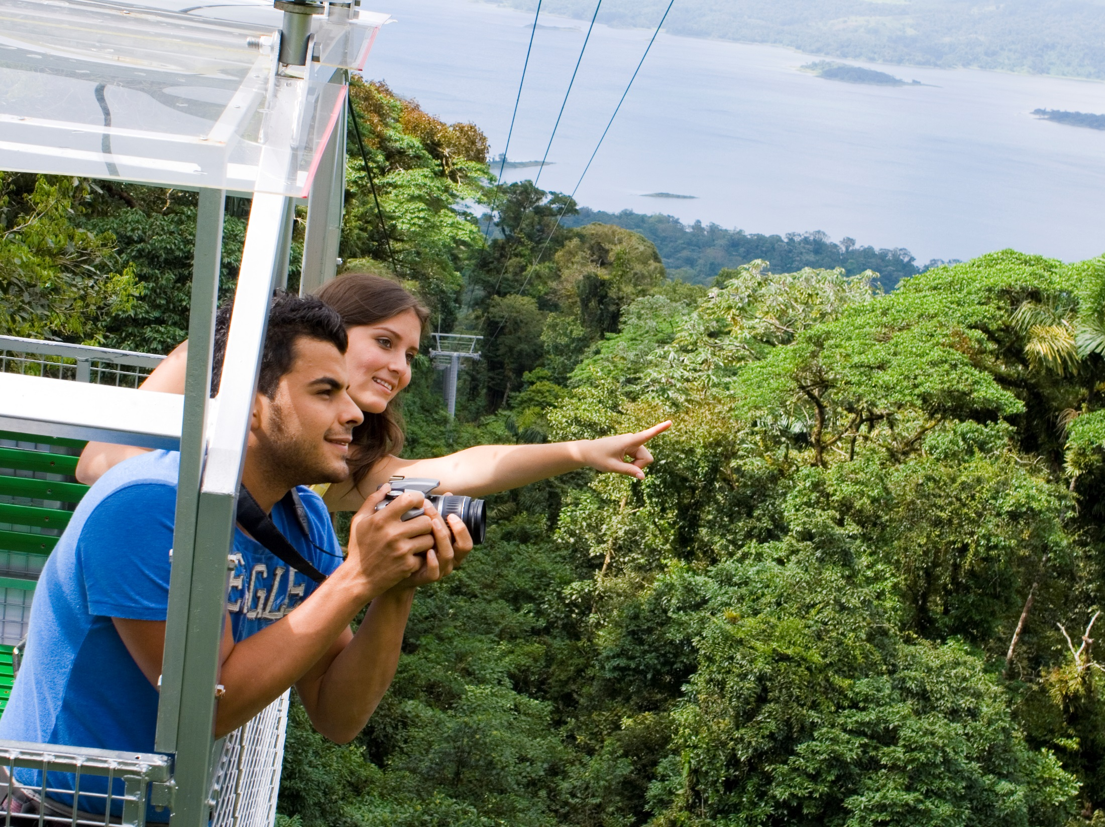
Sky Tram

Slide 55

Sky Trek

Slide 56
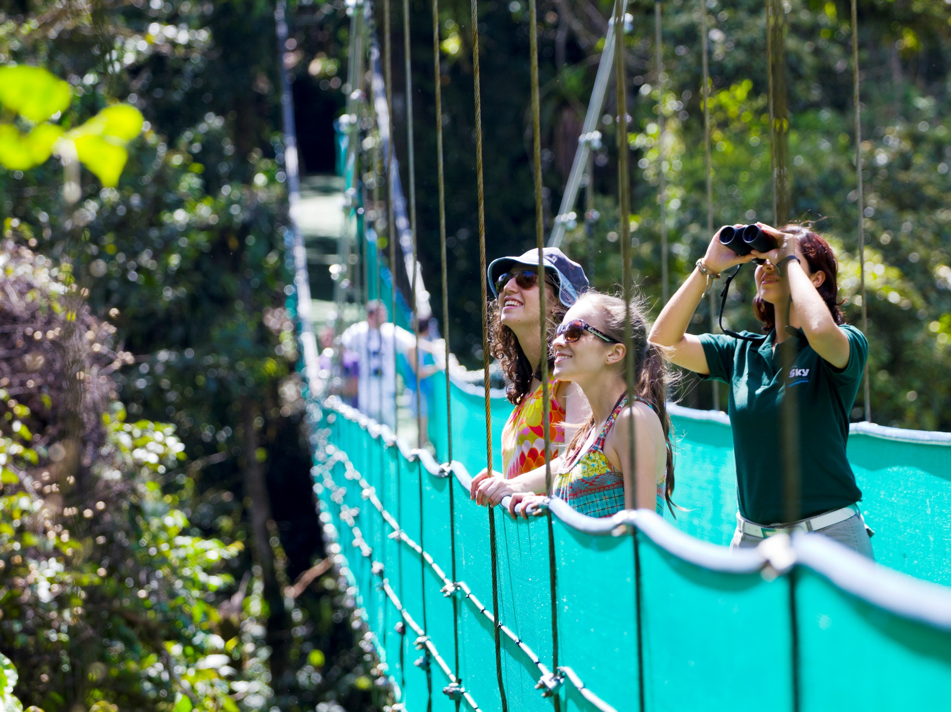
Sky Walk

Slide 57
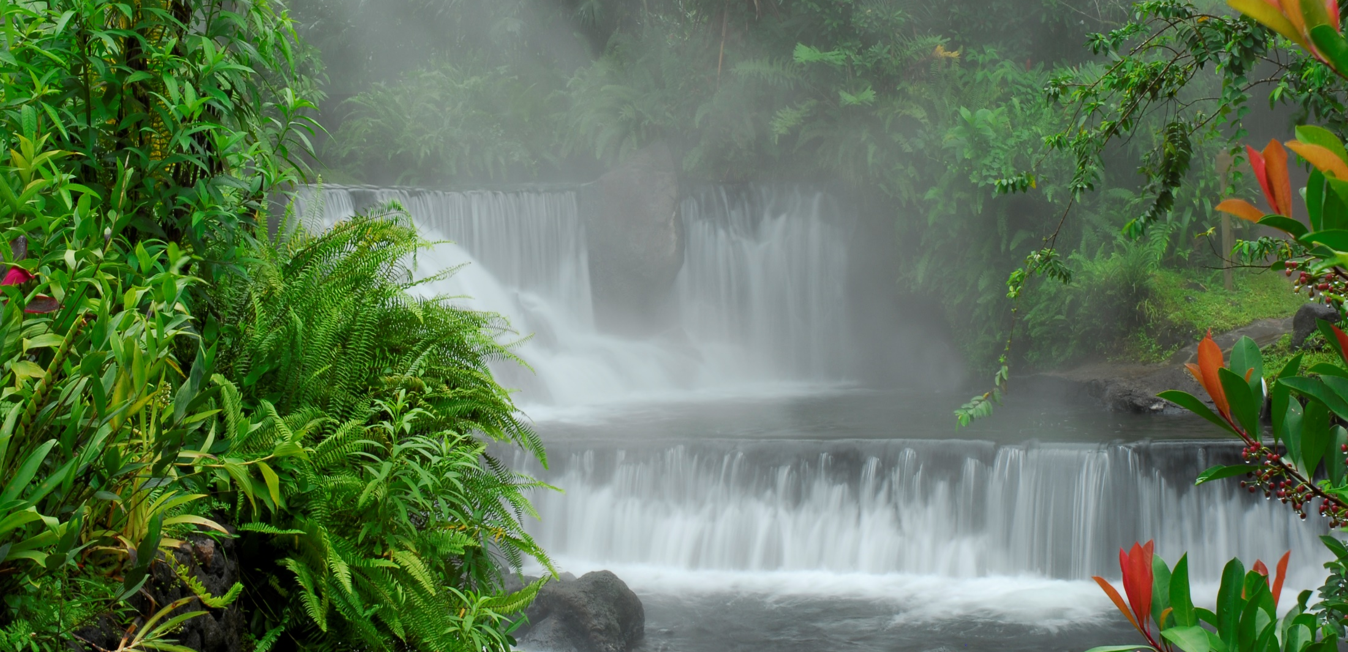
This afternoon, we conclude with the Hot Springs, where you can enjoy a delicious and healthy bath in the thermal mineral waters, with the option of access to a relaxing spa, where a variety of beauty treatments and massages are also offered (extra charges apply). Dinner, buffet style, will be served directly at the hot springs restaurant.

Slide 58
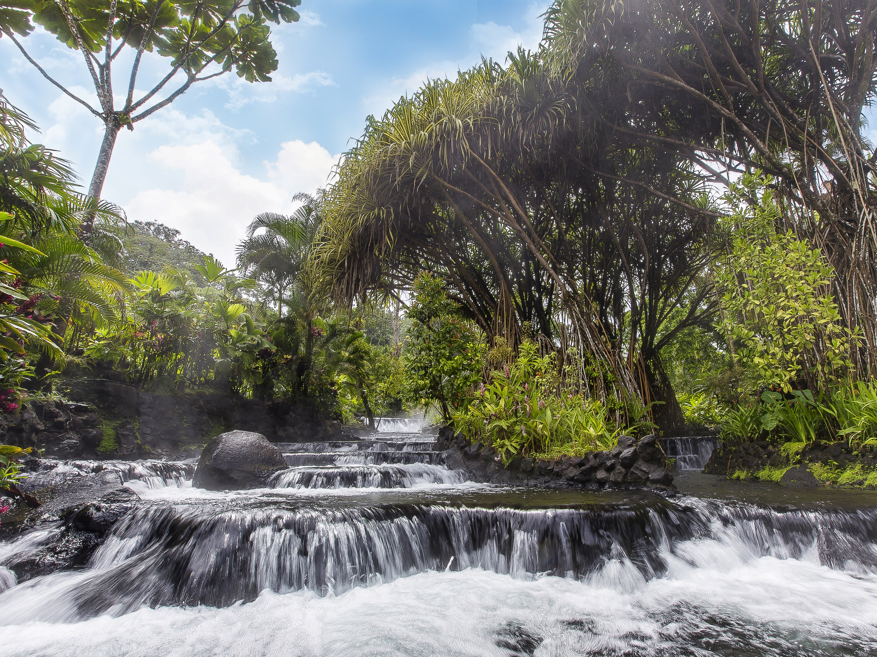

Slide 59
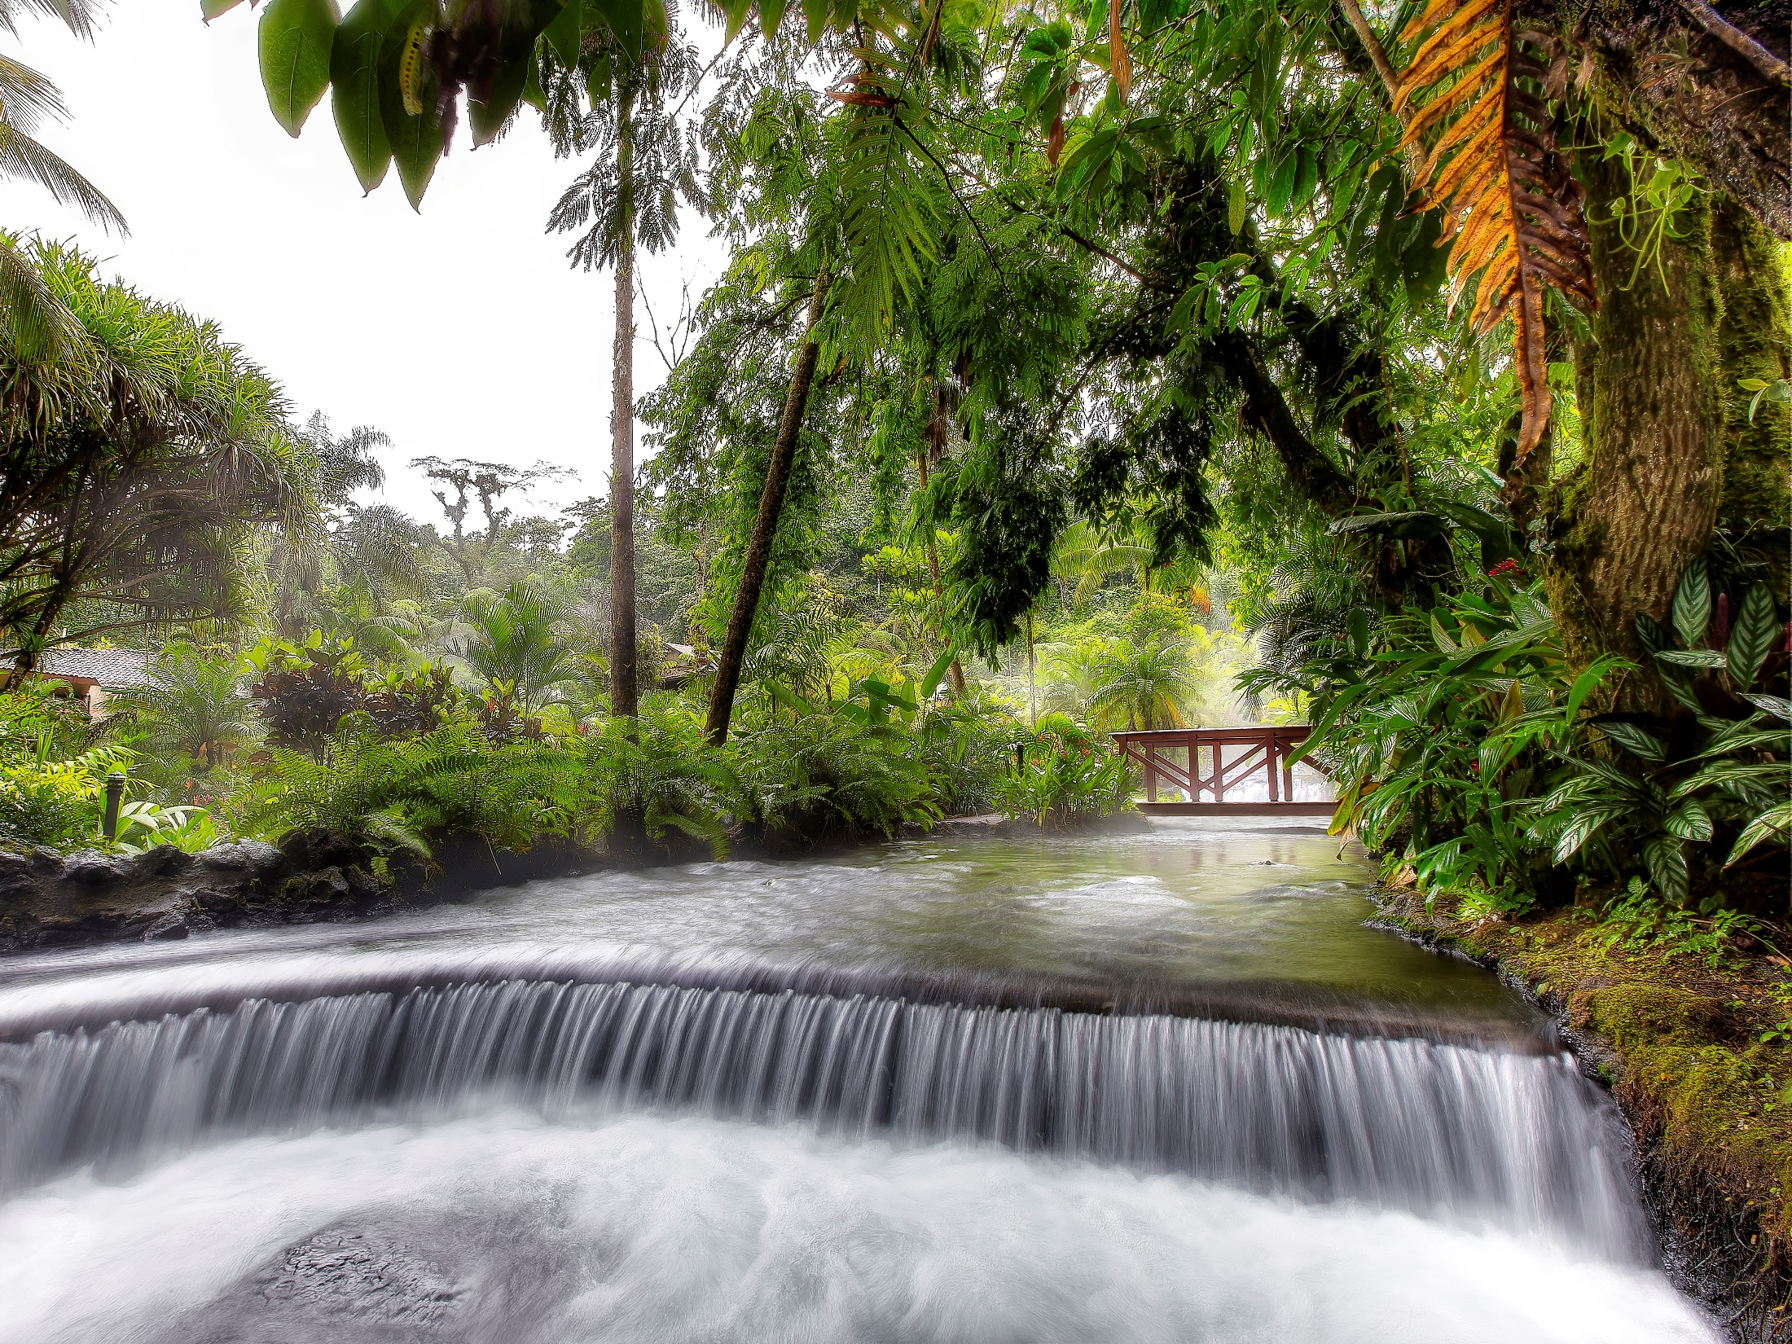

Slide 60
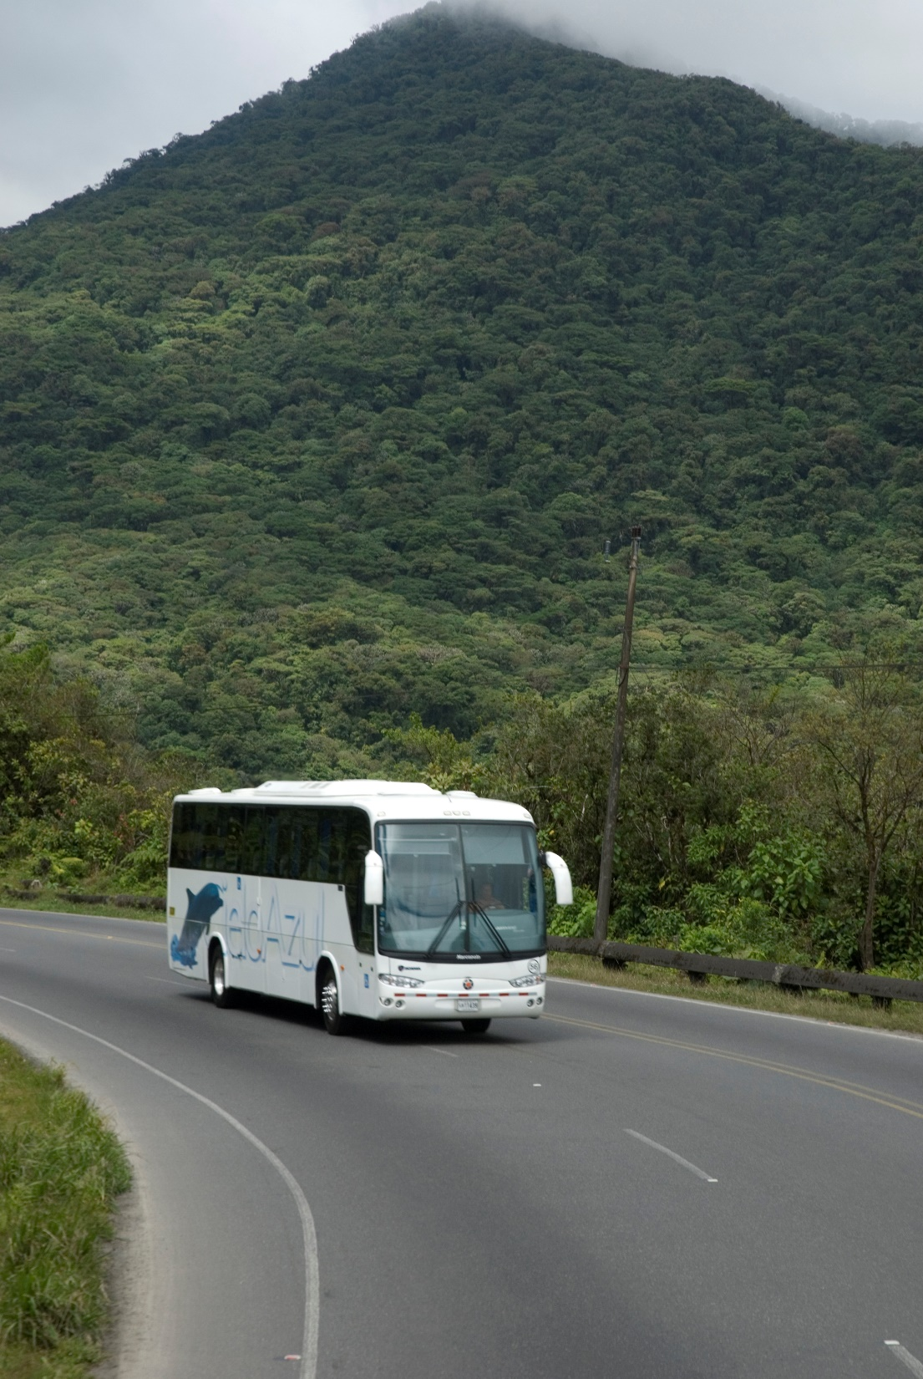
DAY SIX
Departing from Arenal to Guanacaste 120 miles, passing by the majestic Arenal Lake, the towns of Nuevo Arenal, Tilaran until the city of Cañas where we will stop to enjoy a delicious Guanacaste barbecue at Hacienda La Pacifica.

Slide 61
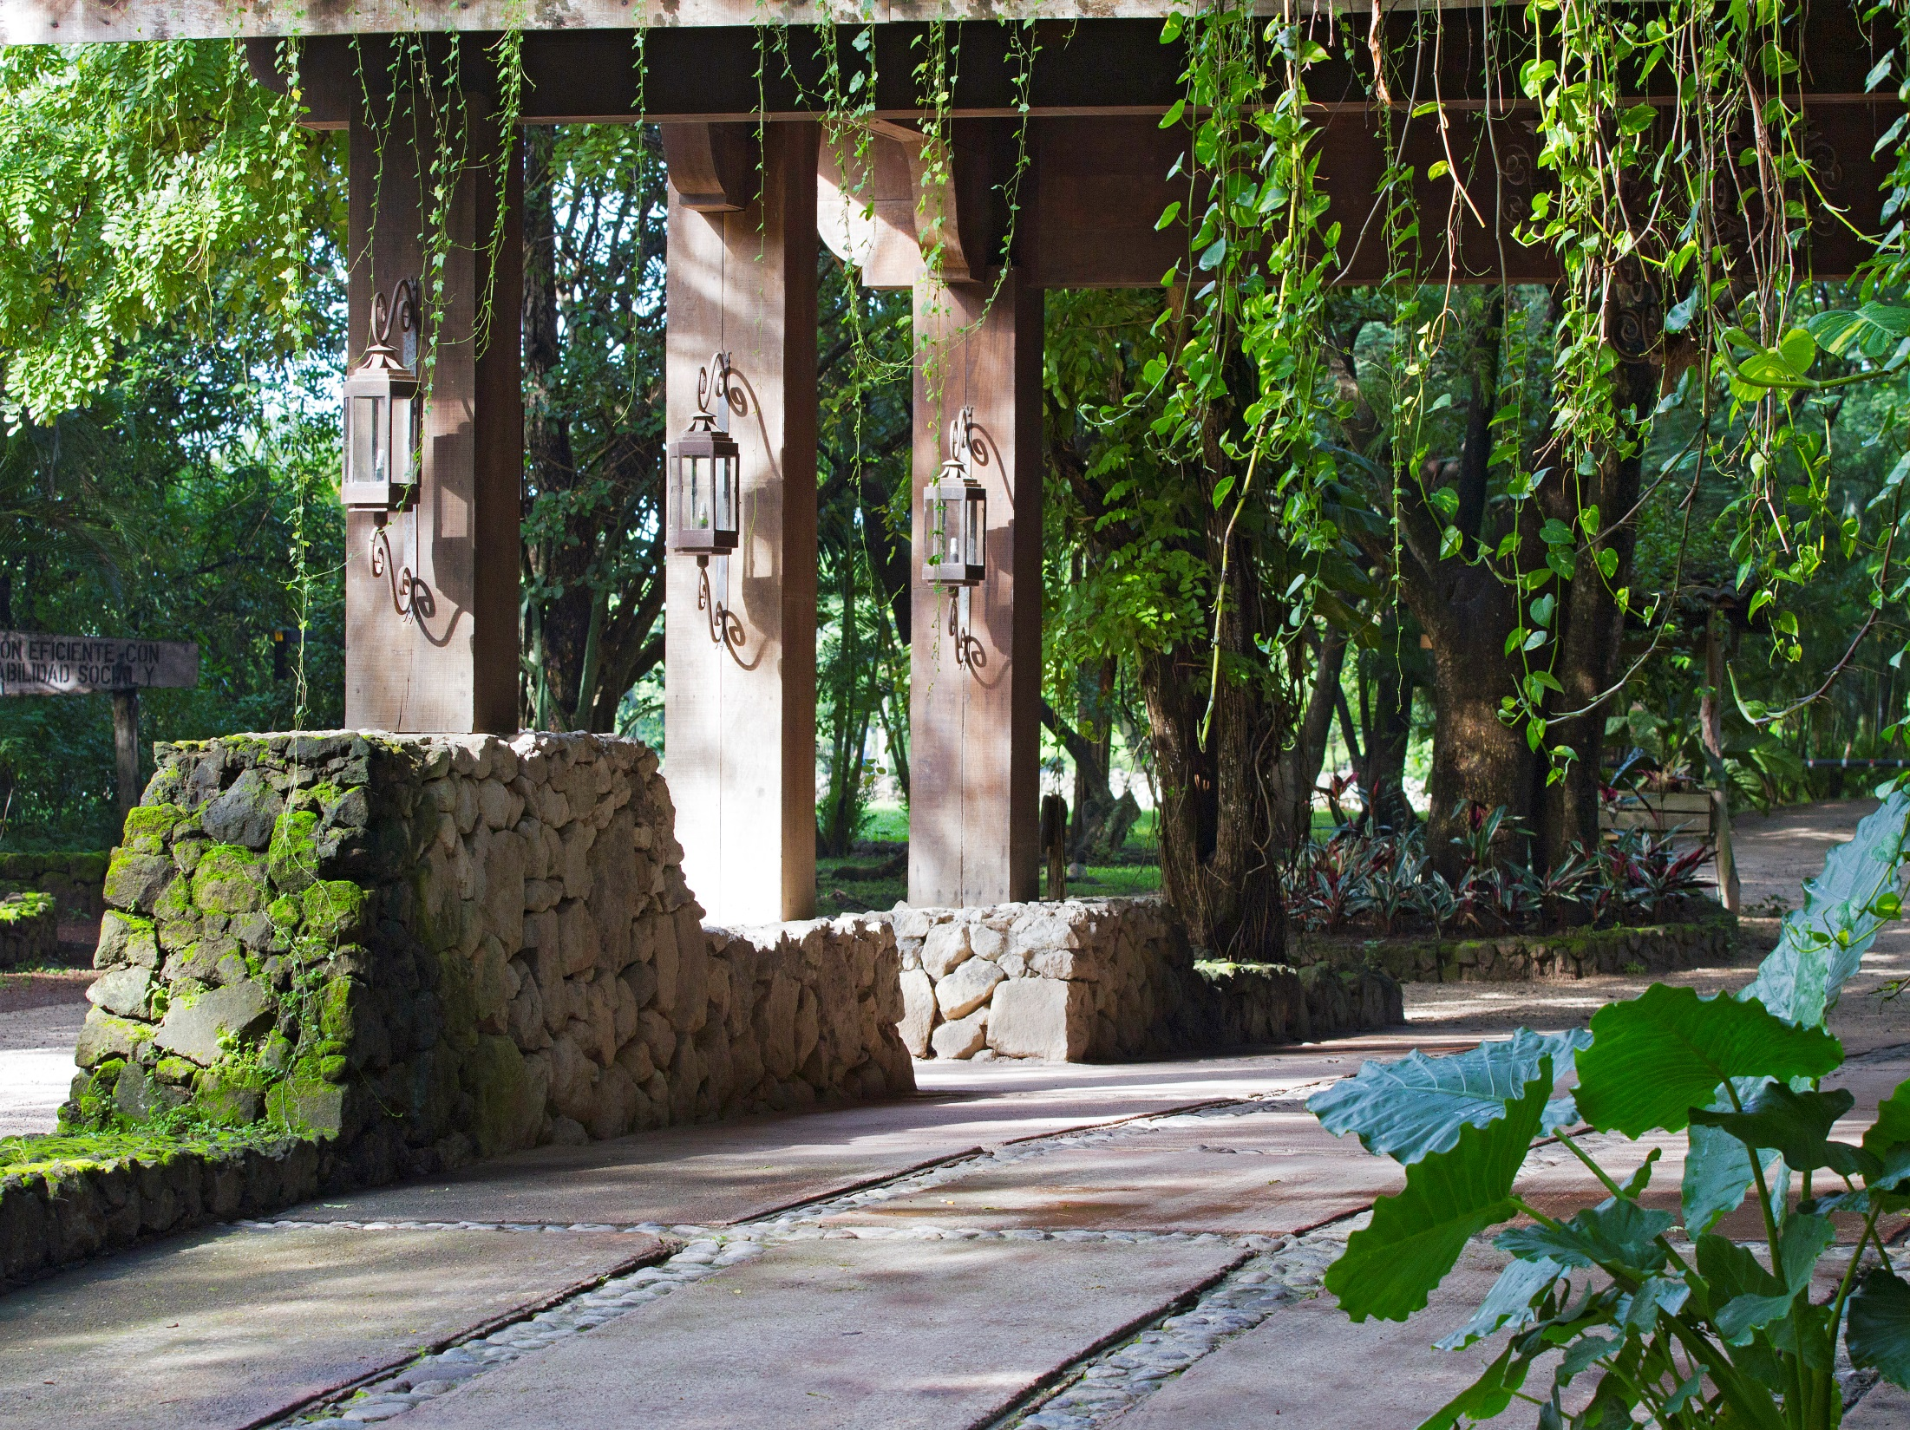
Hacienda La Pacífica
Cañas, Guanacaste

Slide 62
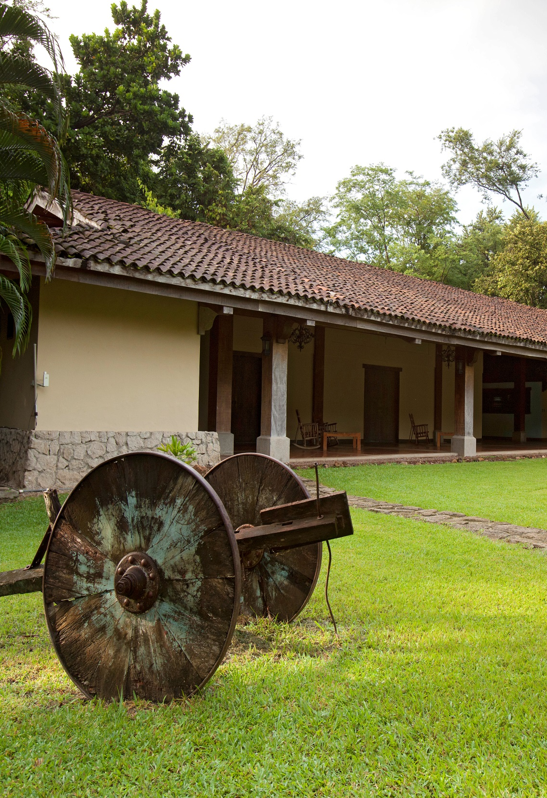
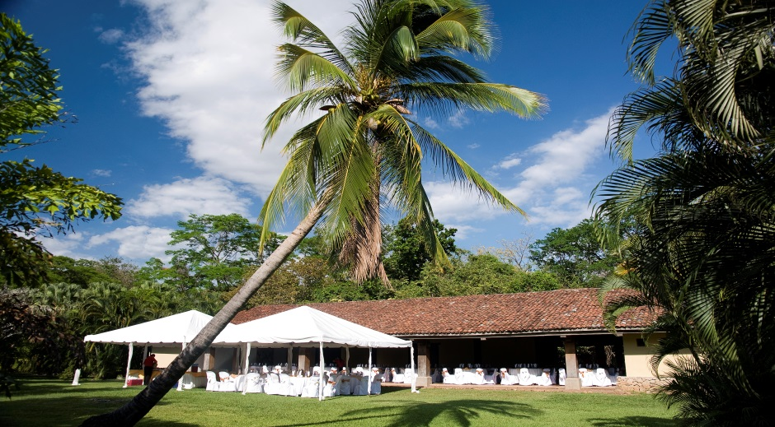
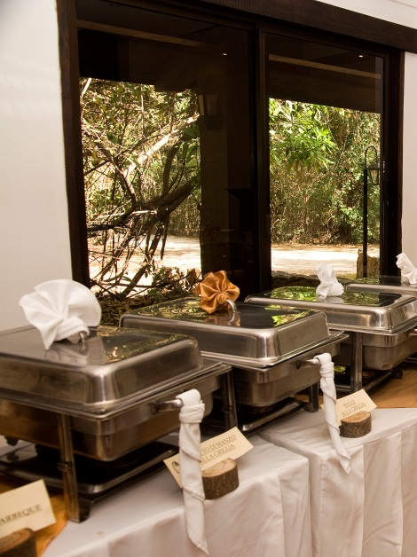
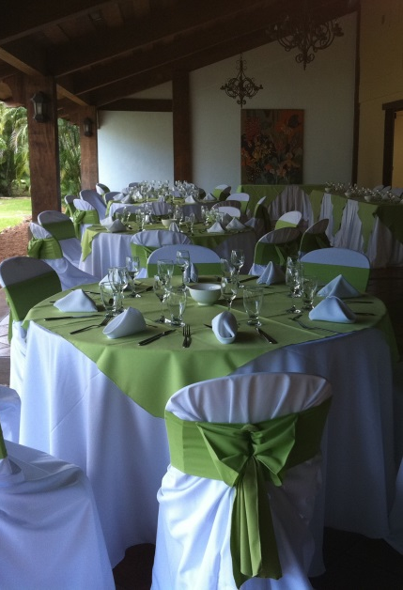
Hacienda la Pacífica

Slide 63


Slide 64


Slide 65


North Pacific – Conchal
Playa Conchal

Slide 66

W Reserva Conchal
Playa Conchal, Guanacaste

Slide 67
W Costa Rica Reserva Conchal
Hidden amongst the mangroves of Guanacaste, W Costa Rica - Reserva Conchal is a modern oasis where undercover rebels let their spirits roam freely. Our lively resort hotel is surrounded by exotic landscapes and the sugar-white sands of Playa Conchal. Inspired by the vibrant culture of Guanacaste, our hotel boasts a bold design that audaciously reinvents the idea of luxury. Admire panoramic views of our reserve from the blissful serenity of plush bedding before splashing into your suite's private plunge pool. After an action-packed day of golfing, surfing or sunbathing, retreat to our resort spa, AWAY®, and sip on a martini while we pamper you from head to toe with locally inspired treatments. When the sun goes down, the party is just getting started. Indulge in an array of decadent dining at one of our many hotel restaurants before dancing the night away at our club, Zona Azul. Whether you're an exotic explorer or a luxury lover, expect an unparalleled stay at W Costa Rica - Reserva Conchal.
Overnight at W Costa Rica Reserva Conchal

Slide 68


Slide 69


Slide 70


Slide 71

Away Spa

Slide 72


Slide 73


Slide 74


Slide 75

El Laberinto y La Senda

Slide 76


Slide 77


Slide 78


Slide 79
DAY EIGHT
TRANSFER W COSTA RICA RESERVA CONCHAL HOTEL TO
LIBERIA INTERNATIONAL AIRPORT
JUAN SANTAMARIA INTERNATIONAL AIRPORT, SAN JOSE

Slide 80

Optional Excursions

Slide 81

Marlin del Rey
Conchal, Guanacaste

Slide 82




Marlin del Rey

Slide 83

El Viejo Wetlands
Palo Verde, Guanacaste

Slide 84




El Viejo Wetlands

Slide 85

Surf Lessons
Tamarindo, Guanacaste

Slide 86




Surf Lessons

Slide 87

Canopy Hacienda El Roble
Guanacaste

Slide 88





Canopy Hacienda El Roble

Slide 89

Quad’s
Tamarindo, Guanacaste

Slide 90

Horseback Riding

Slide 91


Quad’s
Tenorio River Class IV

Slide 92

Costa Rica Top Tours
We take your event to the next level!

