Slide 1
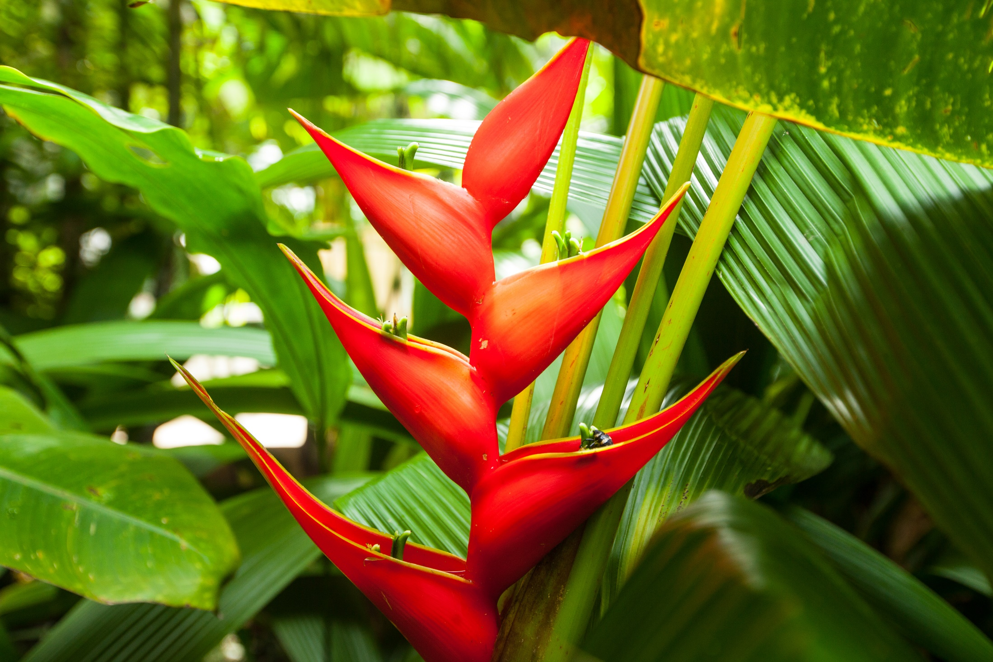
COSTA RICA

Slide 2
COSTA RICA
Costa Rica covers an area of 20,000.00 square miles. It is located on the southern tip of Central America, between the Pacific Ocean and the Caribbean which allows it to be a privileged spot. The average temperature fluctuates between 20 ºC (68 ºF) - 26 ºC (79 ºF) degrees all year around. The "green season" runs from May until November; Dry season, the equivalent of summer, starts in November ending in April.
The population is 5,000,000 of mostly white race, descendants from the Spaniards who arrived during the XVI century. There are 2 minority groups: one whose origin is Jamaica 50.000 people, and few tribes of native Indians about 10,000.
The religion is Catholic. Currency is the "colon".
No inoculations are required.
Voltage: The electric current in Costa Rica is 110 volts and 60 cycles.
To make a phone call to Costa Rica you dial 00-506 followed by the number you are calling.
Due to its position, it has flora and fauna found in both Northern and Southern hemispheres. There are 760 species of birds (more than the US and Canada combined), 900 species of plants, 1200 species of orchids, and ten percent of the world's butterflies. This tiny nation has the international standing in the conservation community for its commitment to preservation of forest and wildlife.

Slide 3

General Facts
Government: Presidential Democracy.
Division: 7 provinces.
Capital: San José.
Population: 5.500.000
Official language: Spanish.
Official religion: Catholic.
Currency: Colón (¢).
Electricity: 110 Voltios.
Dry season : Second half November – April (dry).
Green season: May – First half November (rainy).

Slide 4

General Facts
More than 600 Species of plantas
230 Species of animals
760 Species of birds
More than1300 Species de trees
More than800 Species of ferns
More than1000 Species of orchids
25.58%
6% of the world’s Biodiversity
25.58% of the Territory is protected

Slide 5
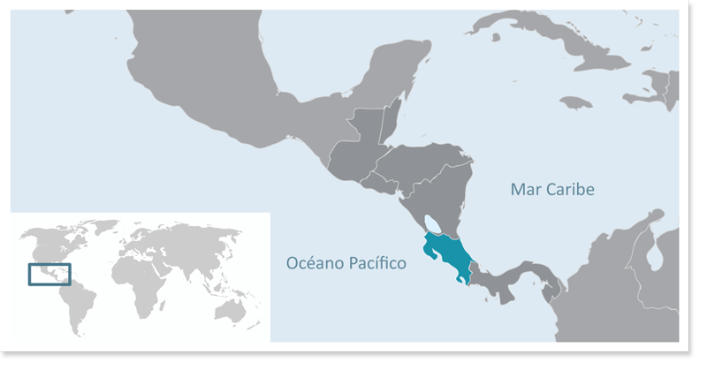
Location
Central America
Limits:
North: Nicaragua.
South: Panamá.
West: Pacific Ocean.
East: Caribbean Sea, Atlantic Ocean.

Slide 6

Entrance requirements:
Passport valid for at least 6 months from your date of entry
Please check if clients require the Yellow Fever Vaccine to enter the country: Countries that require Yellow Fever Vaccine
Please check if you require a visa to enter Costa Rica using the following link https://migracion.go.cr/Paginas/Visas.aspx

Slide 7
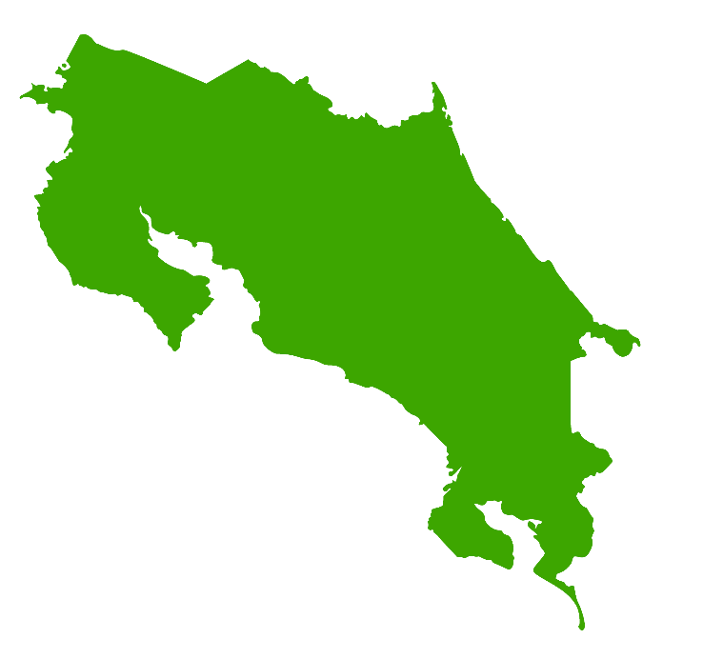

International Airports:
Apto. Intl. Juan Santamaría
Apto. Intl. Daniel Oduber

Slide 8
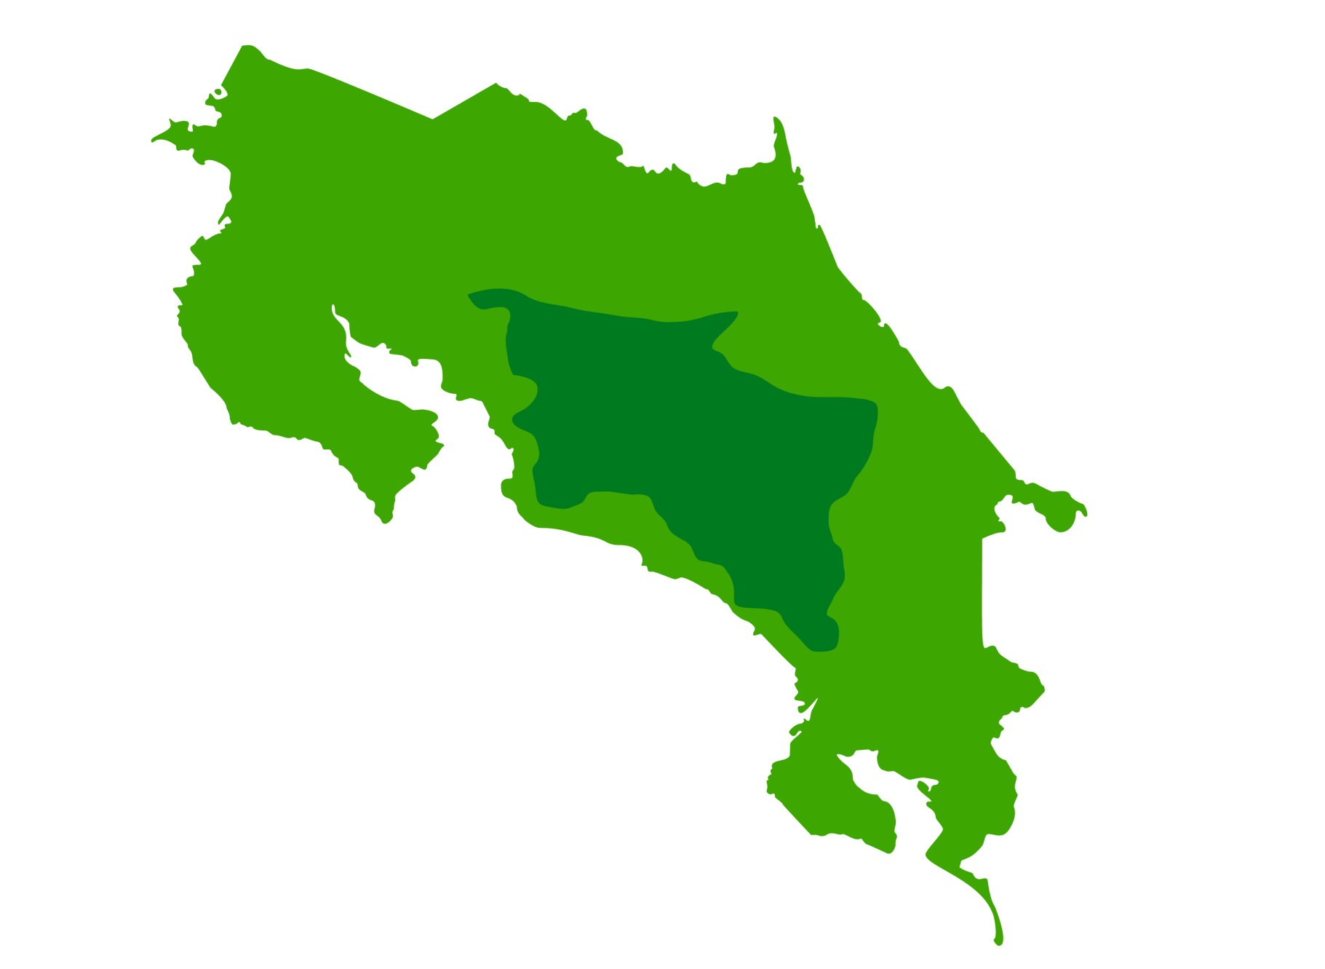
San José
San Jose

Slide 9
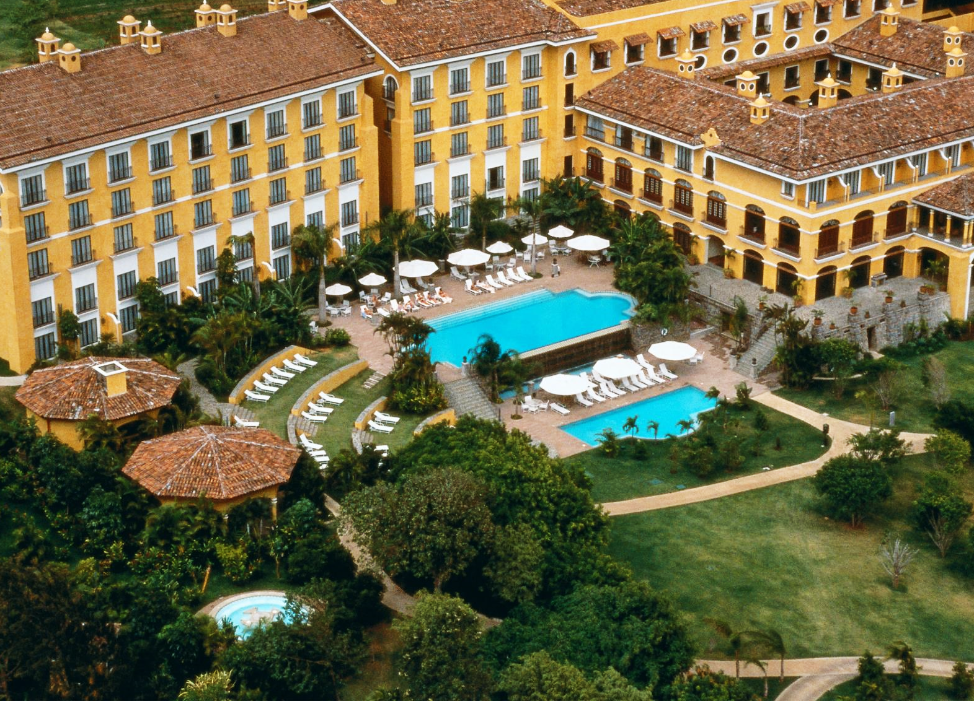
Costa Rica Marriot

Slide 10
COSTA RICA MARRIOTT HOTEL
Location: 9.987214, -84.173593
Tucked within a 30 acre Central Valley coffee plantation, the spectacular Colonial hacienda-style Costa Rica Marriott, is surprisingly close to both downtown San José (fifteen minutes) and the International Airport (five minutes). This full-service hotel is renowned for its beautiful grounds, luxurious rooms, colonial ambiance and exceptional service. Relax and enjoy the two outdoor pools, spa, tennis courts, driving range and three restaurants.

Slide 11
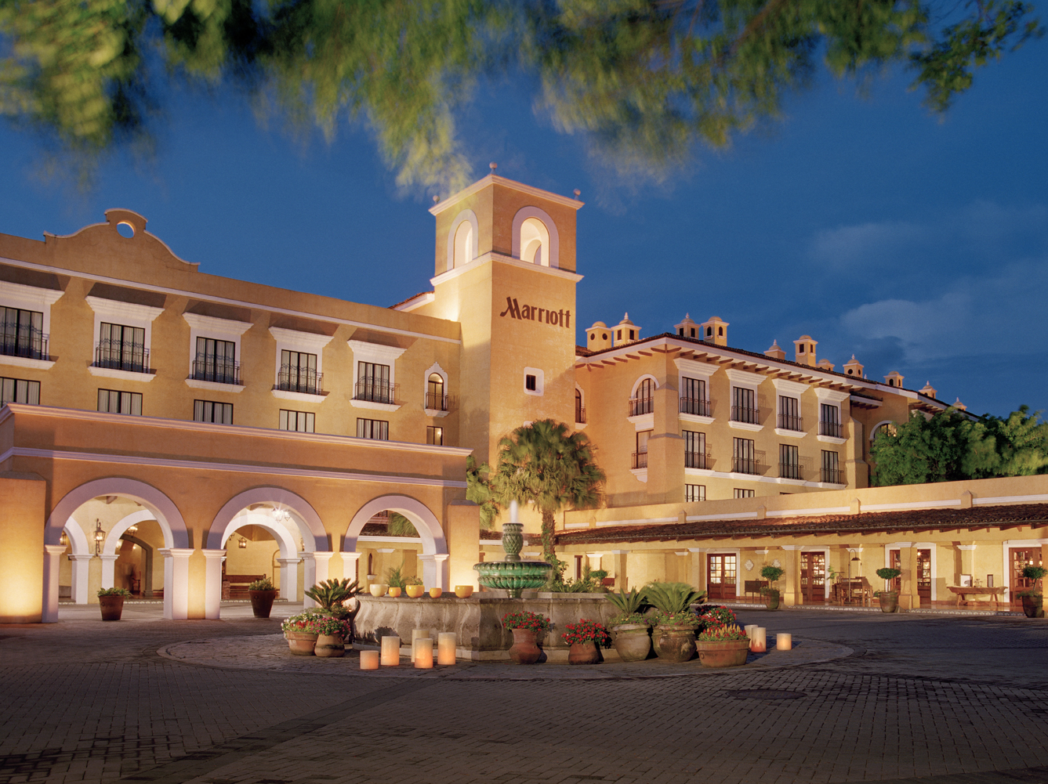

Slide 12
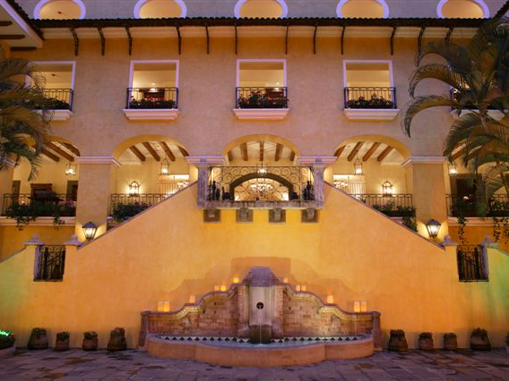

Slide 13
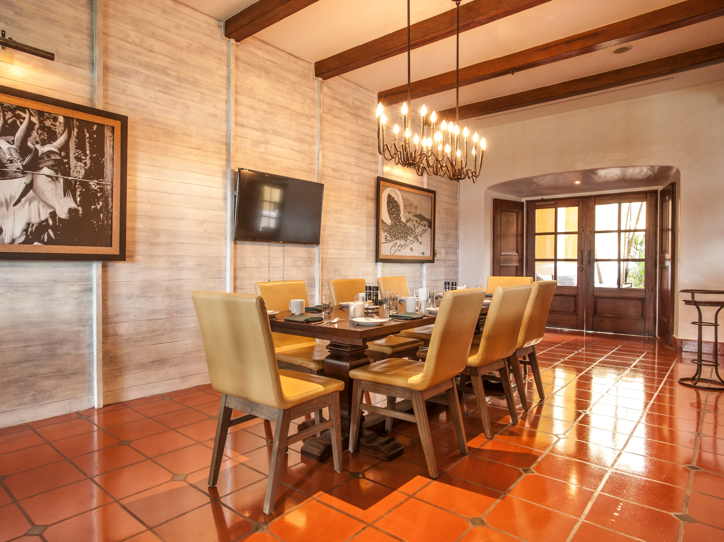

Slide 14
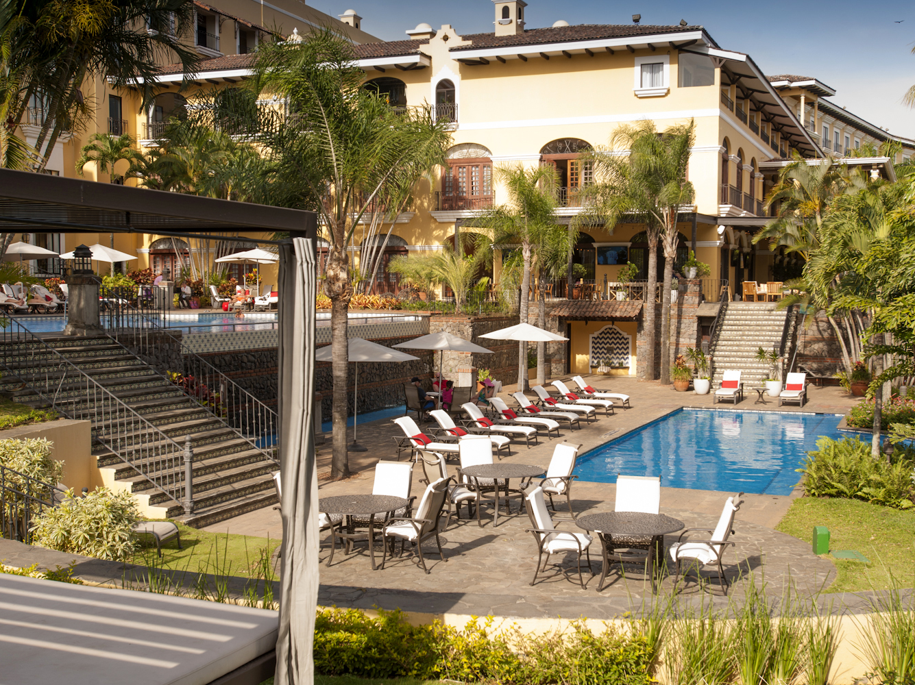

Slide 15
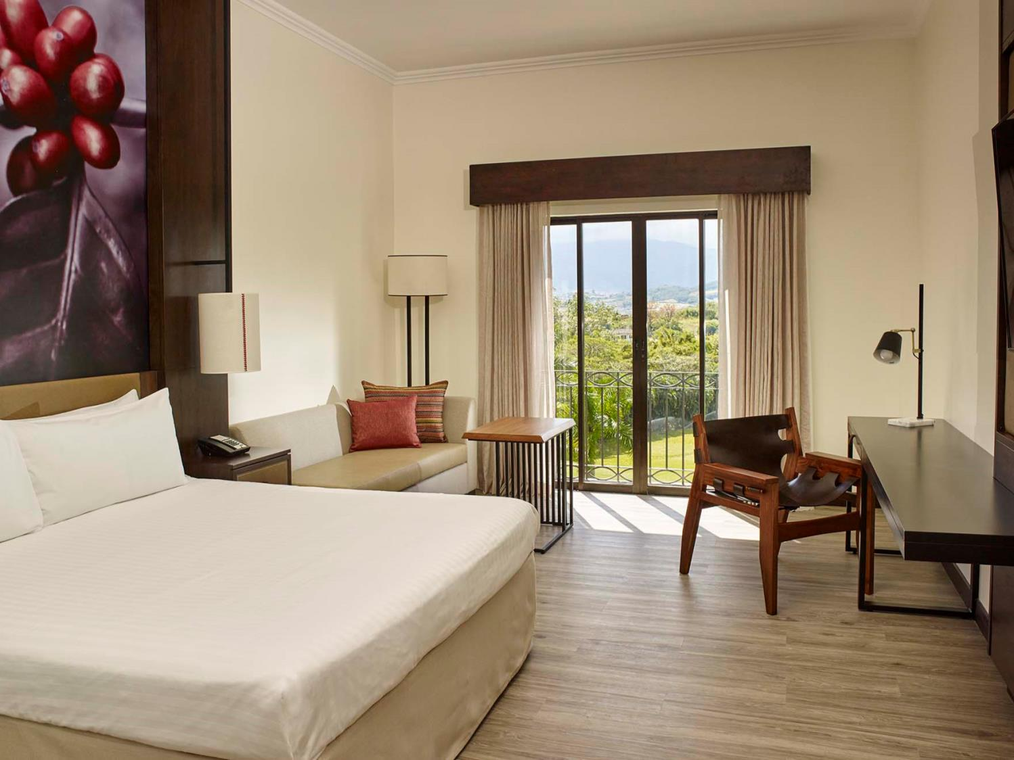

Slide 16
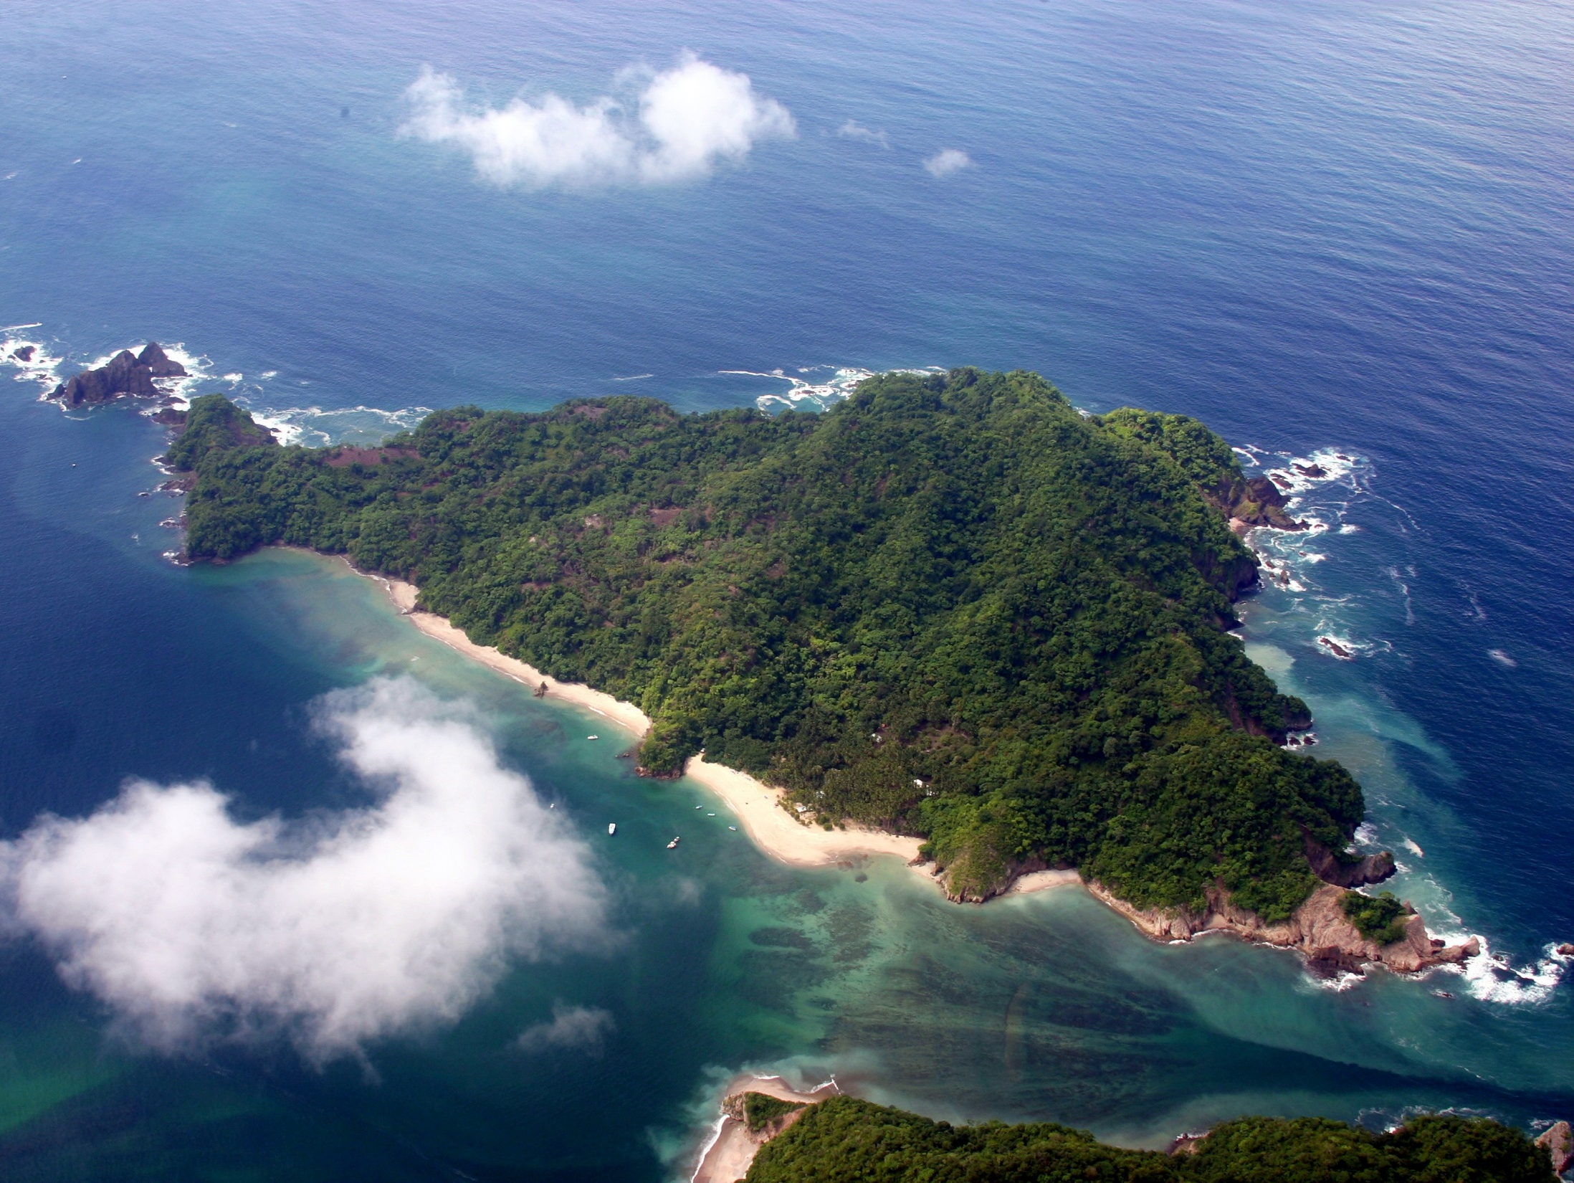
Tortuga Island

Slide 17
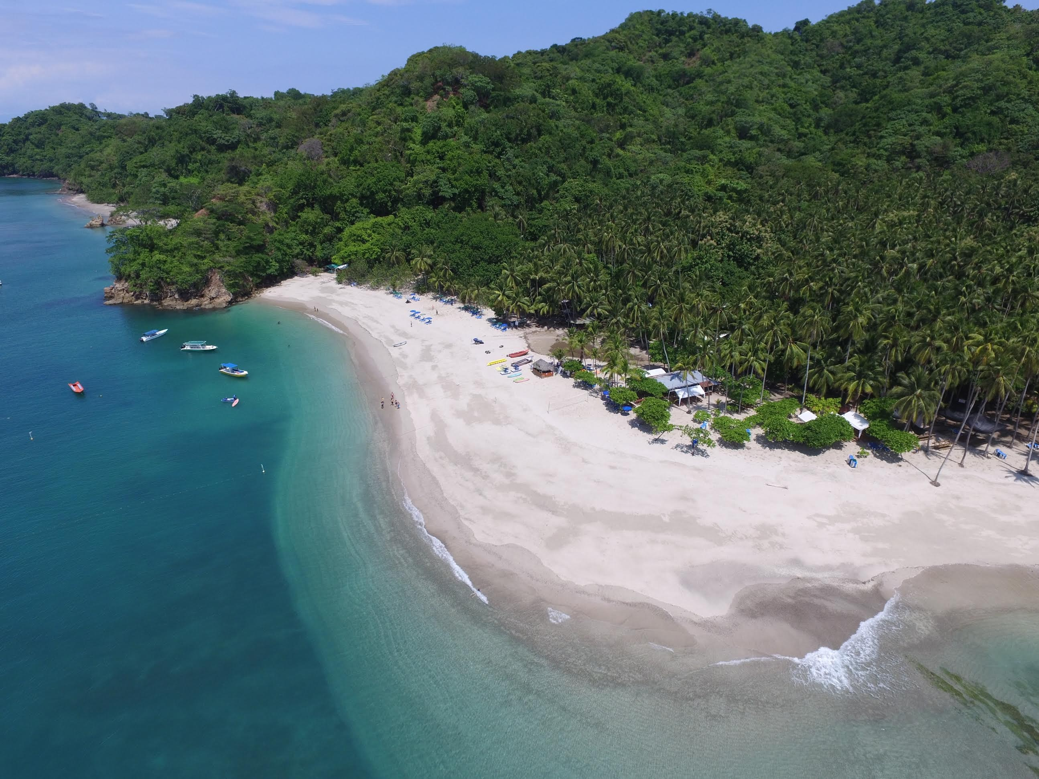

Slide 18
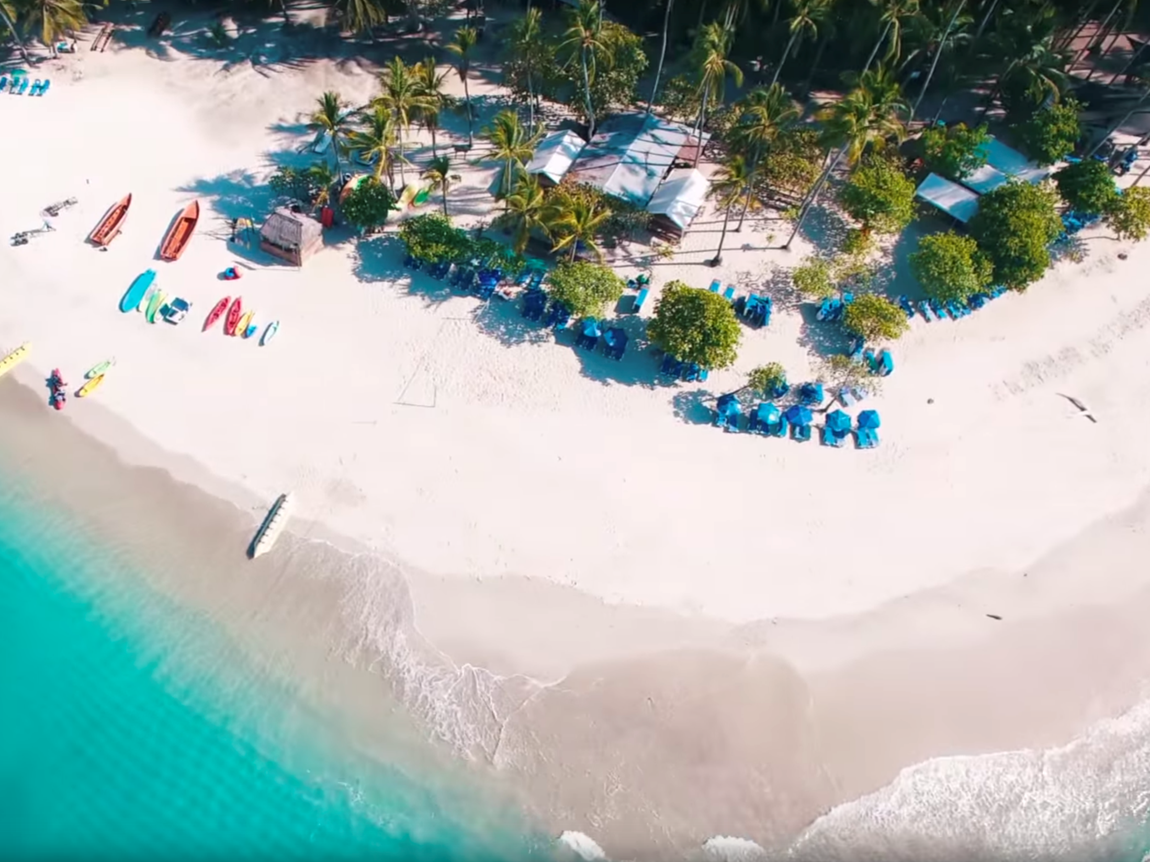

Slide 19
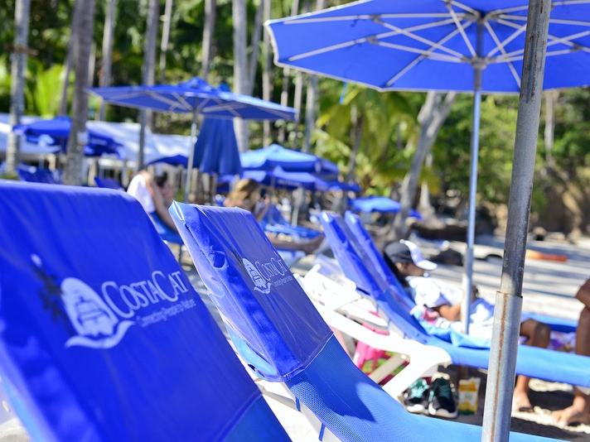

Slide 20
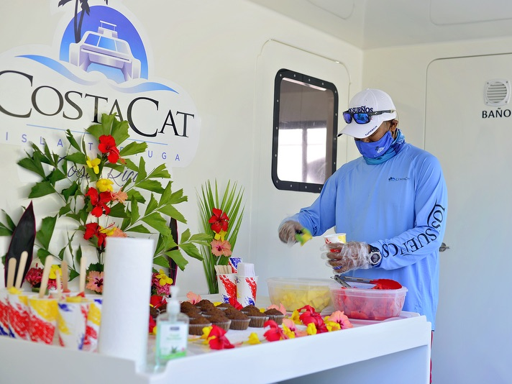

Slide 21
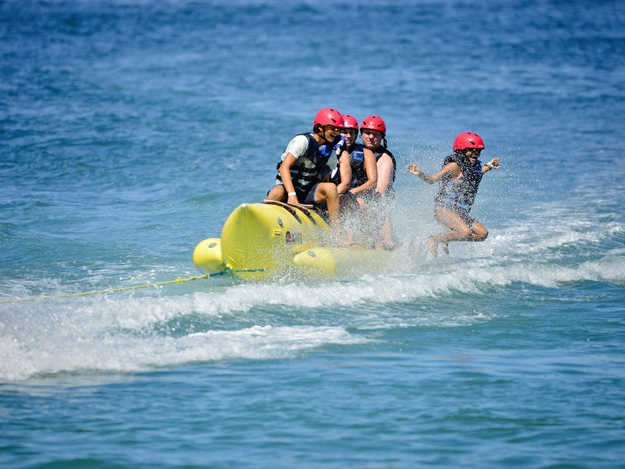

Slide 22
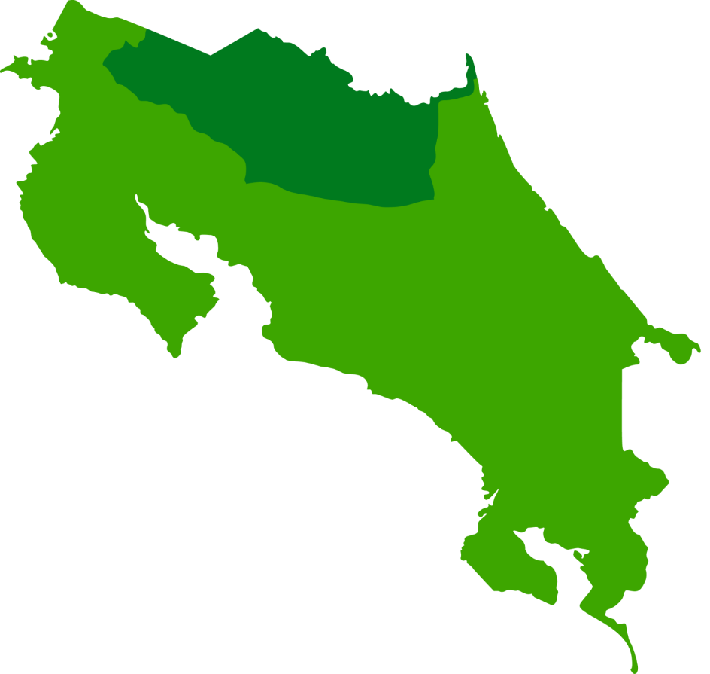
Mountain
La Fortuna - Arenal

Slide 23
The constant energy of the active volcano, the warmth of the hot spring rivers, and the tropical forest environment offer an incomparable experience in Costa Rica's renowned jewel. This extraordinary environment, combined with exceptional service, warm smiles and excellent facilities, guarantee guests a relaxing and unforgettable EXPERIENCE.

Slide 24
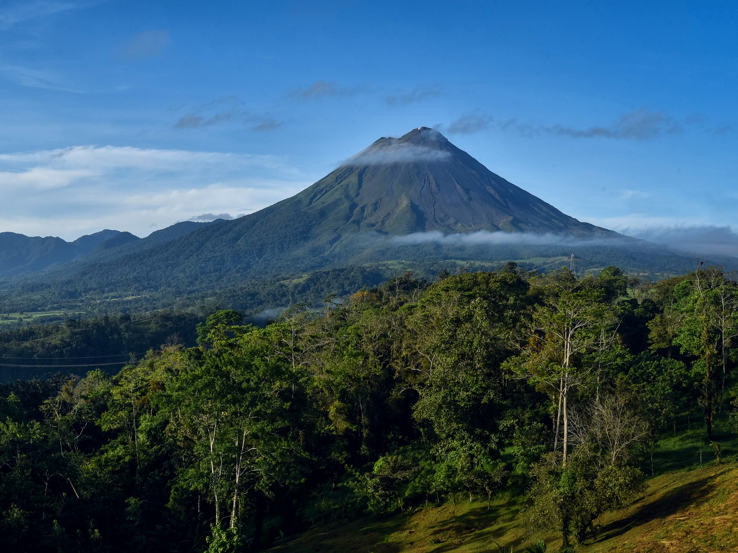

Slide 25
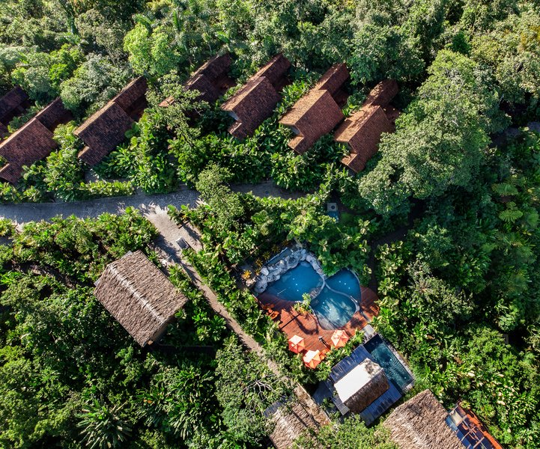
Amor Arenal Hotel

Slide 26
Hotel Amor Arenal
Check In: Hotel Amor Arenal
Este Boutique Hotel se encuentra en la cima de las colinas del Volcán Arenal, donde la elevación más alta genera temperaturas más frescas y brisas constantes que seguramente atraerán a los huéspedes al aire libre. Los huéspedes podrán admirar una vista en primera fila del imponente Volcán Arenal desde la terraza de su Casita y la piscina de inmersión del spa. Justo debajo de las Casitas, los huéspedes encontrarán senderos para explorar la jungla circundante. Los senderos del hotel son perfectos para largas caminatas a través de la espectacular flora y fauna local. Le invitamos a descubrir este maravilloso lugar, estamos seguros que lo disfrutara.
Almuerzo en Hotel Amor Arenal

Slide 27
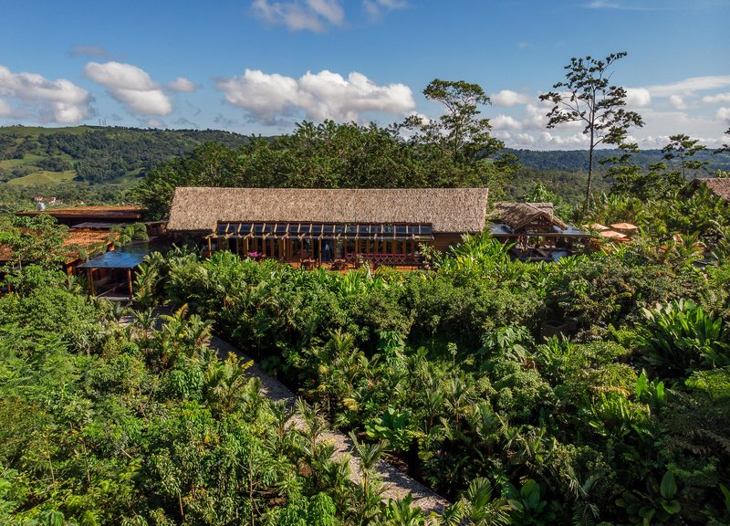

Slide 28
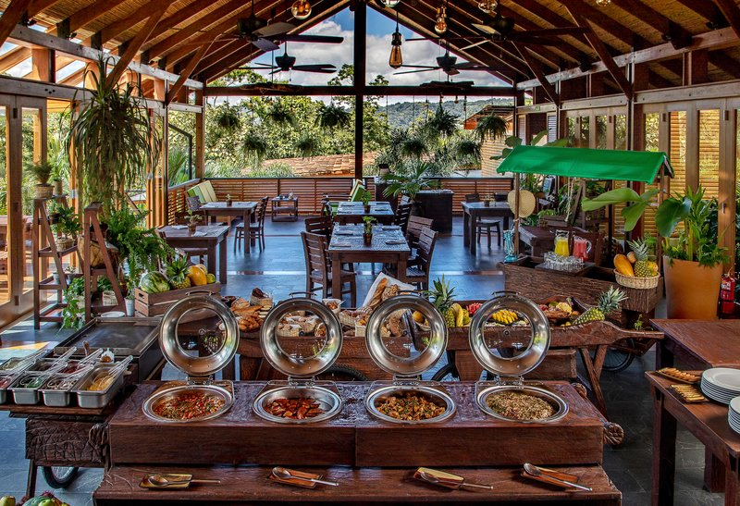

Slide 29
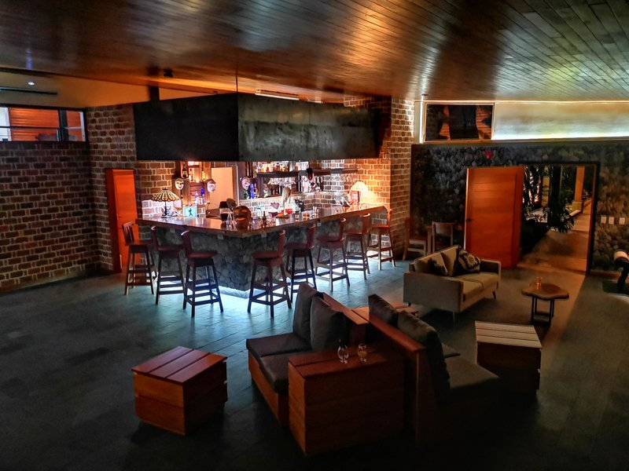

Slide 30
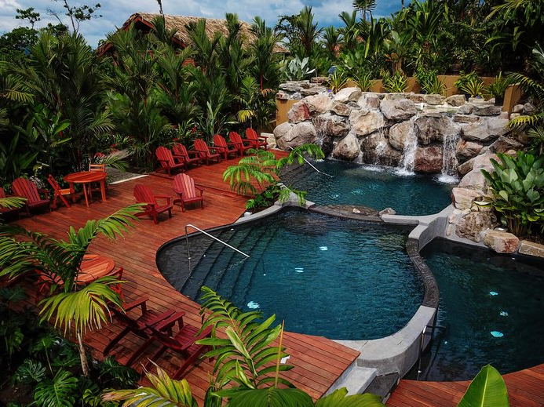

Slide 31
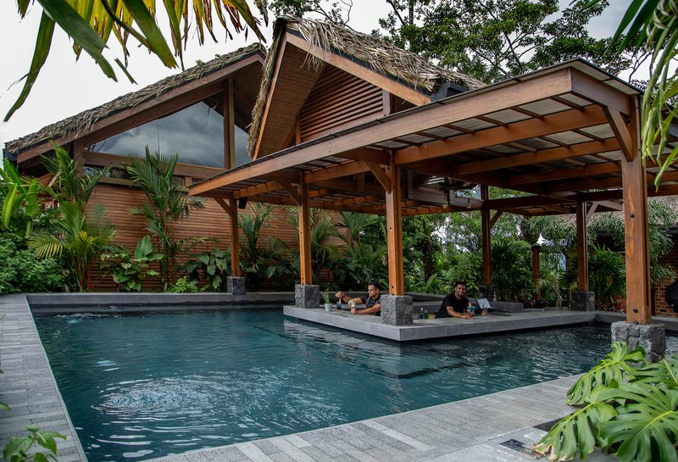

Slide 32
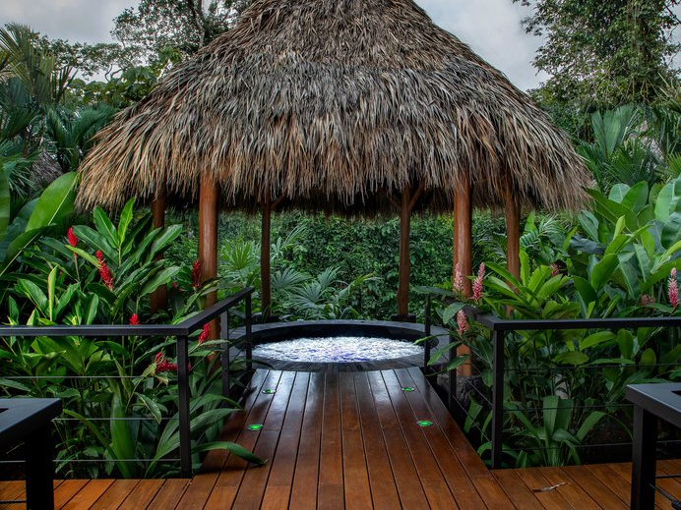

Slide 33
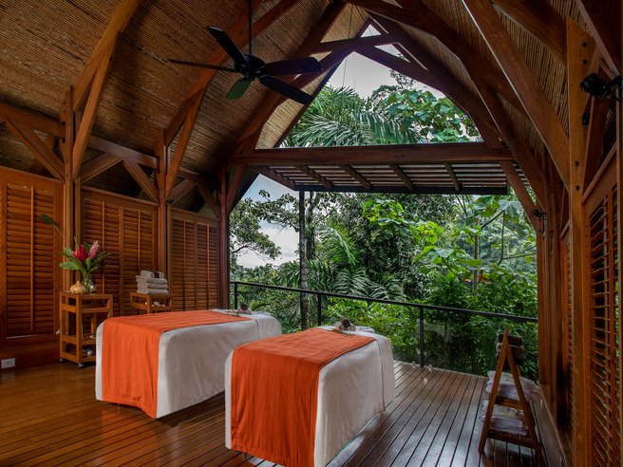

Slide 34
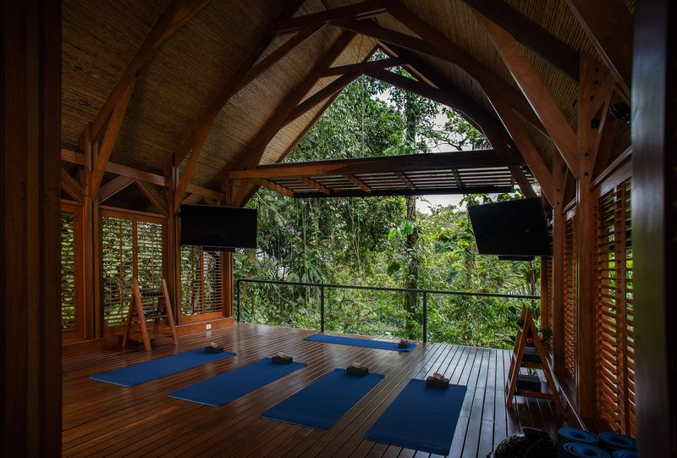

Slide 35
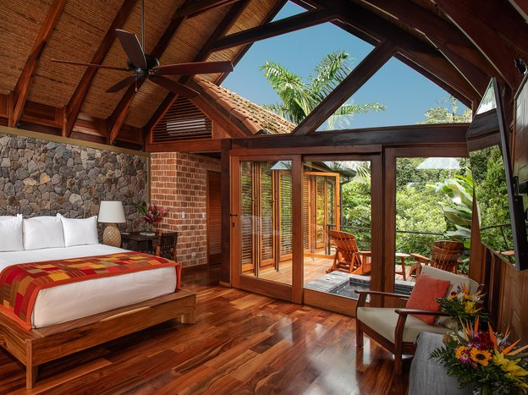

Slide 36
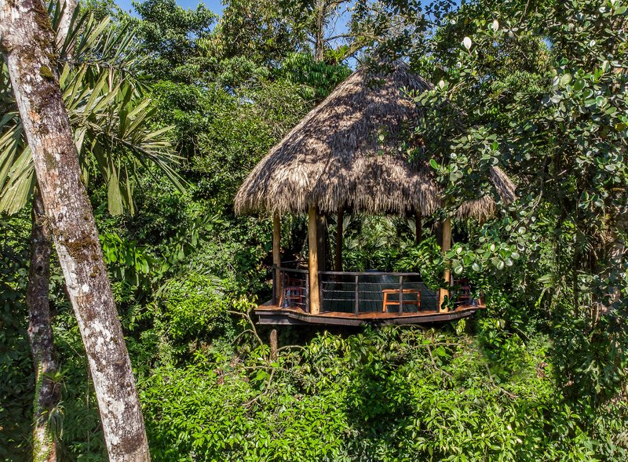

Slide 37
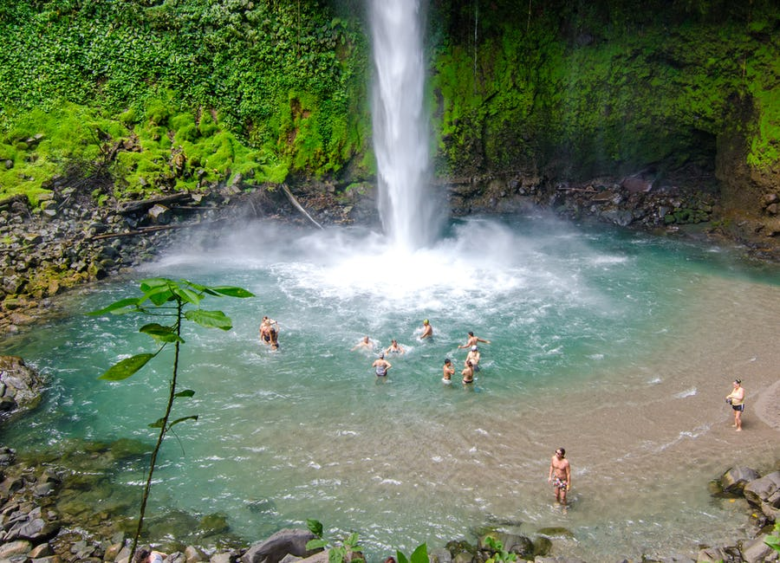
La Fortuna Waterfall

Slide 38
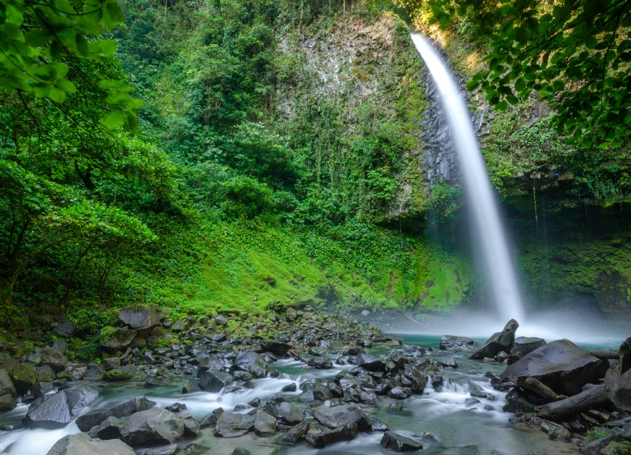

Slide 39
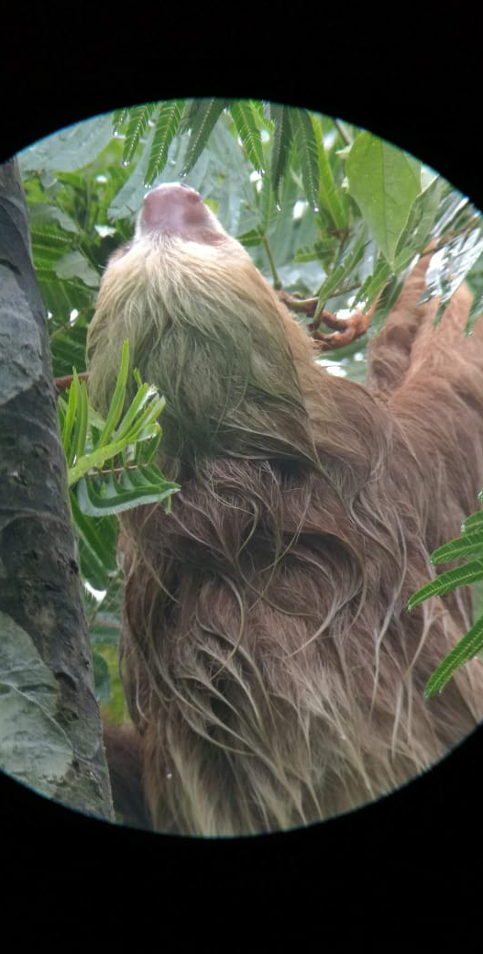
Arenal
OPTIONAL EXPERIENCE:
Possibility to visit The Sloth trail…..
The sloth watching trail in Arenal is located 600 meters from the central park in La Fortuna Costa Rica, we have about 20 hectares area and a trail of approximately 2 km long.
Our guided hiking tour last one hour and a half, with the help of an expert guide you can get to see from 4 to 6 sloths in their own habitat, different species of birds, sometimes snakes, insects and frogs.

Slide 40
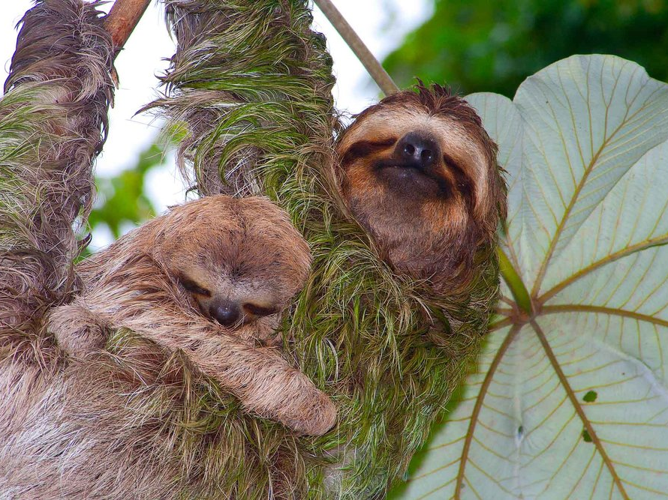

Slide 41
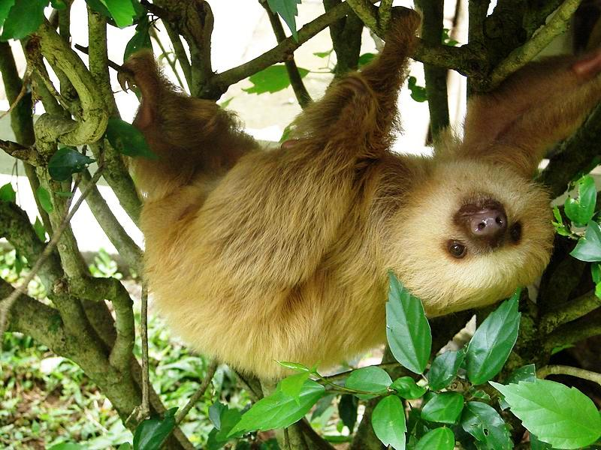

Slide 42
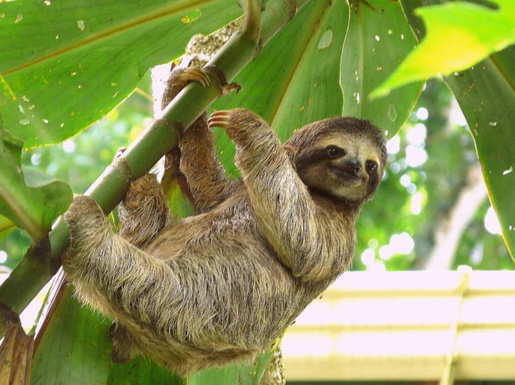

Slide 43
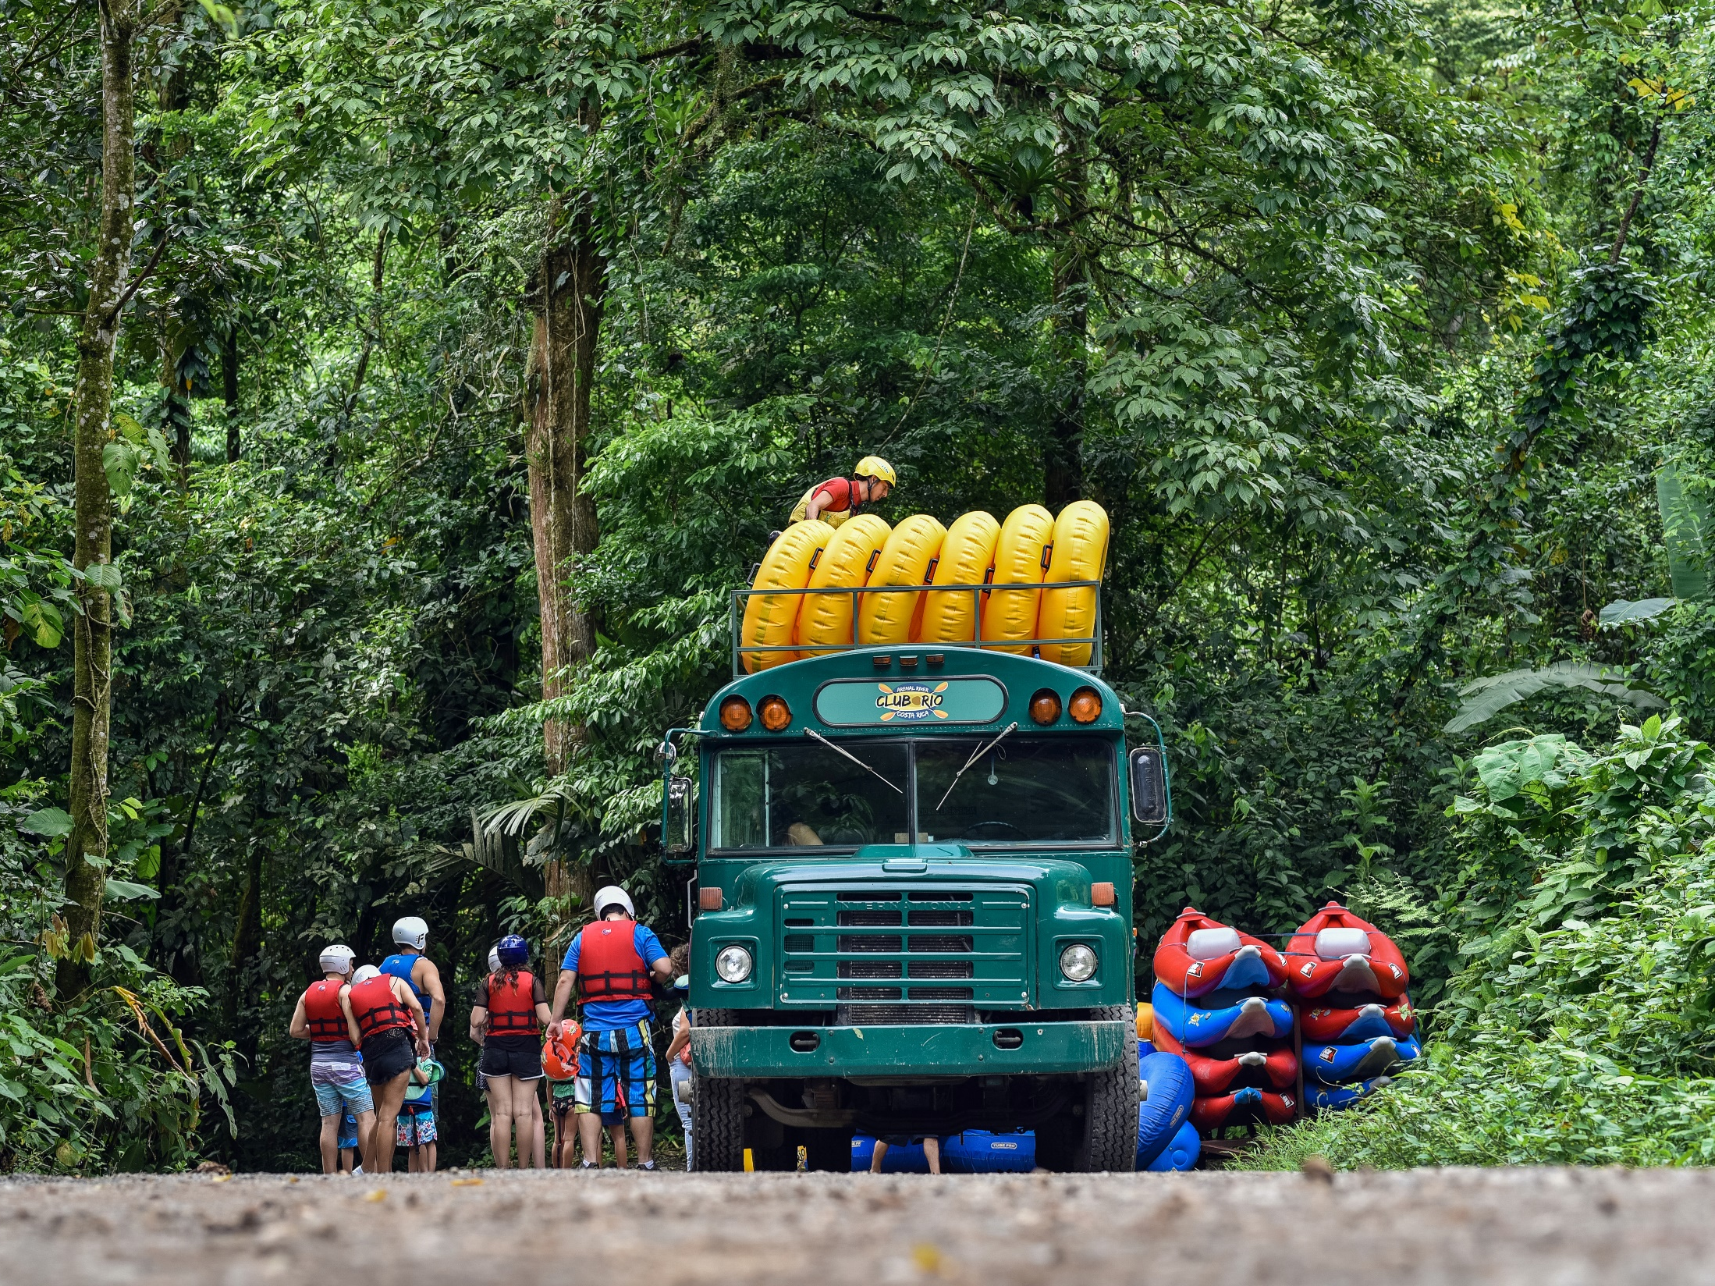
Club del Rio

Slide 44
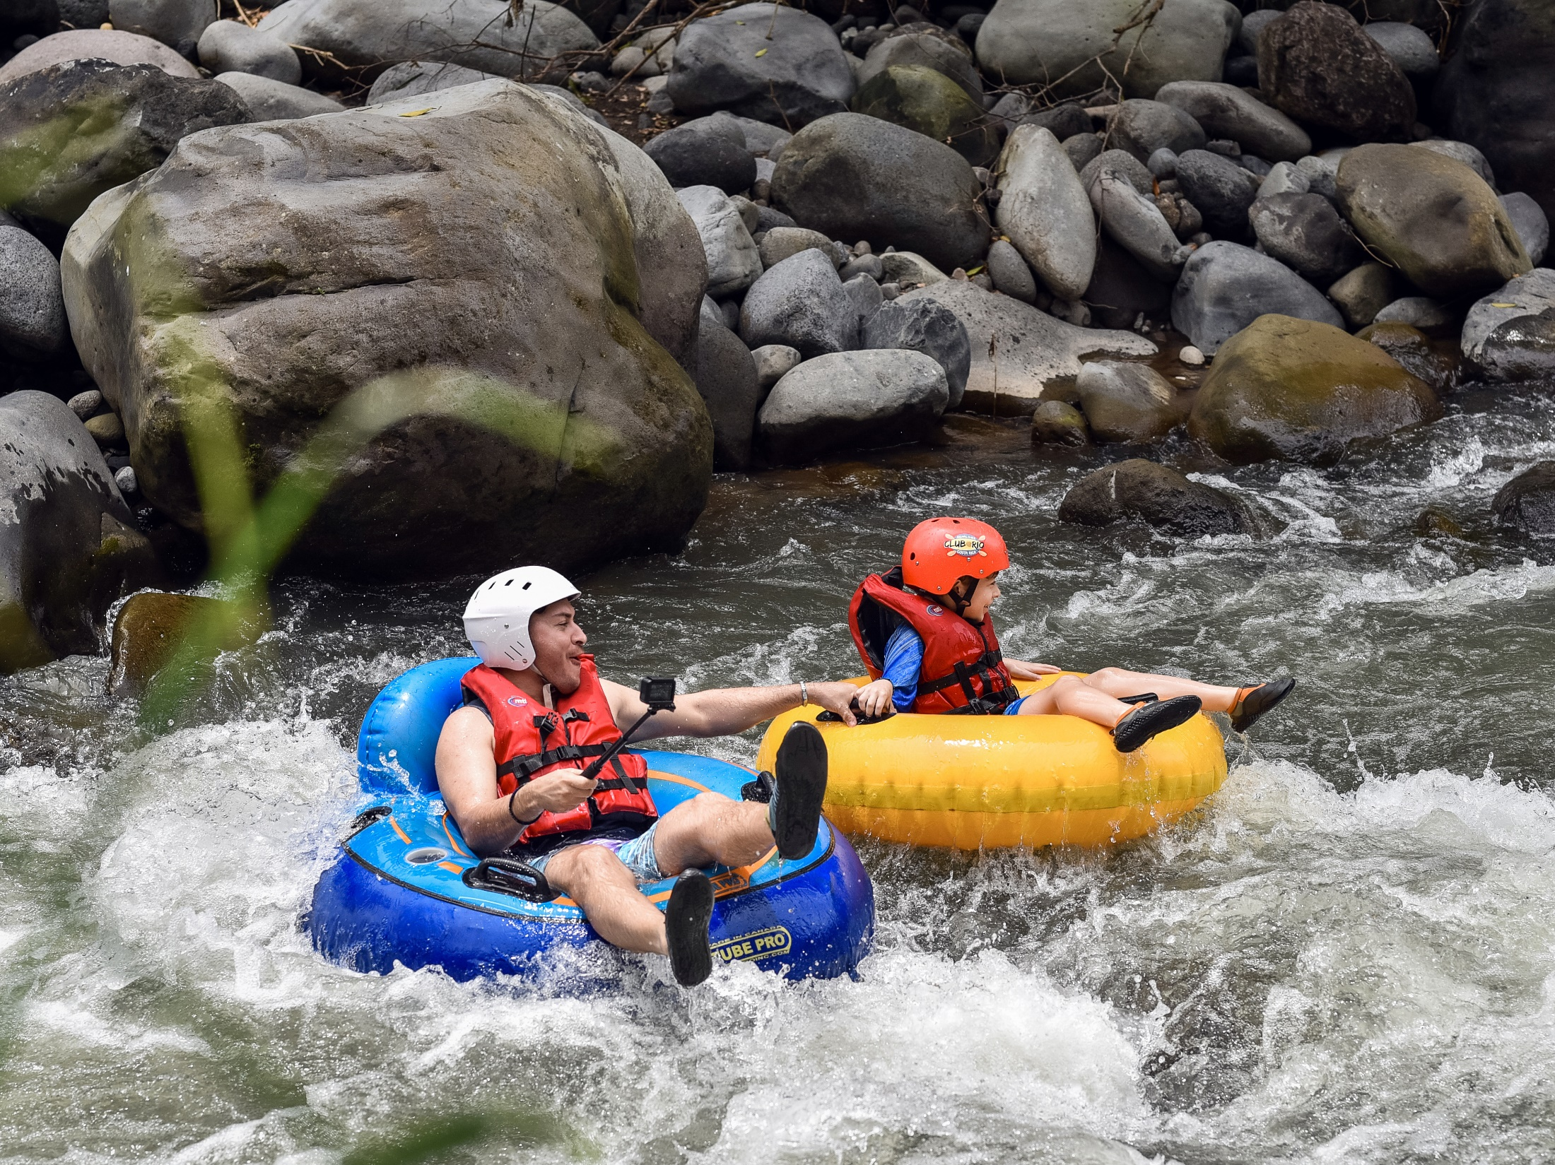

Slide 45
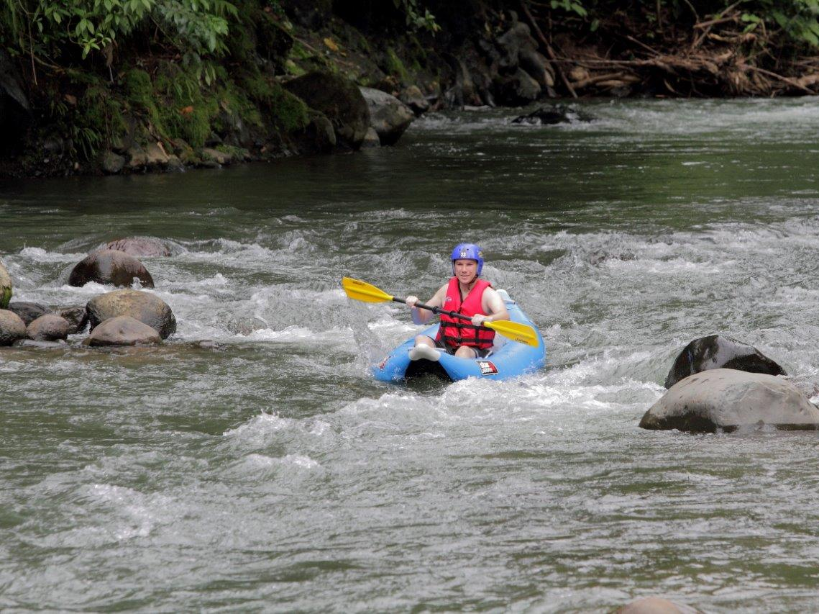

Slide 46
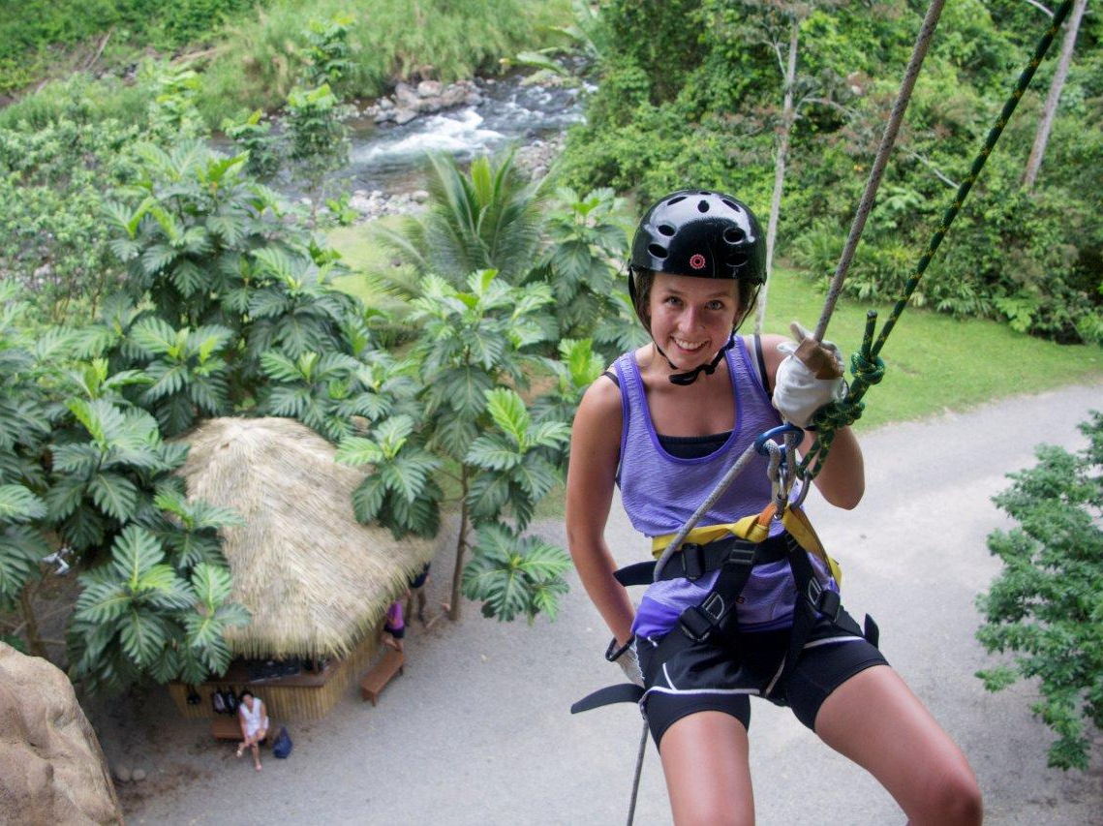

Slide 47
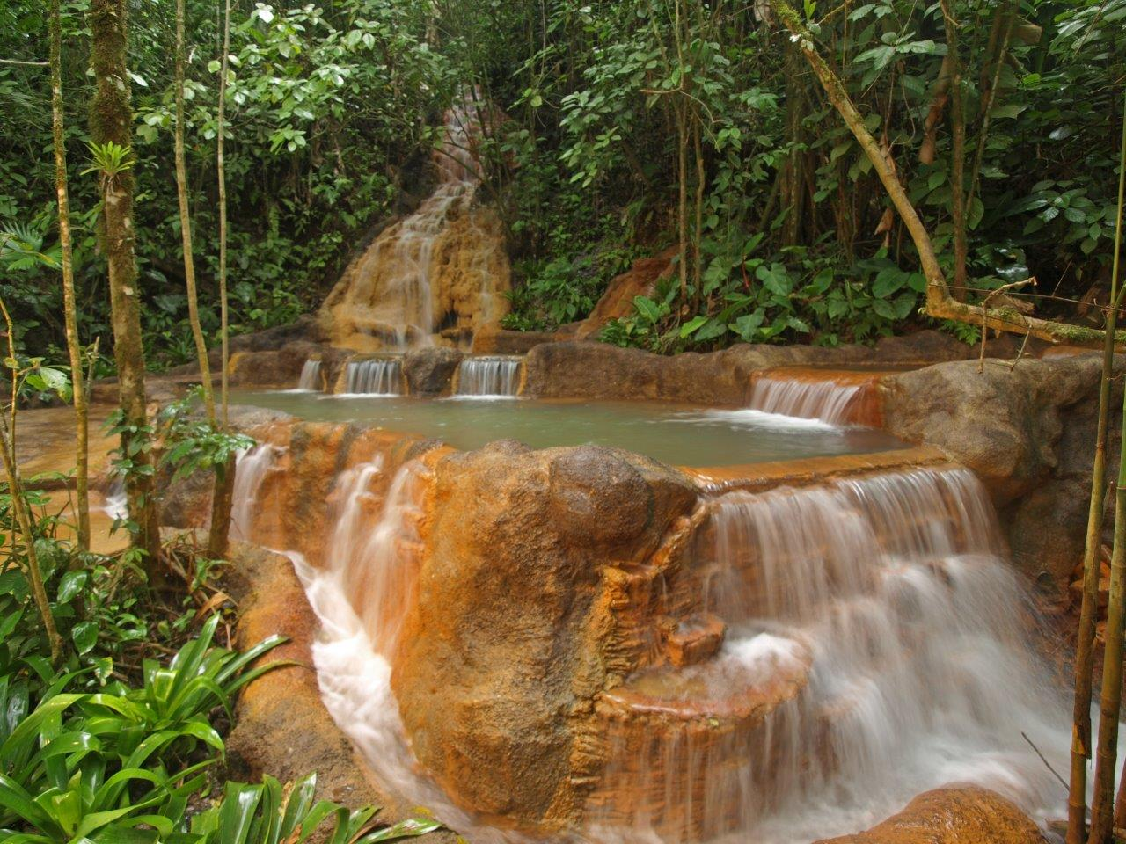

Slide 48
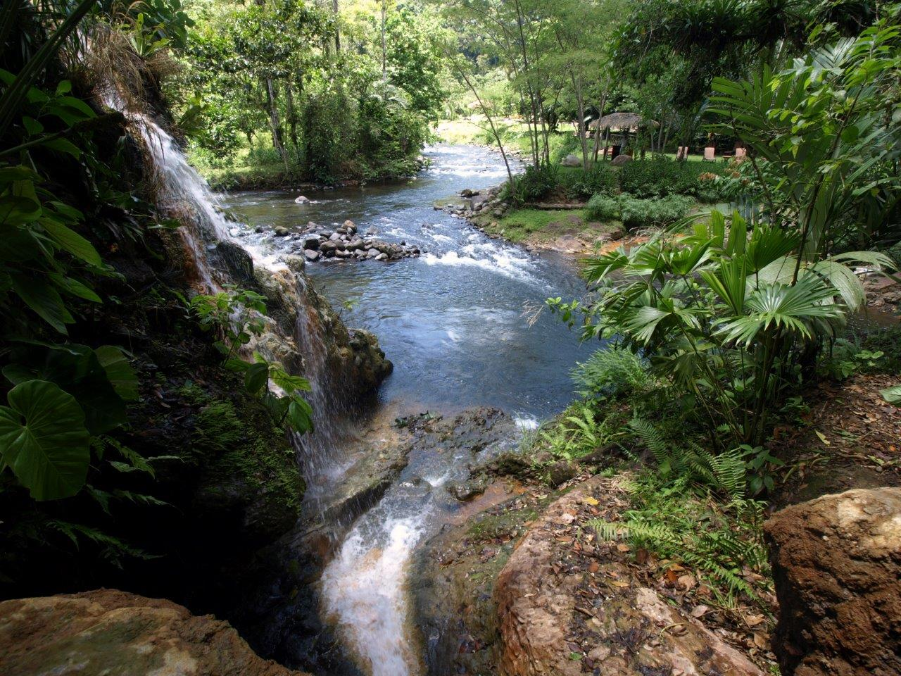

Slide 49
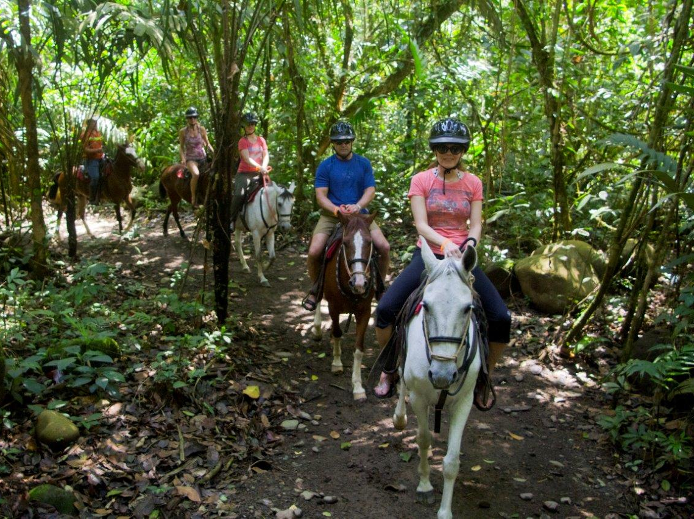

Slide 50
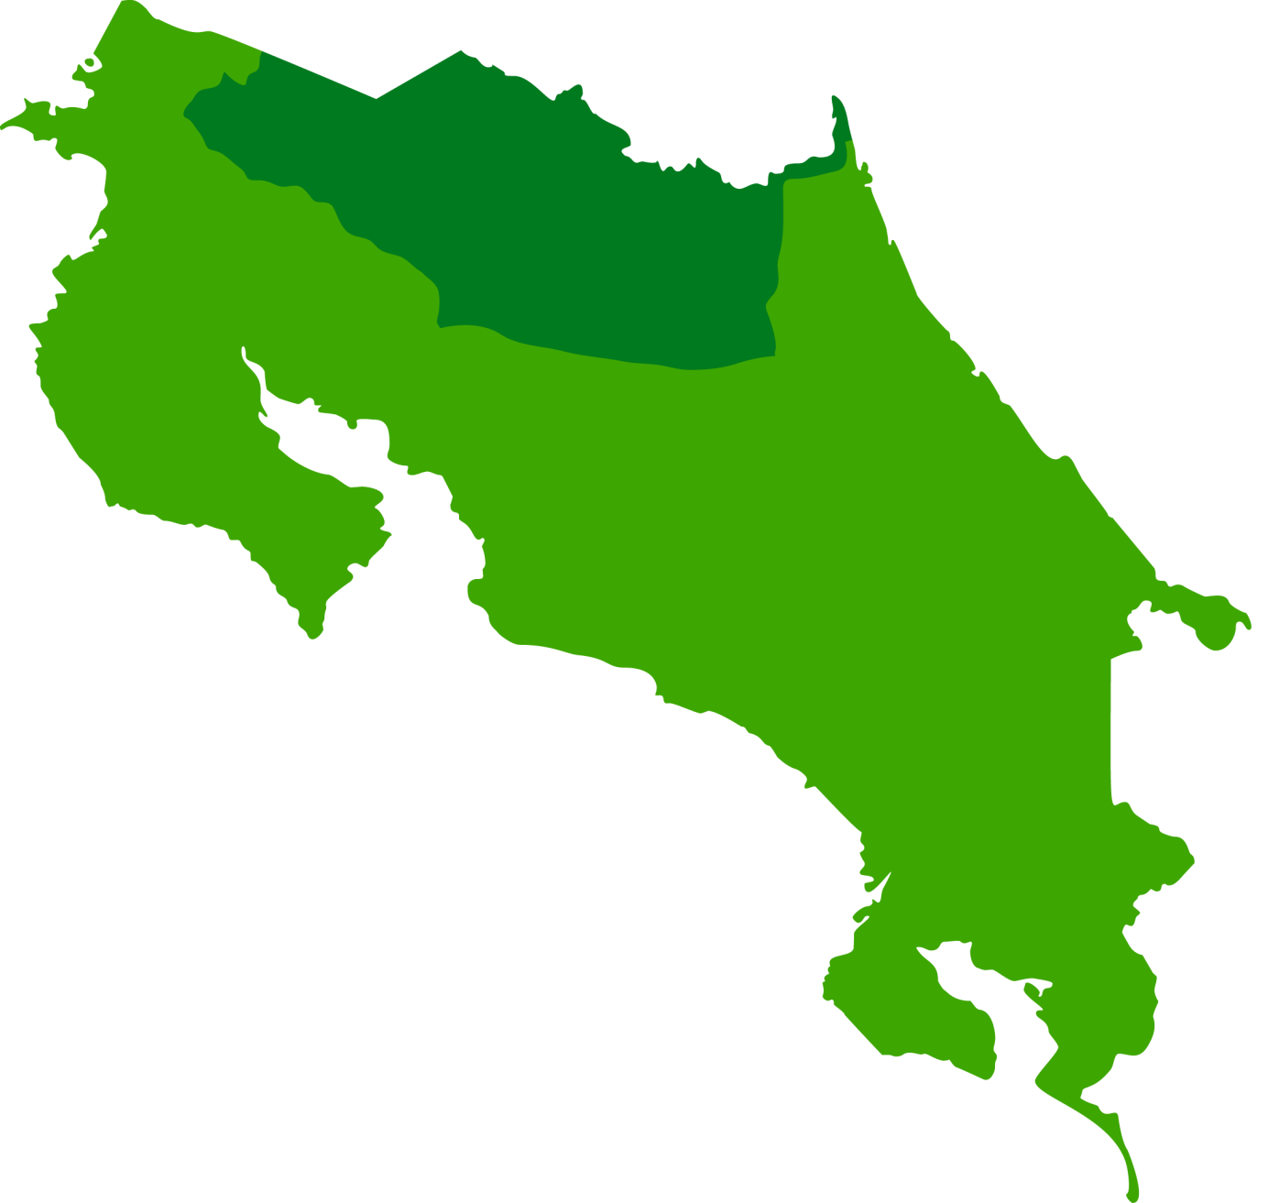
Mountain
Monteverde

Slide 51
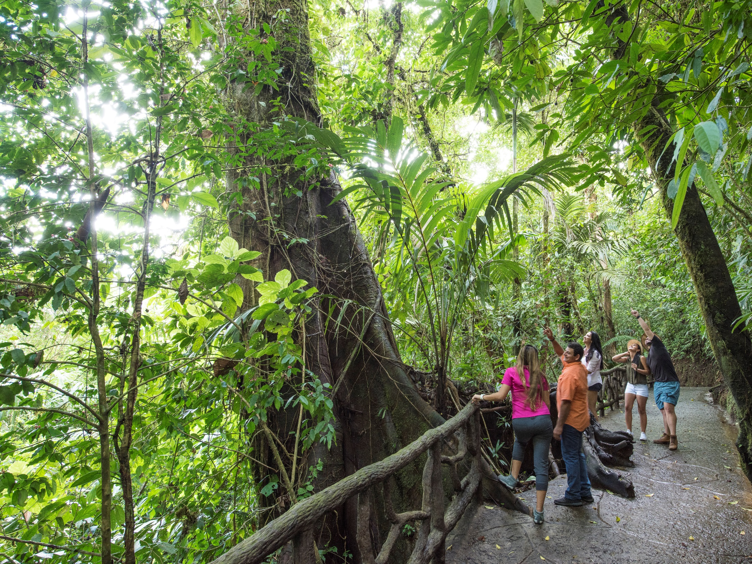

Slide 52
Lake Crossing Arenal – Monteverde
At 2:30 p.m. you will Travel between Arenal and Monteverde. You will be transferred by a vehicle to the lake and then board a boat for approximately one hour to take us across to Monteverde. This service is the fastest and a very scenic way to travel, where you can admire the beautiful views of all of the mountains, sky and the colossal Arenal volcano itself on our way across the lake. When you reach the other side of the lake, you will be picked up and driven to your hotel in Monteverde.
Monteverde is a place of cloud forests and coffee plantations, monkeys, mist, and friendly locals. The town of Santa Elena is small and quaint, filled with tasty restaurants and folksy artisan shops, while the nearby rainforest hosts a remarkable amount of biodiversity.

Slide 53
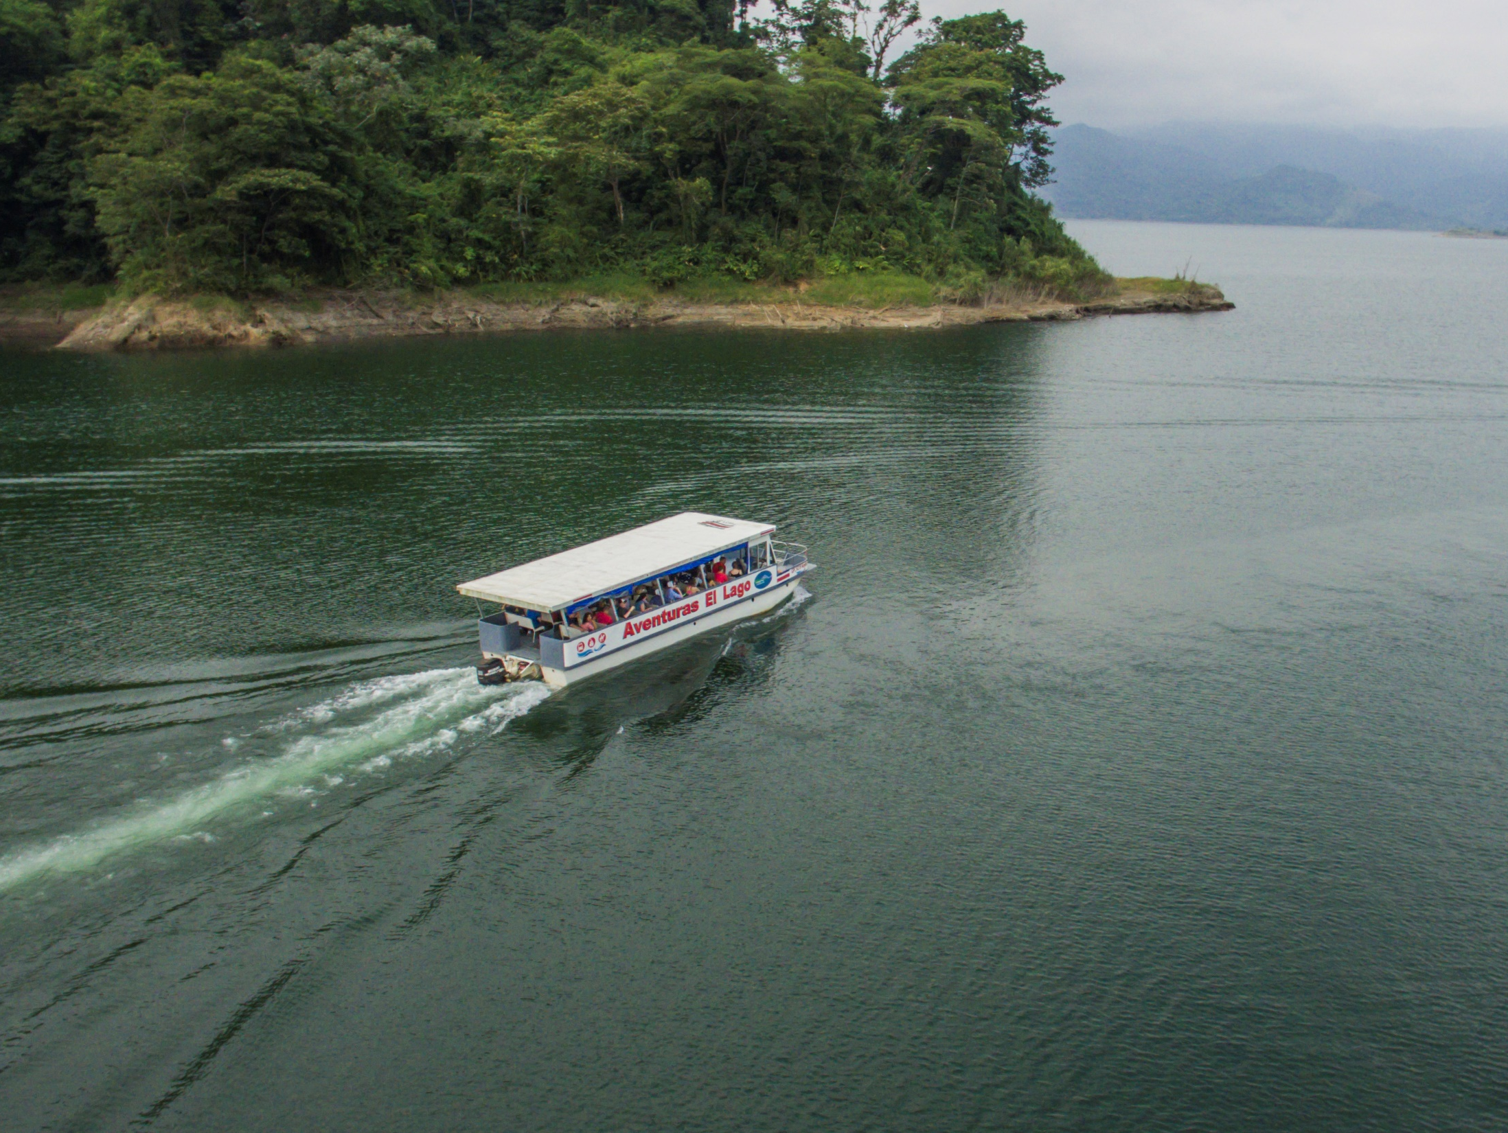

Slide 54
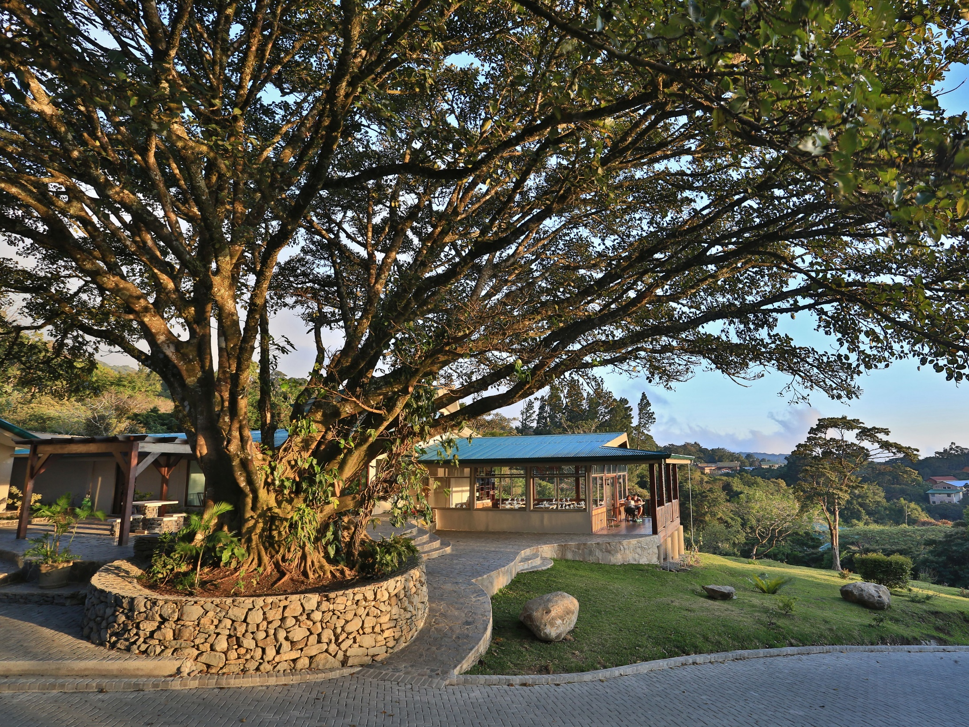
Senda Monteverde Hotel

Slide 55
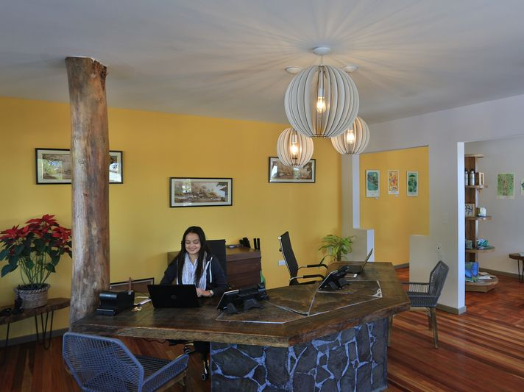

Slide 56
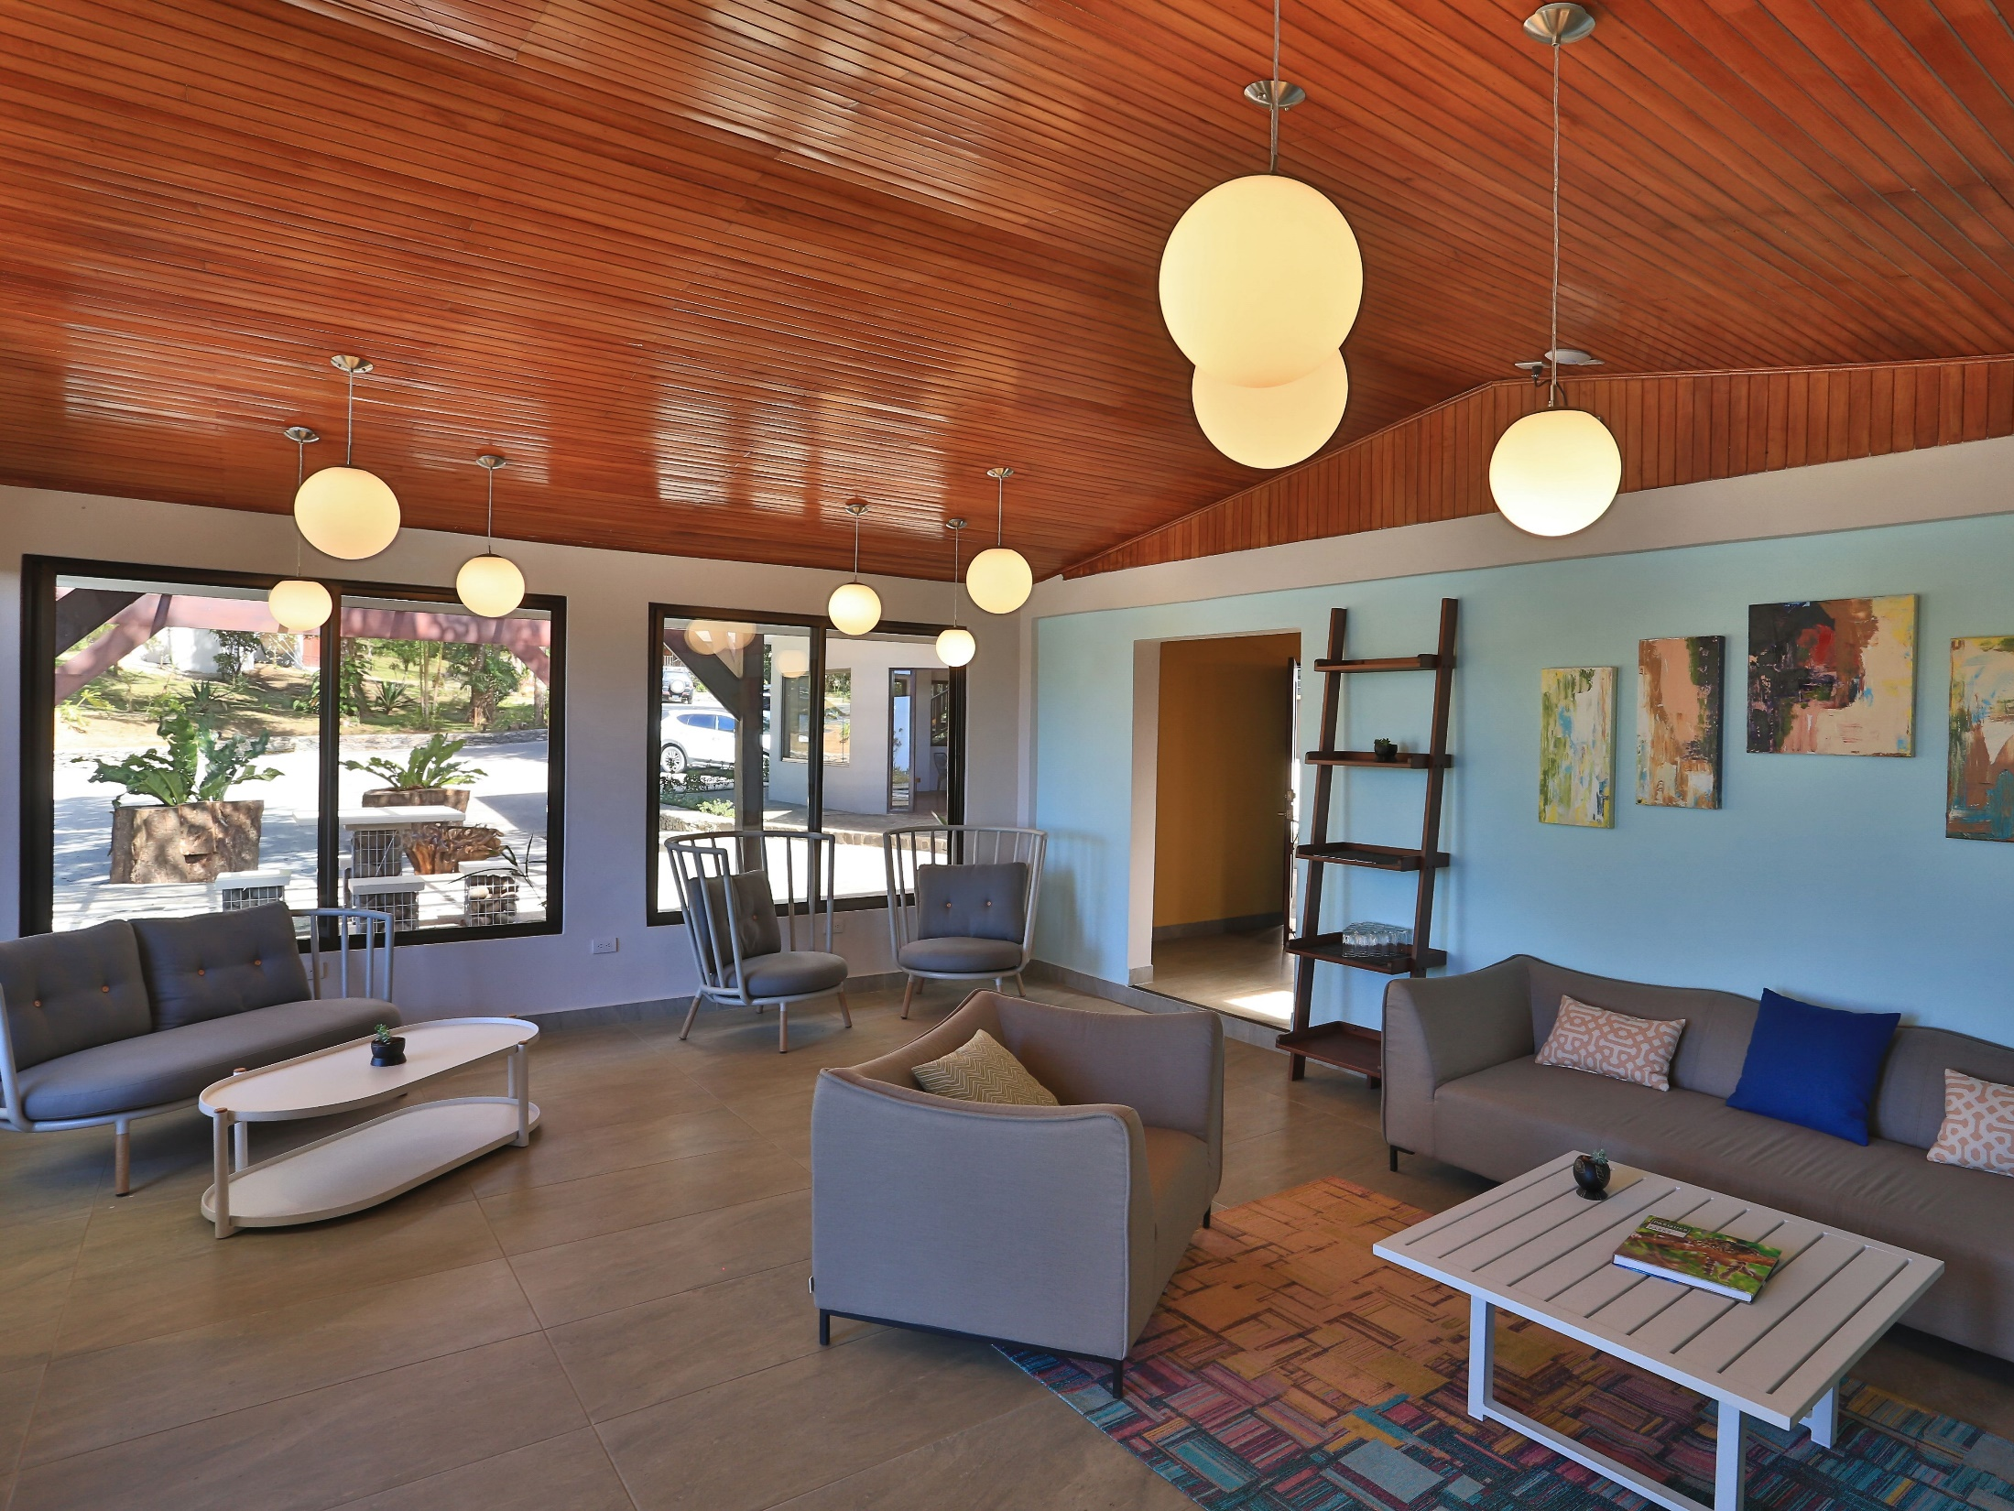

Slide 57
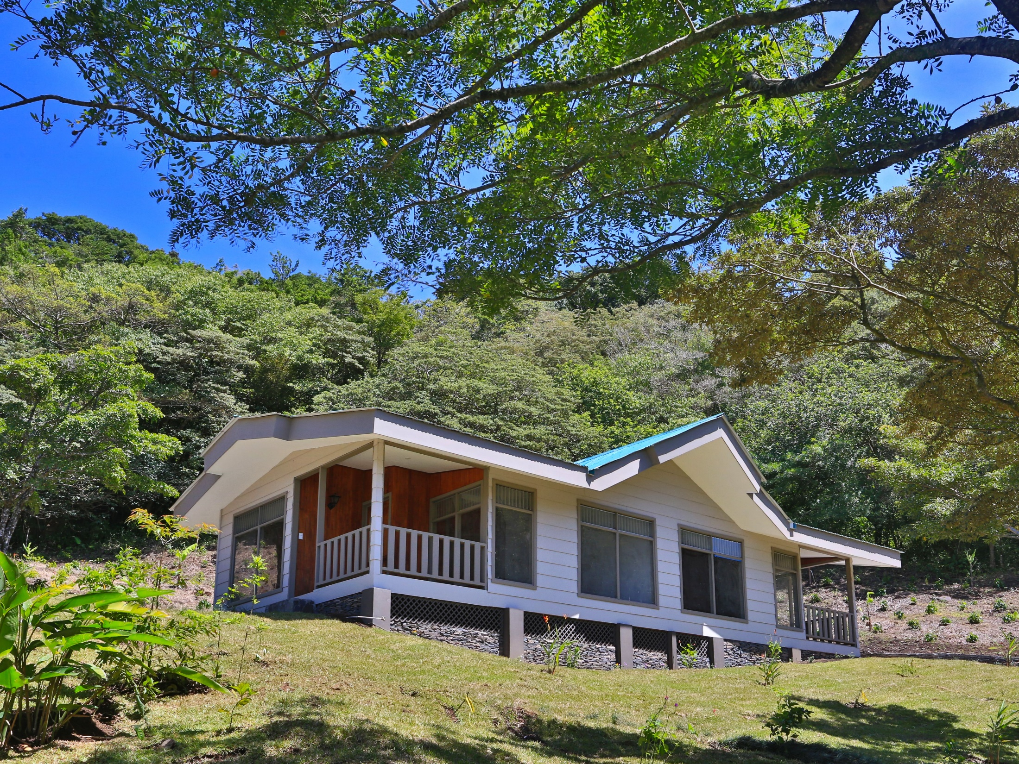

Slide 58
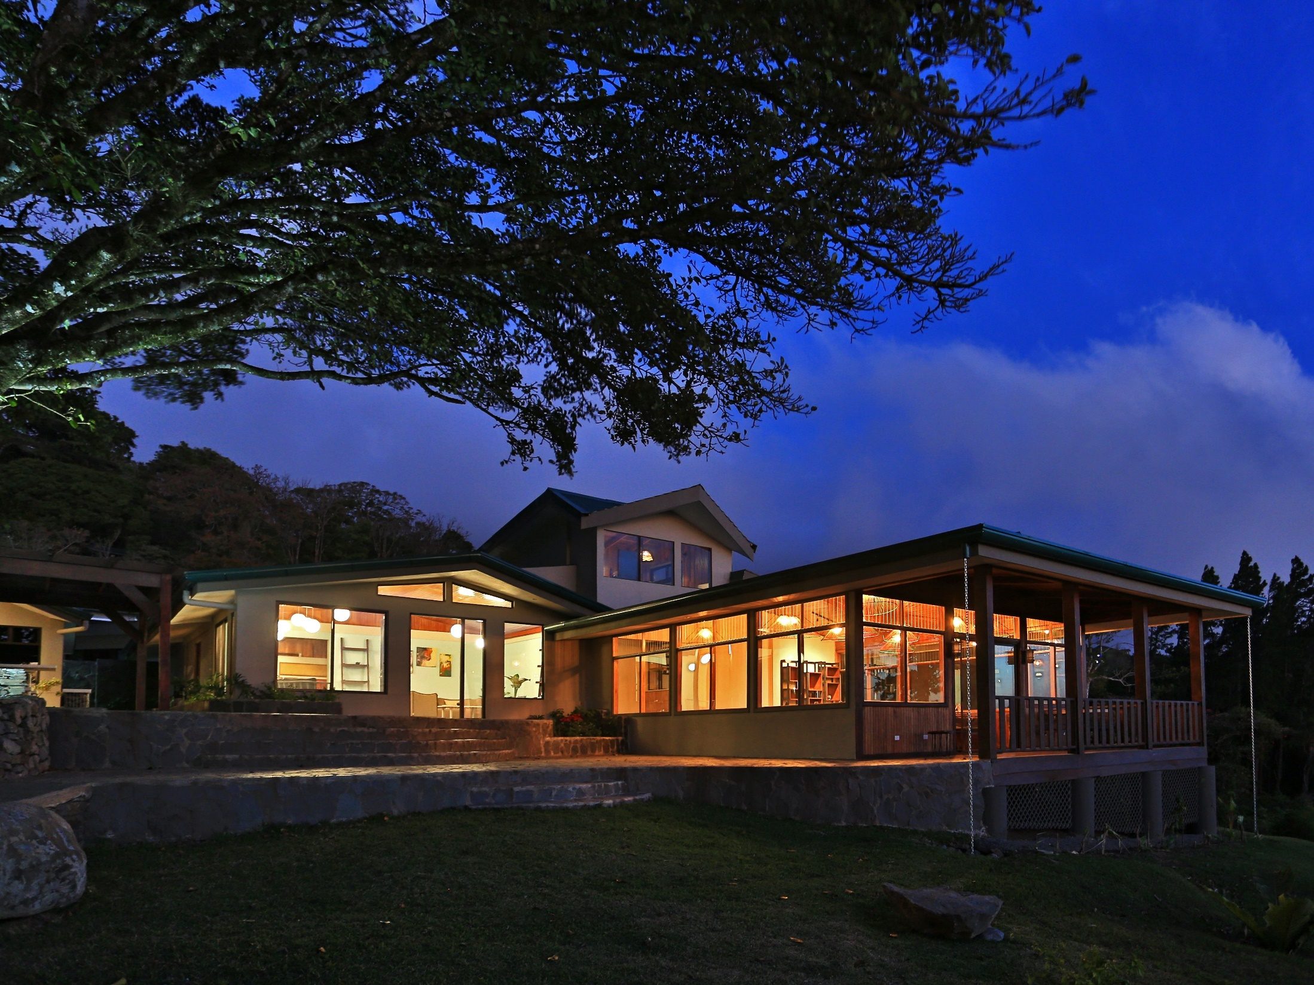

Slide 59


Slide 60

Sky Tram

Slide 61

Sky Trek
ó

Slide 62


Slide 63


Slide 64


Slide 65


Slide 66

Central Pacific
Manuel Antonio

Slide 67

Parador Hotel

Slide 68
Hotel Parador
Introducing Parador Resort & Spa, a place where Green is more than just a color. The resort is considered a one-of-a-kind, from its elegant Mediterranean-inspired architecture, its lush tropical garden, to the staggering panoramic Pacific Ocean views. With 129 rooms and suites, Parador Resort & Spa offers all the amenities expected for a four-star resort, while maintaining an intimate, serene atmosphere.
Dinner at leisure
Overnight at Hotel Parador “Vista Suite”

Slide 69


Slide 70


Slide 72


Slide 73




Parque Nacional Manuel Antonio

Slide 74
Manuel Antonio National Park
Take a leisurely stroll or an intense hike, with a highly trained naturalist guide, through our exotic bio-diverse tropical rain forest preserved in the last 34 year as national treasure, Manuel Antonio National Park.
The pace of this adventure is determined by your abilities and interests, and the abundance of wildlife you want to stop and observe, all in its natural and breathtaking habitat. Watch sloths and numerous species of monkeys travel through the tree canopy, hunt for nocturnal silky ant eaters and several types of non-poisonous snakes resting in the tropical rain forest, and listen to the songs of the various birds as they glide above your group, curiously looking for adventure. And if you are lucky, you might spot one of the only 1,000 remaining endangered Titi or squirrel monkey.
See how many different kinds of flora and fauna you can spot just in the span of a 2 ½ hour nature walk or hike.

Slide 75


Slide 76

Costa Rica
Pura Vida

