Slide 1



SNAP FINANCE
APRIL, 2022

Slide 2
COSTA RICA
Costa Rica covers an area of 20,000.00 square miles. It is located on the southern tip of Central America, between the Pacific Ocean and the Caribbean which allows it to be a privileged spot. The average temperature fluctuates between 20 ºC (68 ºF) - 26 ºC (79 ºF) degrees all year around. The "green season" runs from May until November; Dry season, the equivalent of summer, starts in November ending in April.
The population is 5,000,000 of mostly white race, descendants from the Spaniards who arrived during the XVI century. There are 2 minority groups: one whose origin is Jamaica 50.000 people, and few tribes of native Indians about 10,000.
The religion is Catholic. Currency is the "colon".
No inoculations are required.
Voltage: The electric current in Costa Rica is 110 volts and 60 cycles.
To make a phone call to Costa Rica you dial 00-506 followed by the number you are calling.
Due to its position, it has flora and fauna found in both Northern and Southern hemispheres. There are 760 species of birds (more than the US and Canada combined), 900 species of plants, 1200 species of orchids, and ten percent of the world's butterflies. This tiny nation has the international standing in the conservation community for its commitment to preservation of forest and wildlife

Slide 3

General Facts
Government: Presidential Democracy.
Division: 7 provinces.
Capital: San José.
Population: 5.500.000
Official language: Spanish.
Official religion: Catholic.
Currency: Colón (¢).
Electricity: 110 Voltios.
Dry season : Second half November – April (dry).
Green season: May – First half November (rainy).

Slide 4
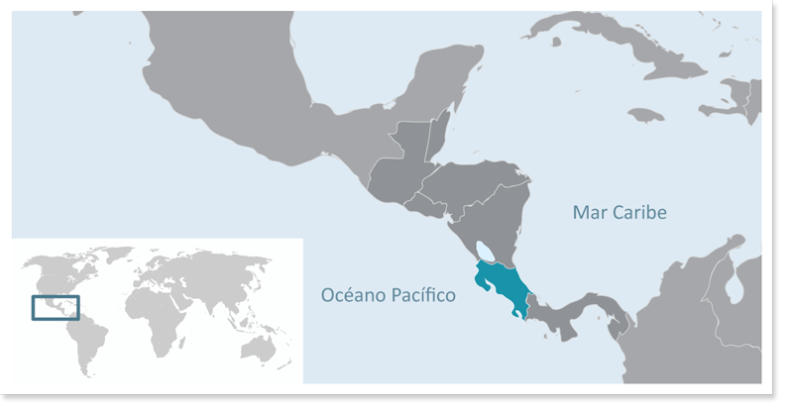
Location
Central America
Limits:
North: Nicaragua.
South: Panamá.
West: Pacific Ocean.
East: Caribbean Sea, Atlantic Ocean.

Slide 5
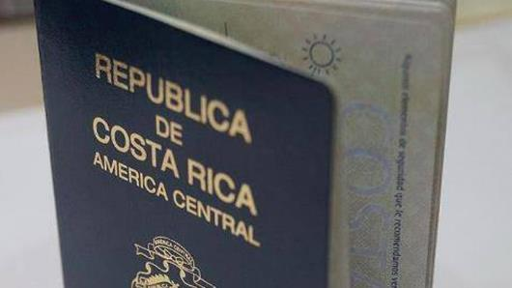
Entrance requirements:
Passport valid for at least 6 months from your date of entry
Please check if clients require the Yellow Fever Vaccine to enter the country: Countries that require Yellow Fever Vaccine
Please check if you require a visa to enter Costa Rica using the following link https://migracion.go.cr/Paginas/Visas.aspx

Slide 6


Aeropuertos Internacionales
Apto. Intl. Juan Santamaría
Apto. Intl. Daniel Oduber

Slide 7
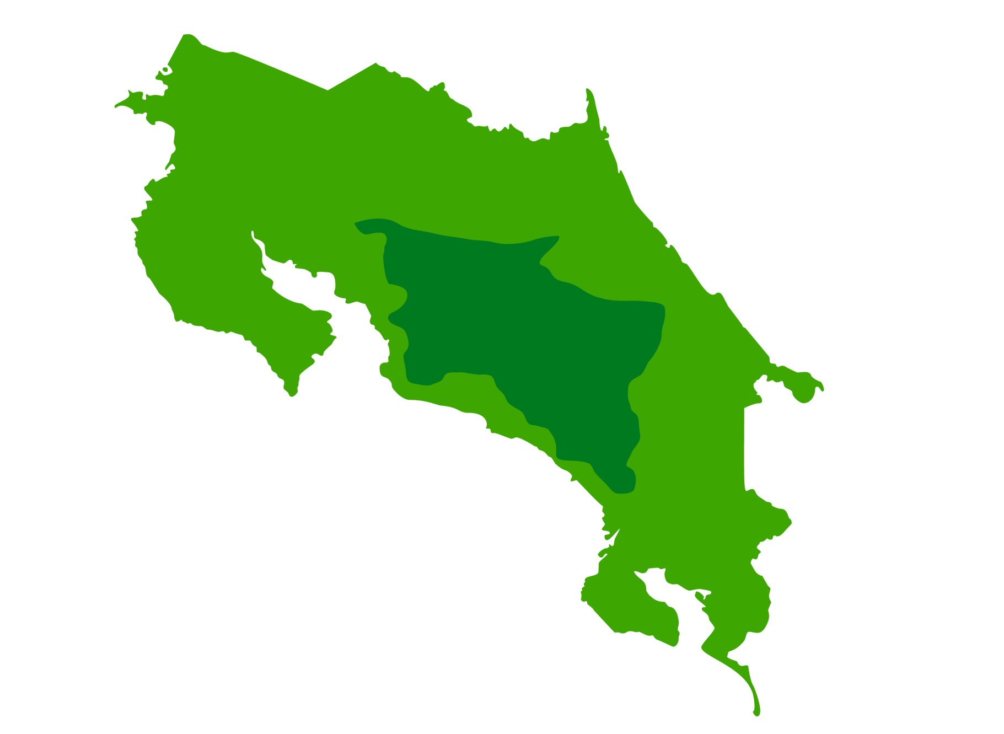
San José
San Jose

Slide 8
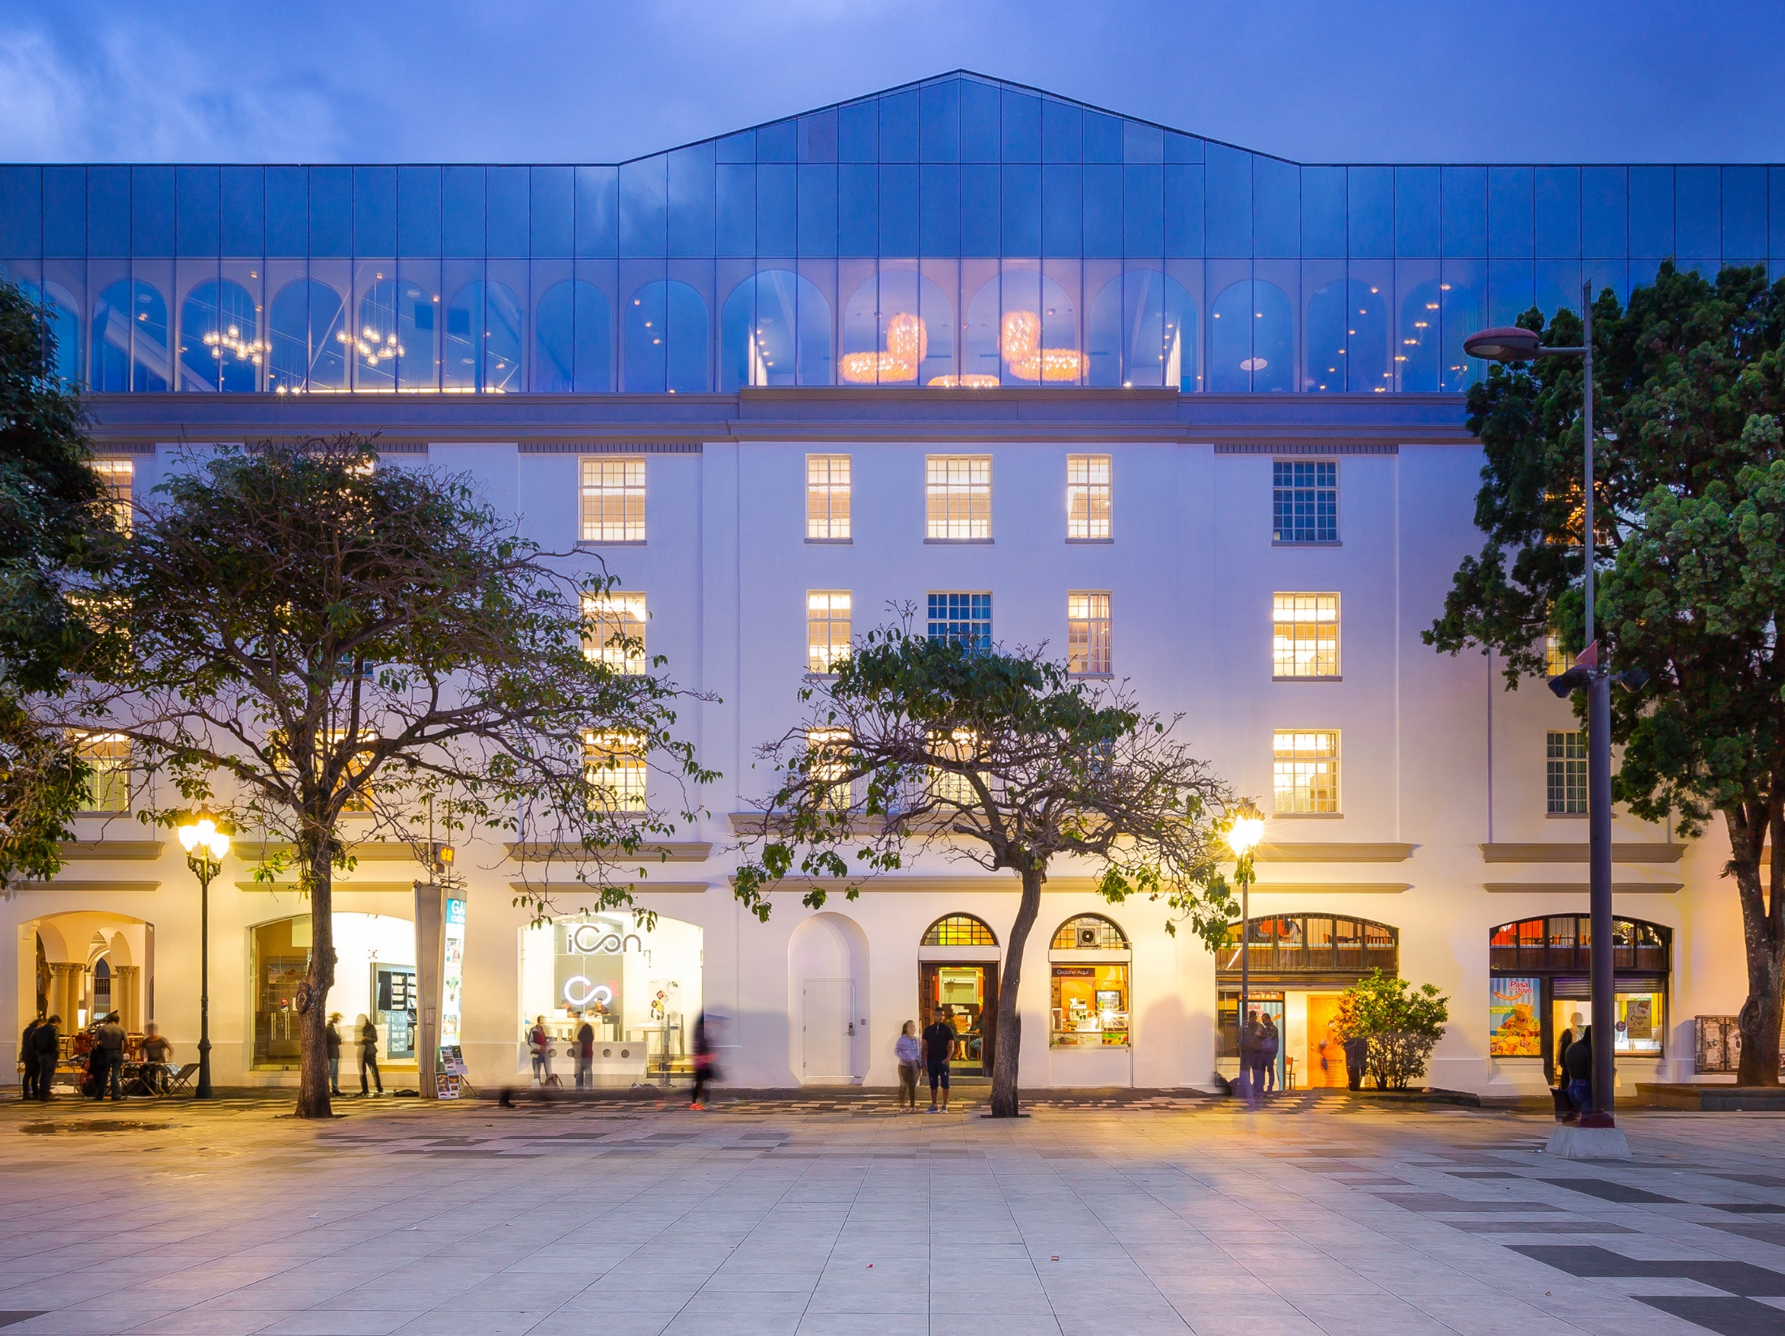
Gran Hotel Costa Rica

Slide 9
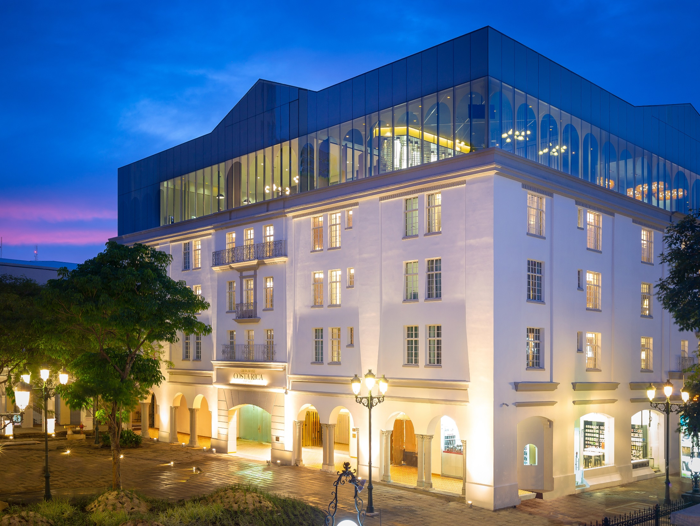

Slide 10
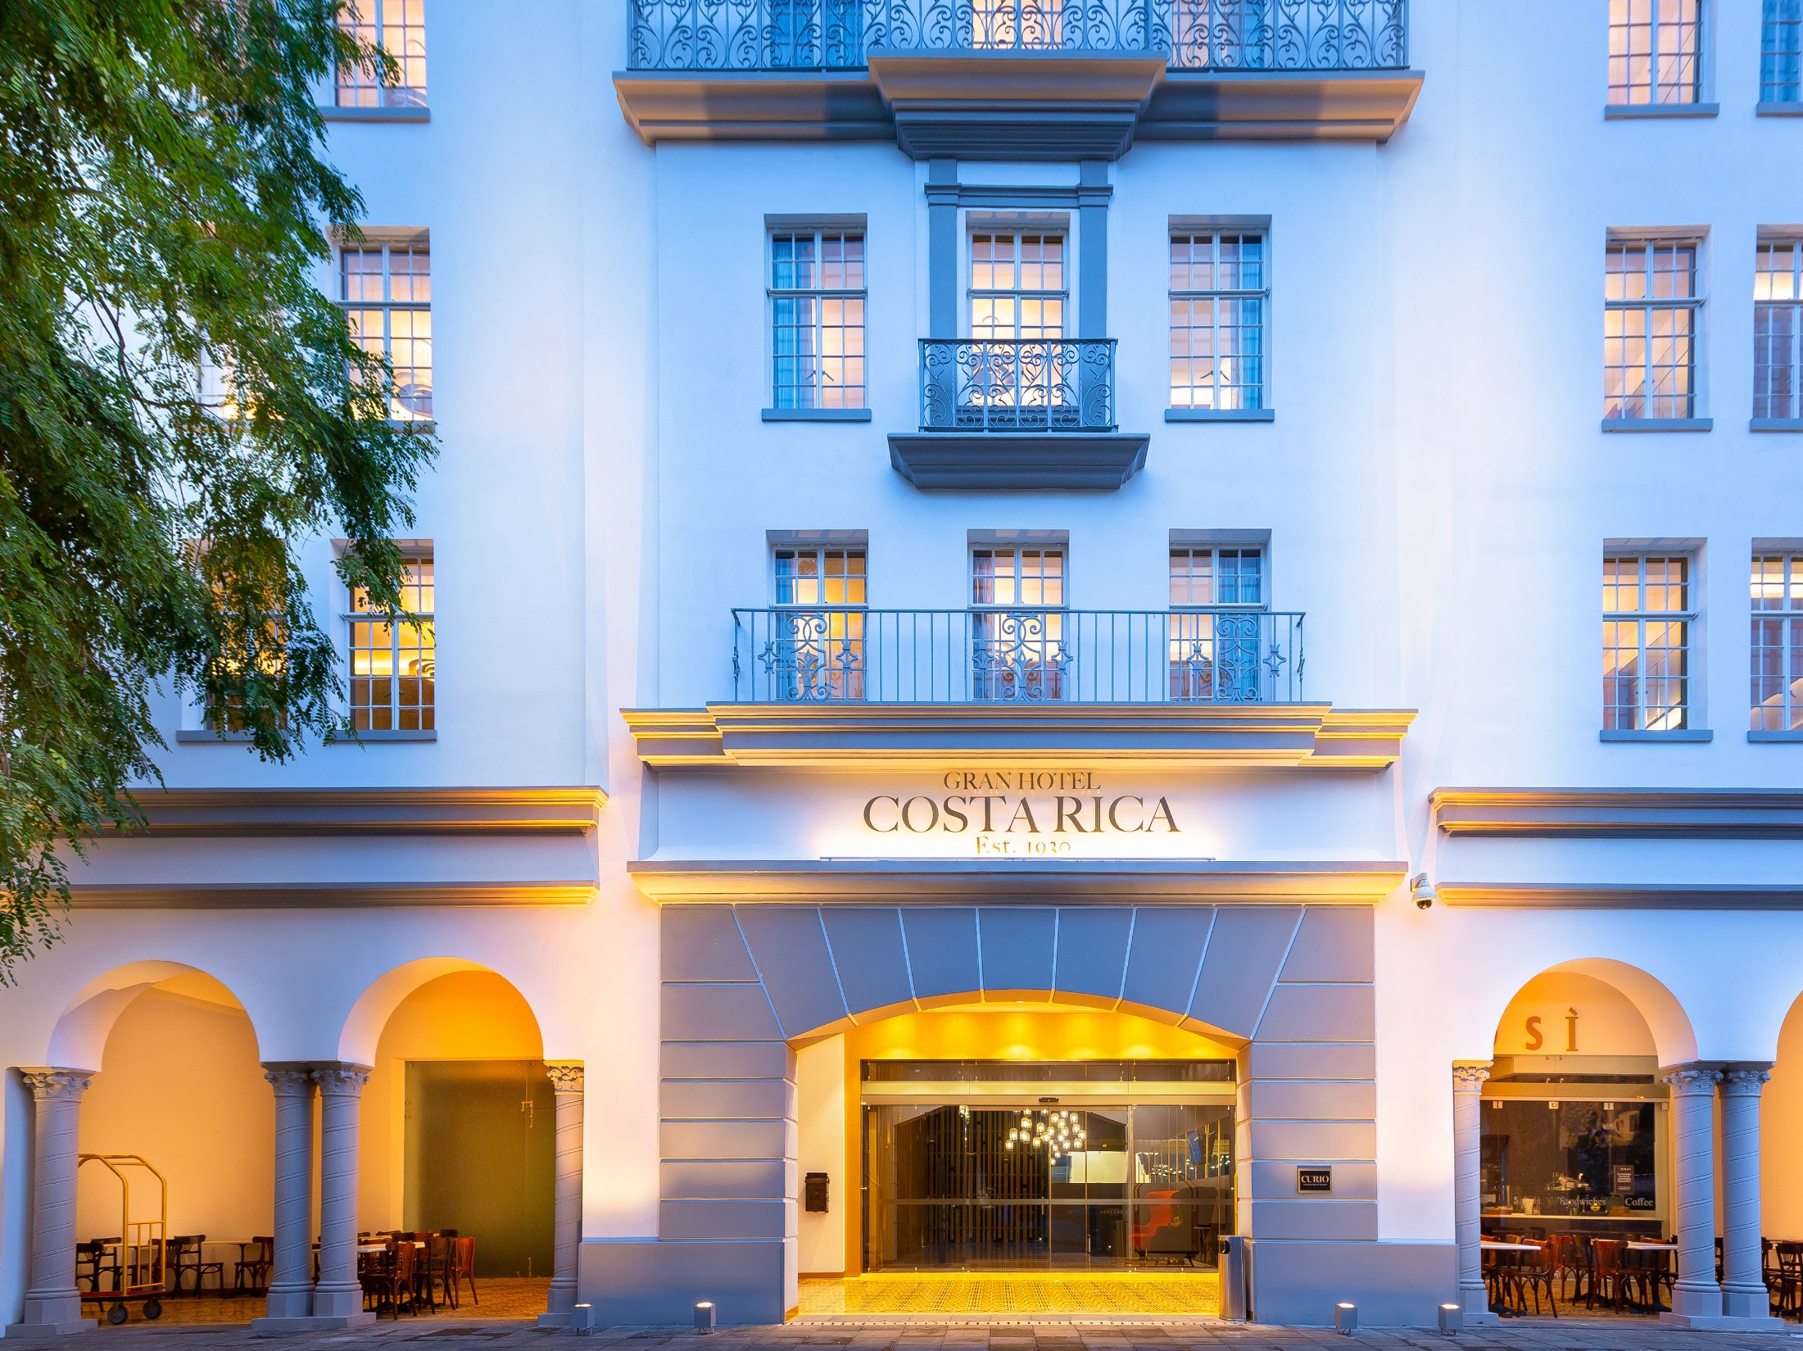

Slide 11
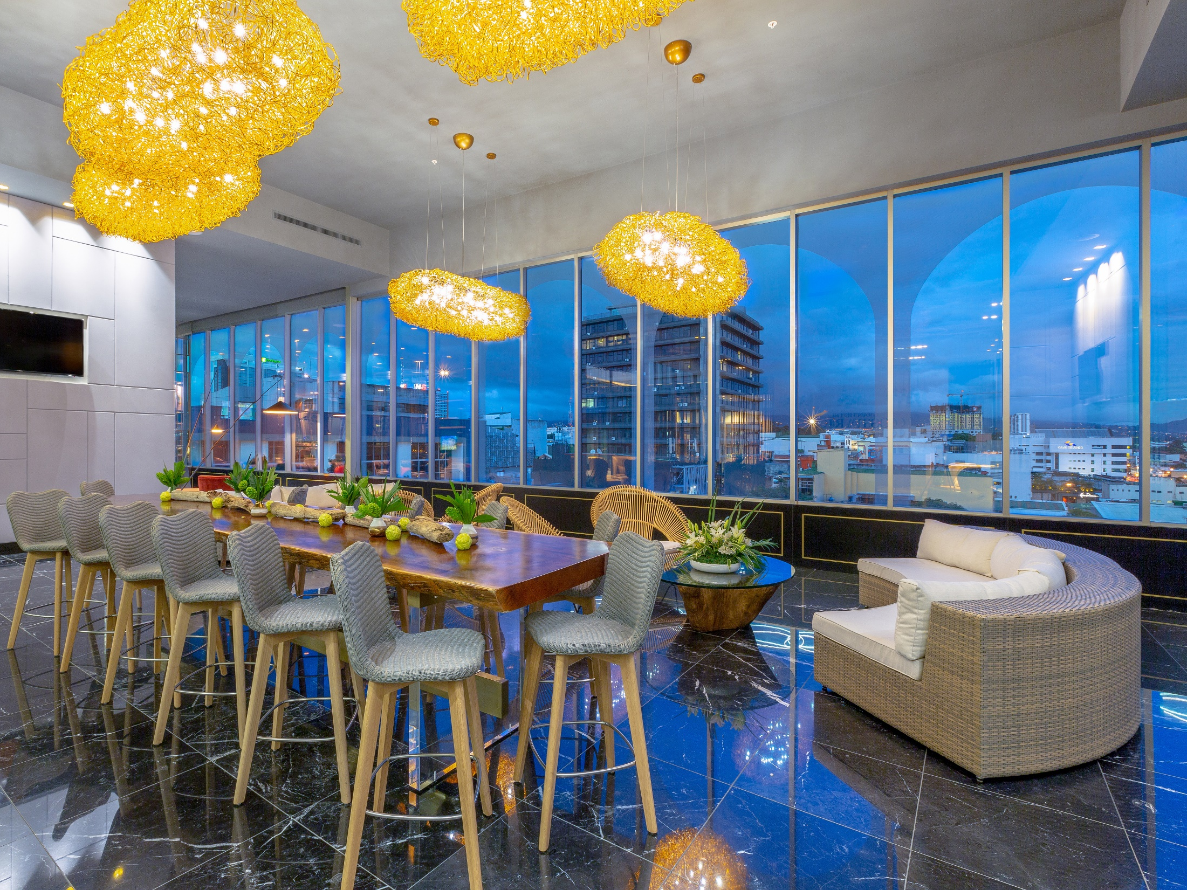

Slide 12


Slide 13
SAN JOSE – PACUARE

Slide 14
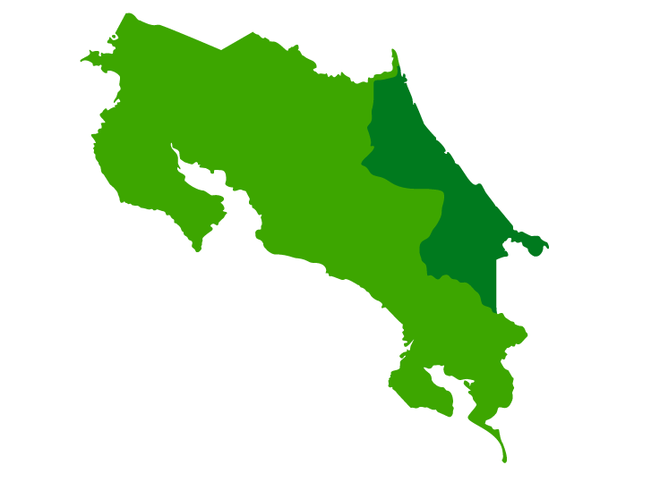
Pacuare
Pacuare

Slide 15
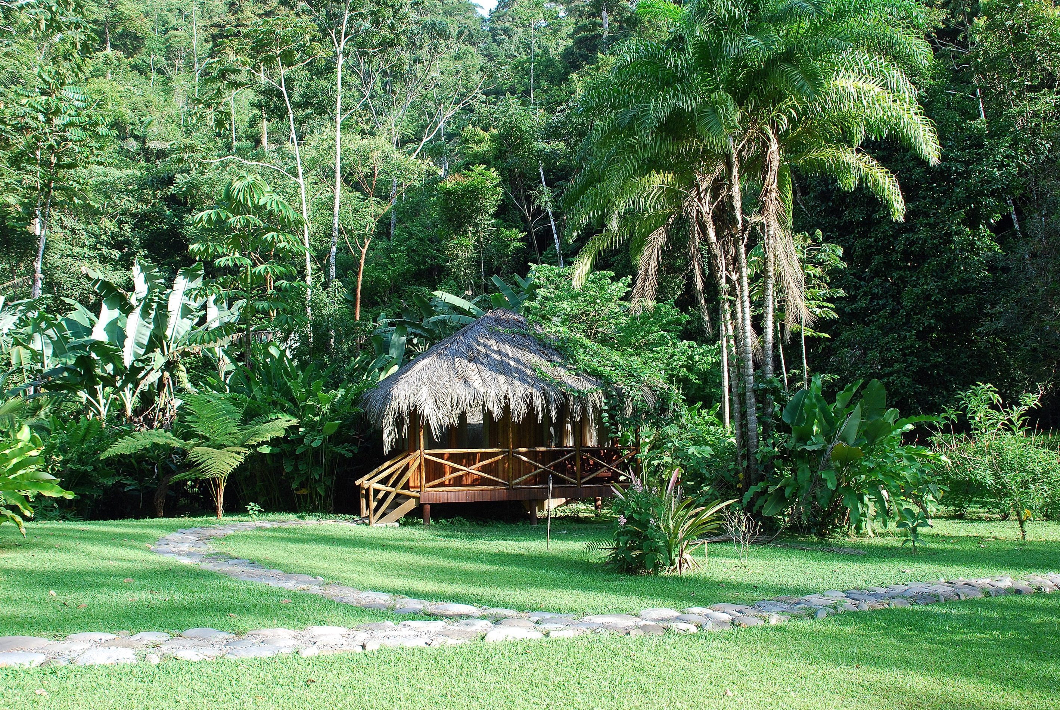
Pacuare Lodge
Limón, Costa Rica

Slide 16
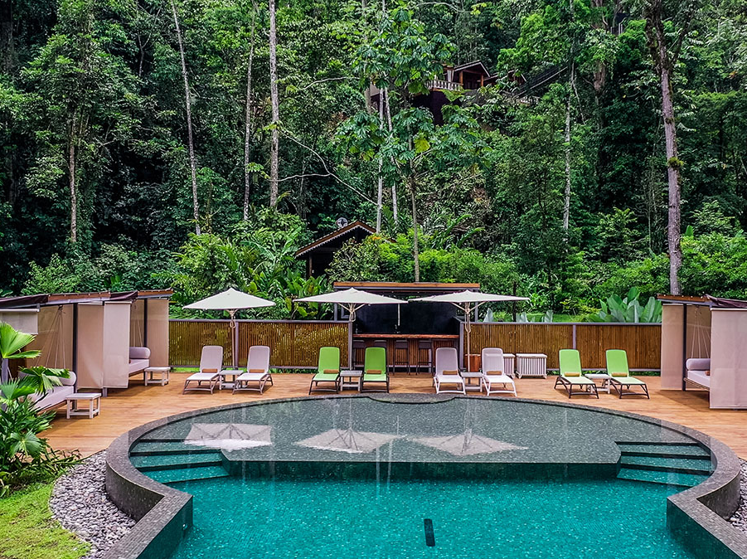

Slide 17
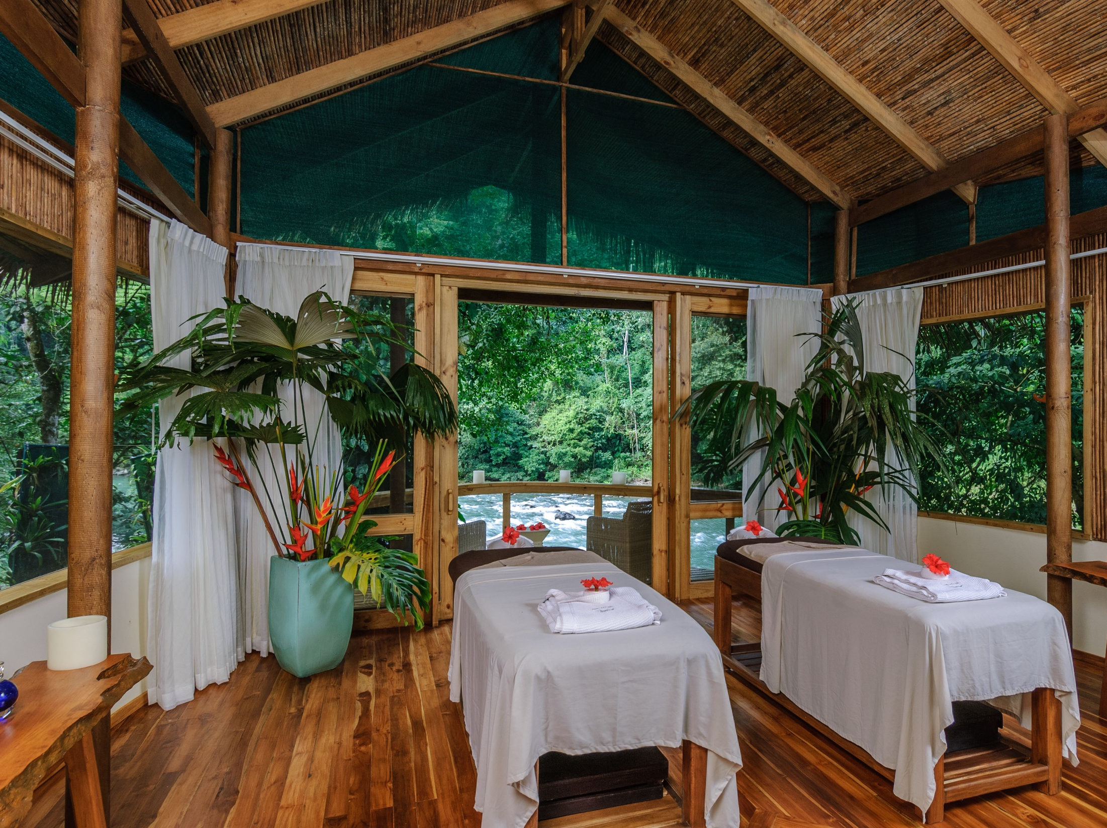

Slide 18
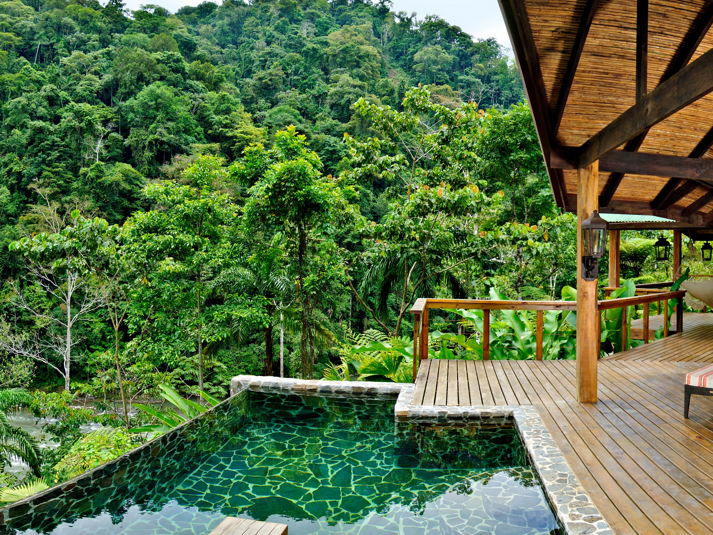
Linda Vista Suite

Slide 19


Slide 20
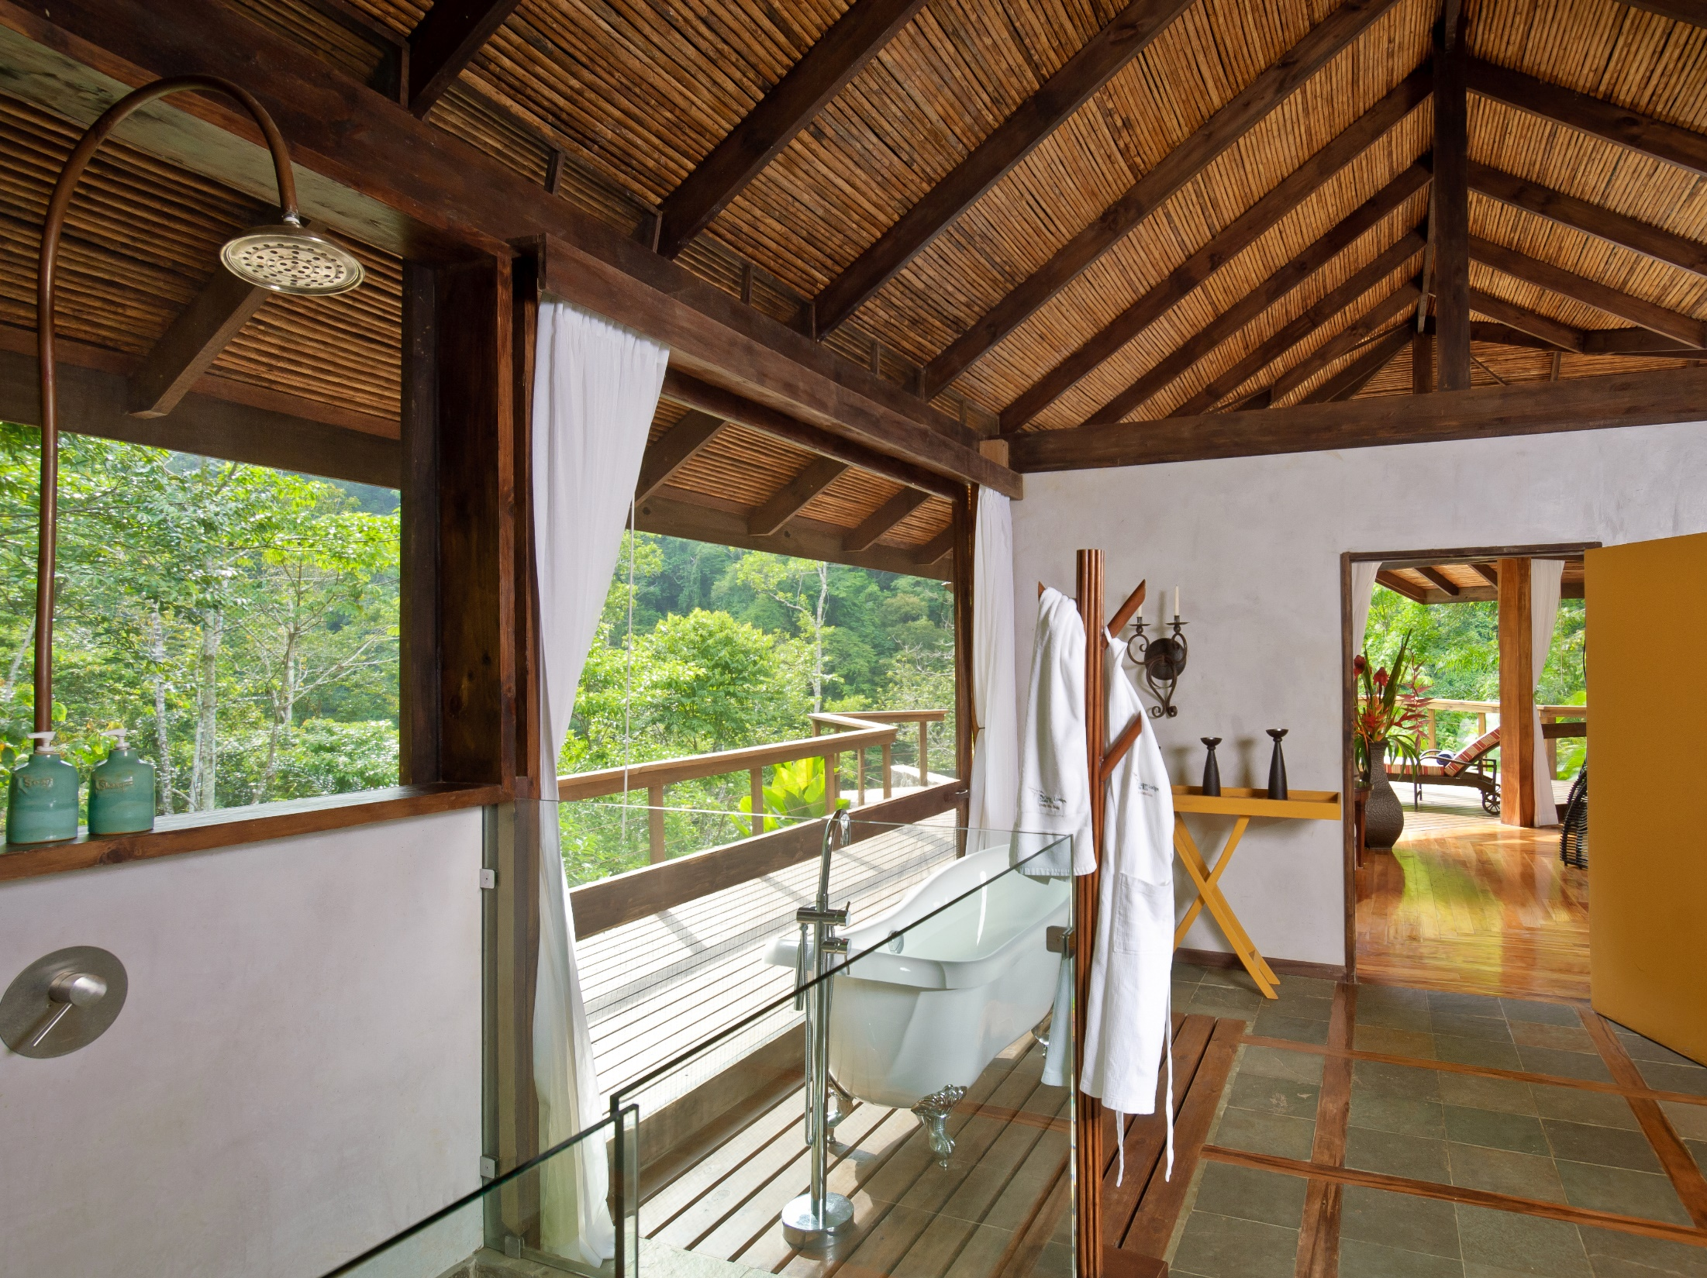

Slide 21
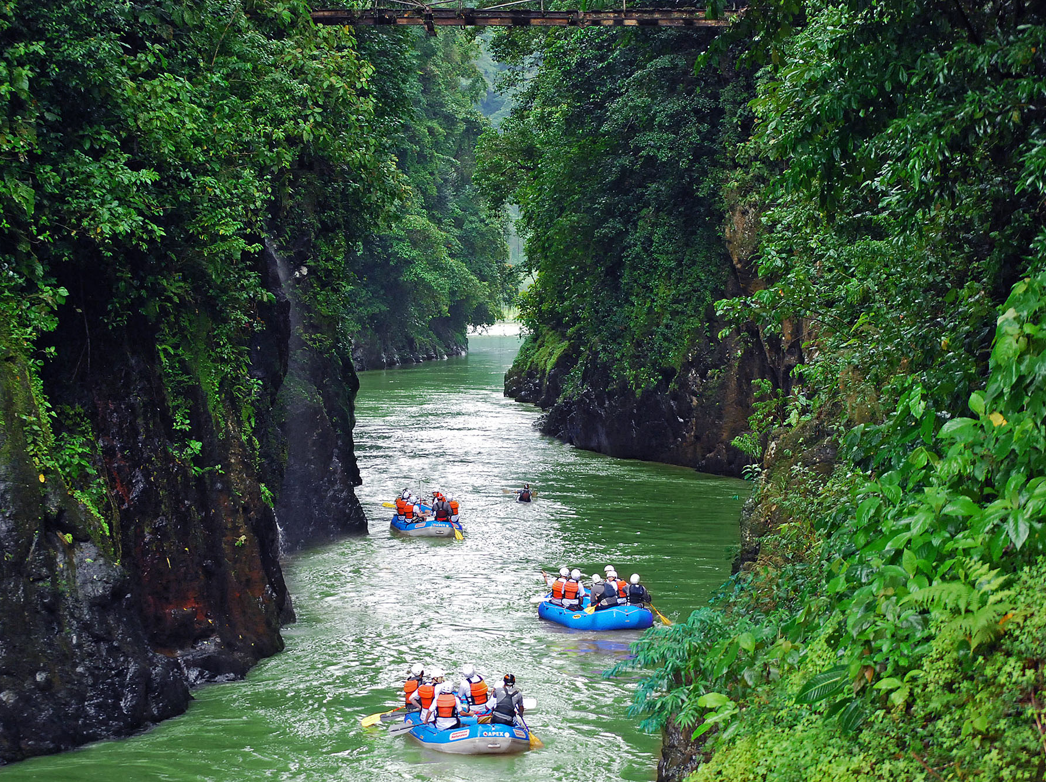

Slide 22

Opcional Experience: Cooking Class Cabecar

Slide 23
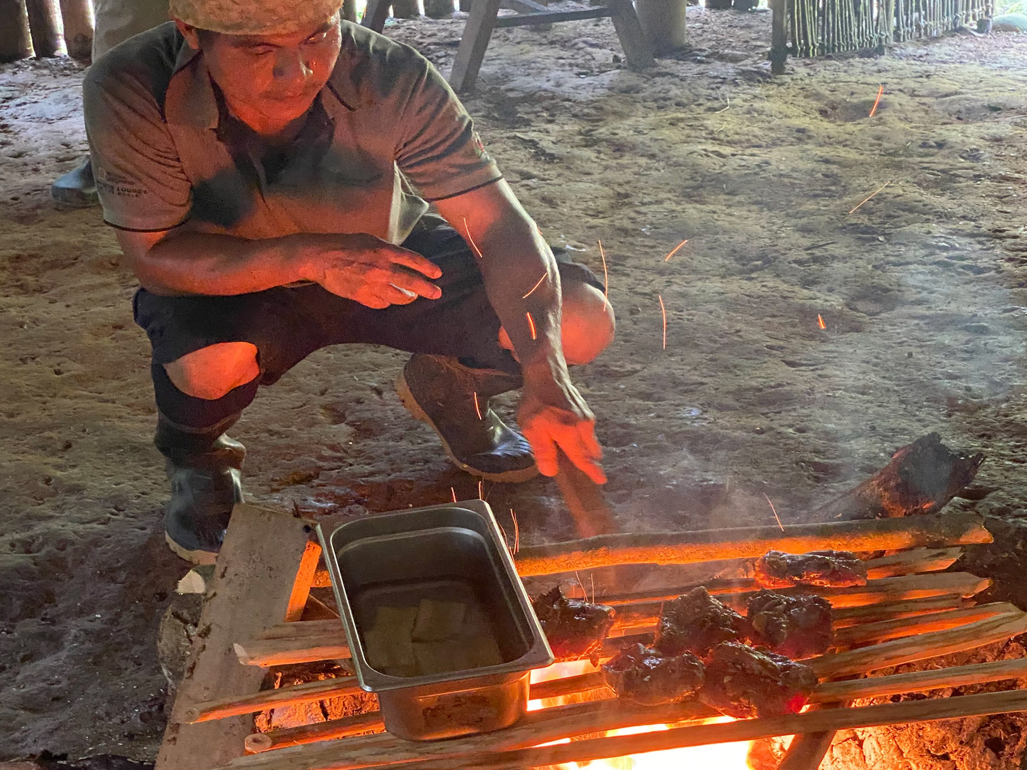

Slide 24
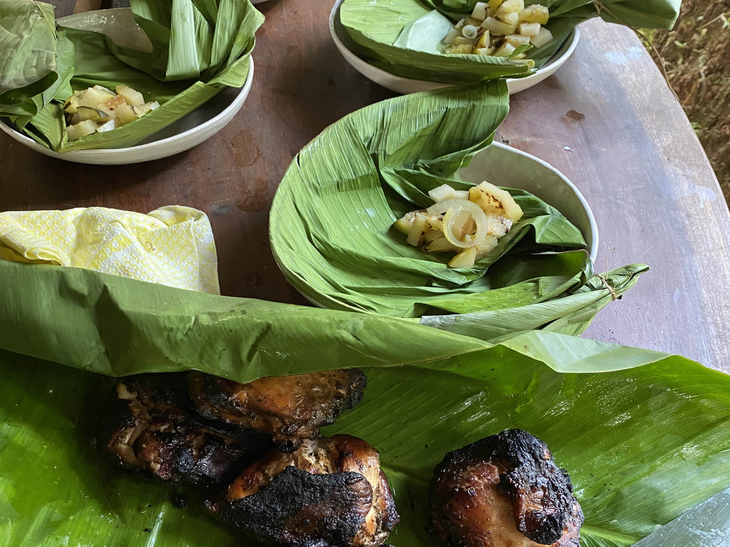

Slide 25
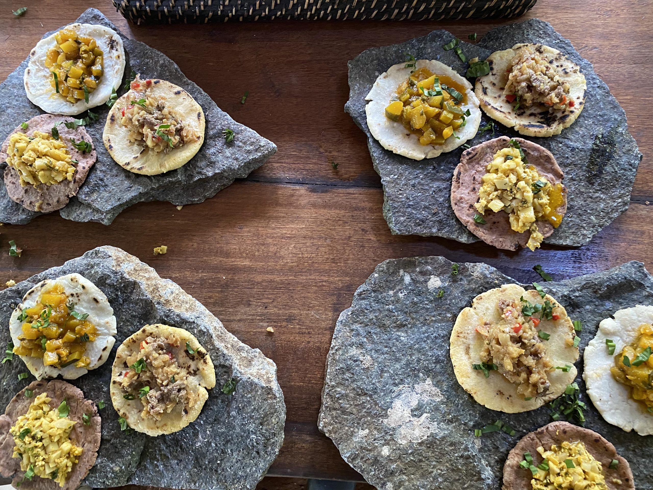

Slide 26
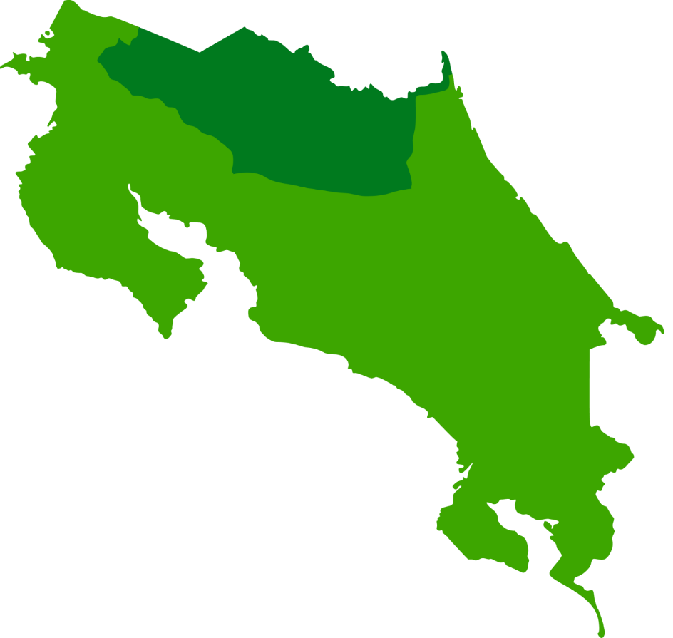
Montaña
La Fortuna - Arenal

Slide 27
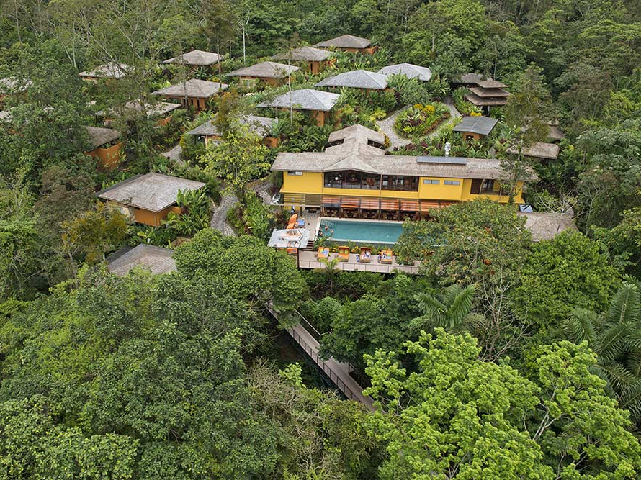
Hotel Arenal Nayara

Slide 28
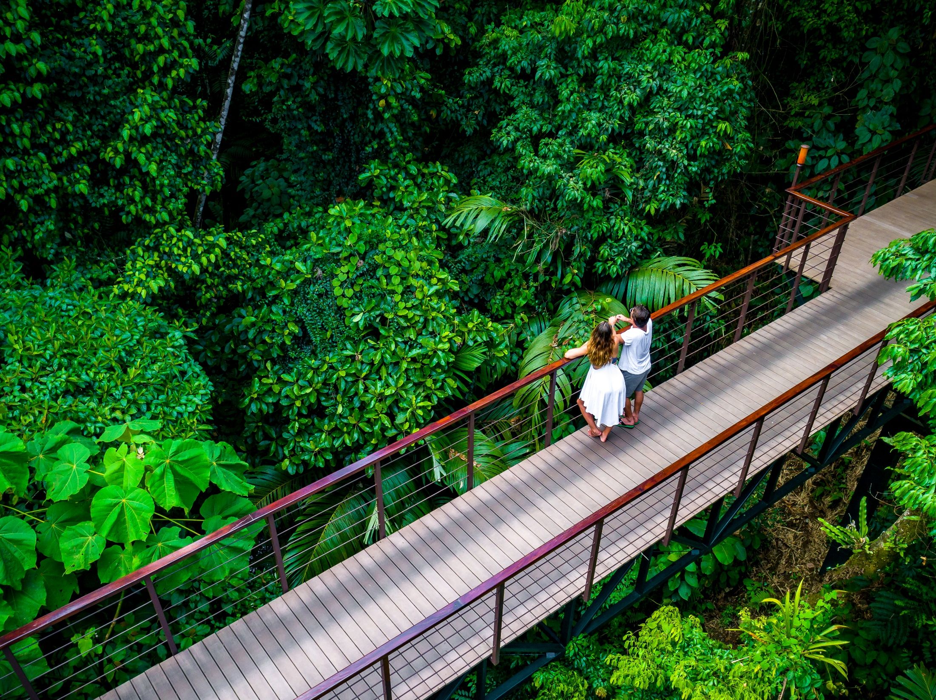

Slide 29
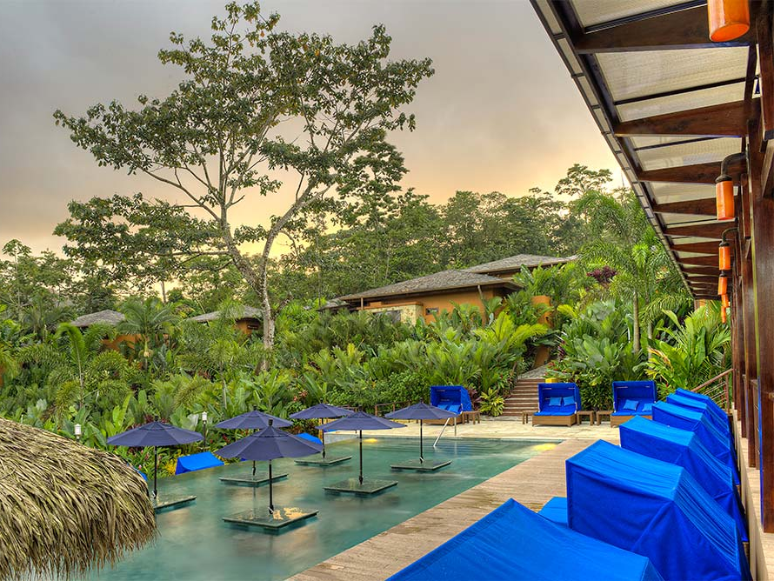

Slide 30
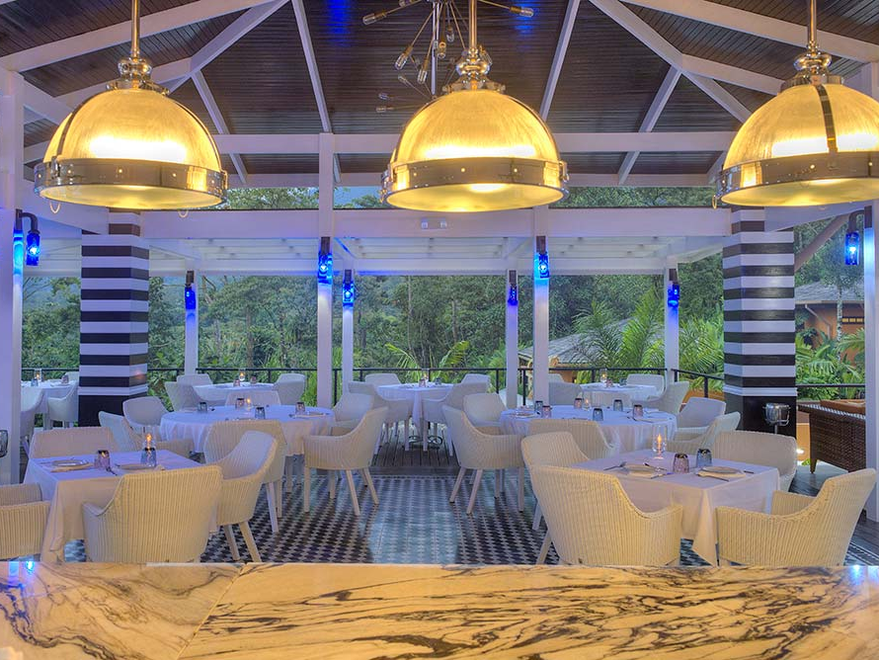

Slide 31
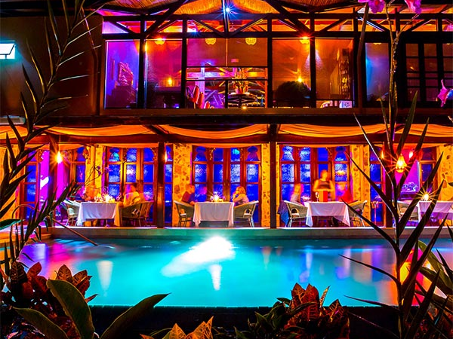

Slide 32


Slide 33
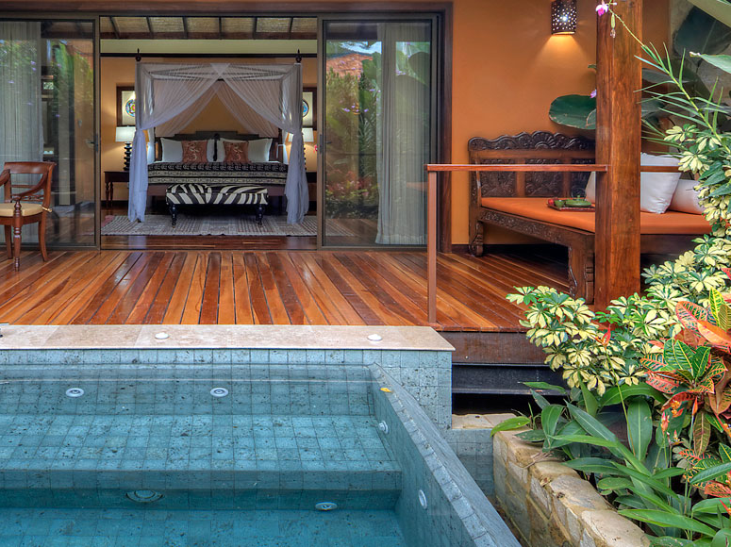

Slide 34
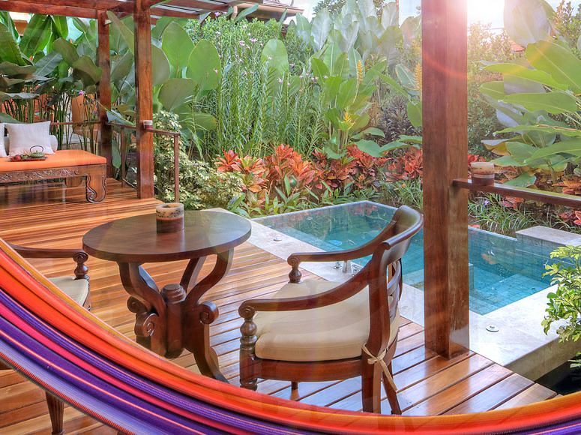

Slide 35
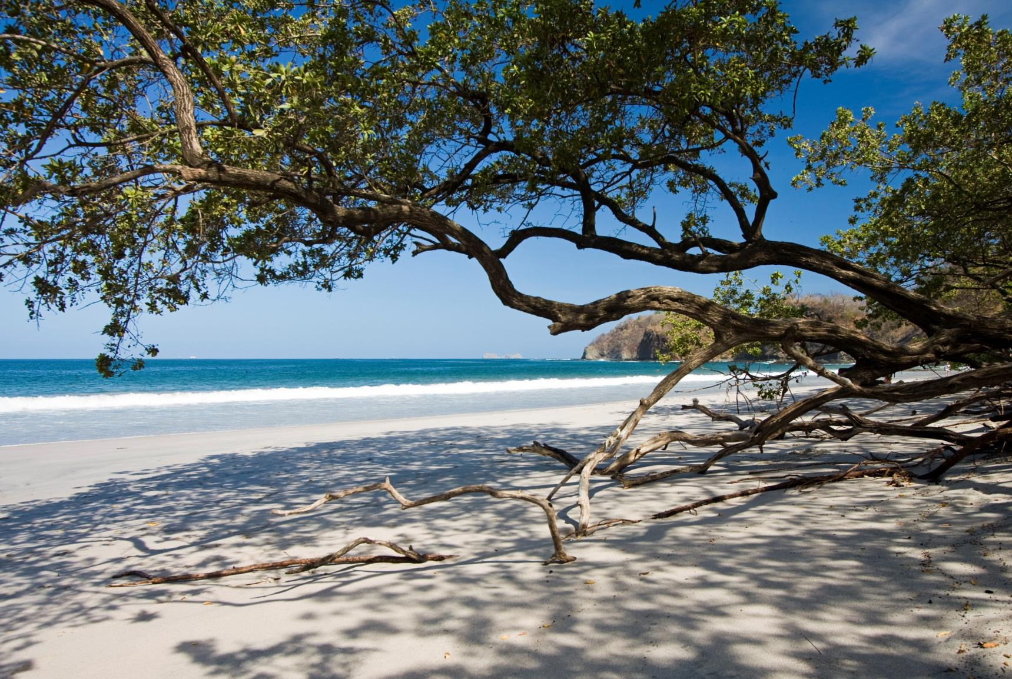
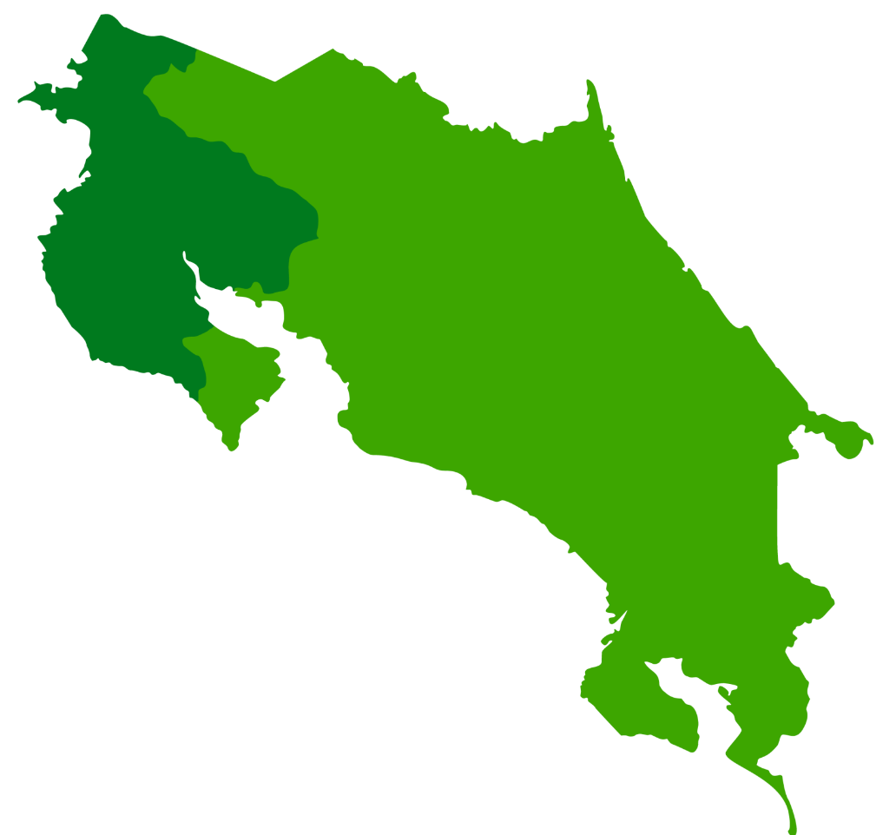
Pacifico Norte – Conchal
Playa Conchal

Slide 36
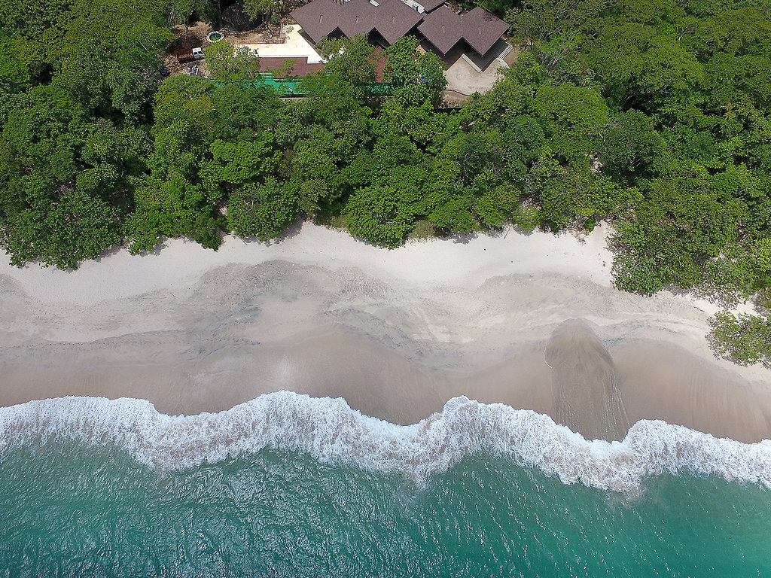
W Reserva Conchal
Playa Conchal, Guanacaste

Slide 37
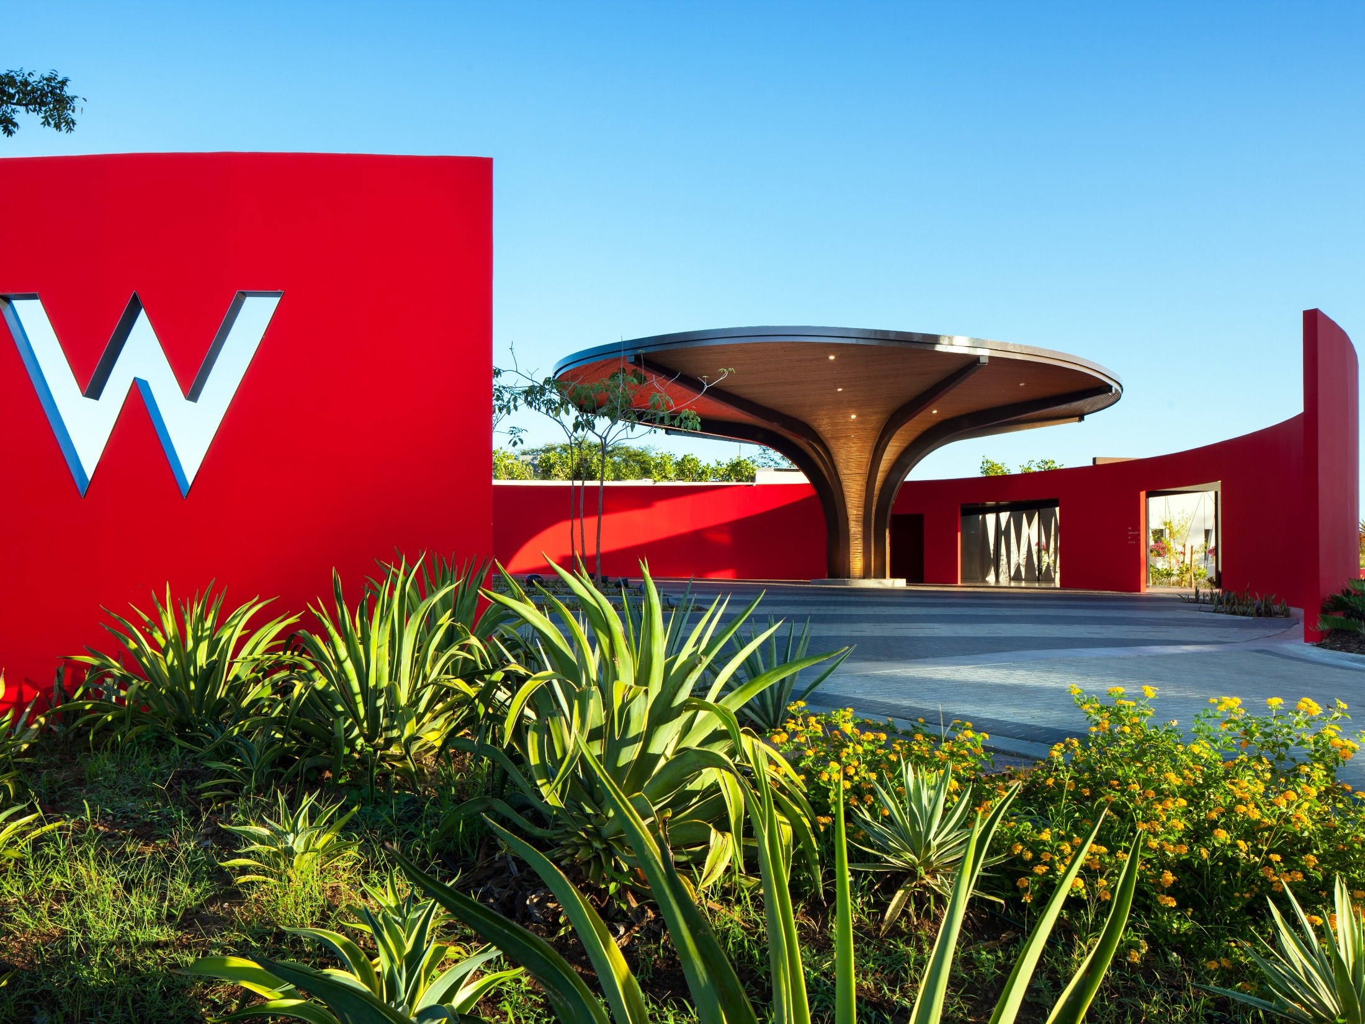

Slide 38
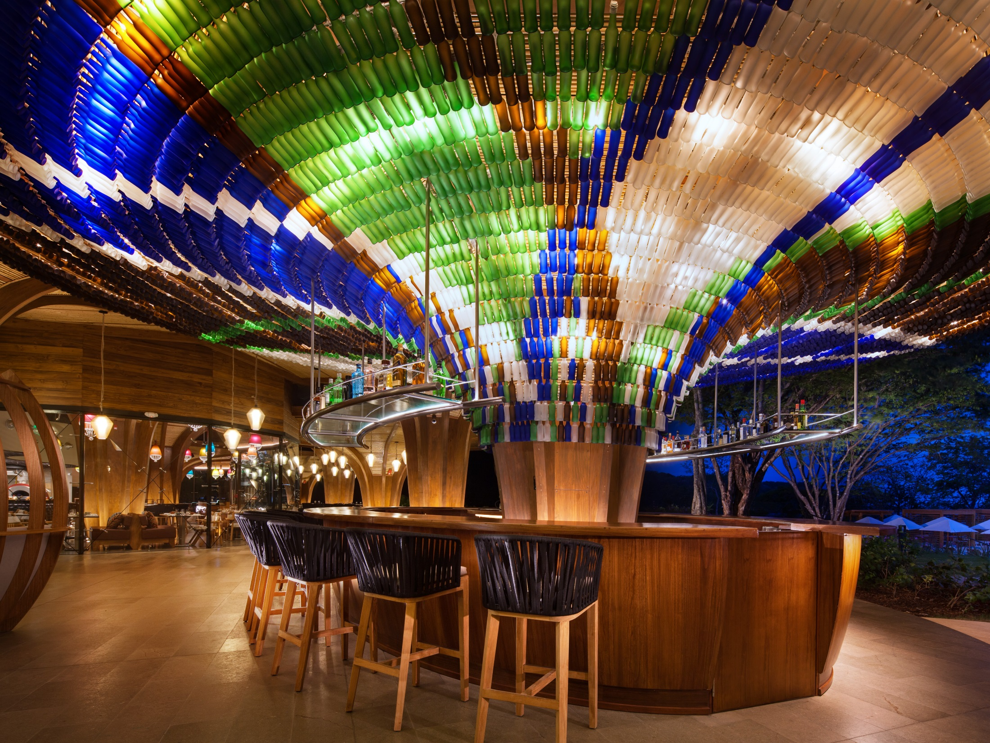

Slide 39
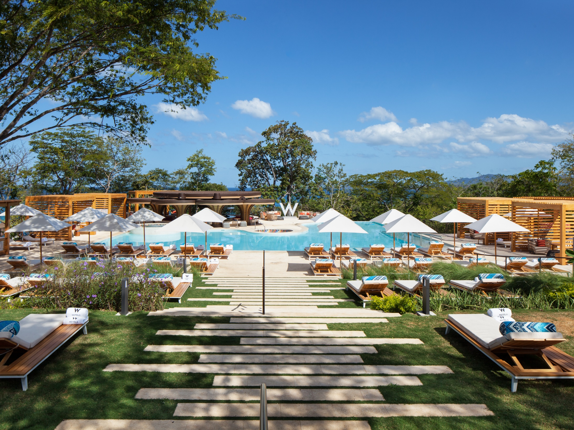

Slide 40
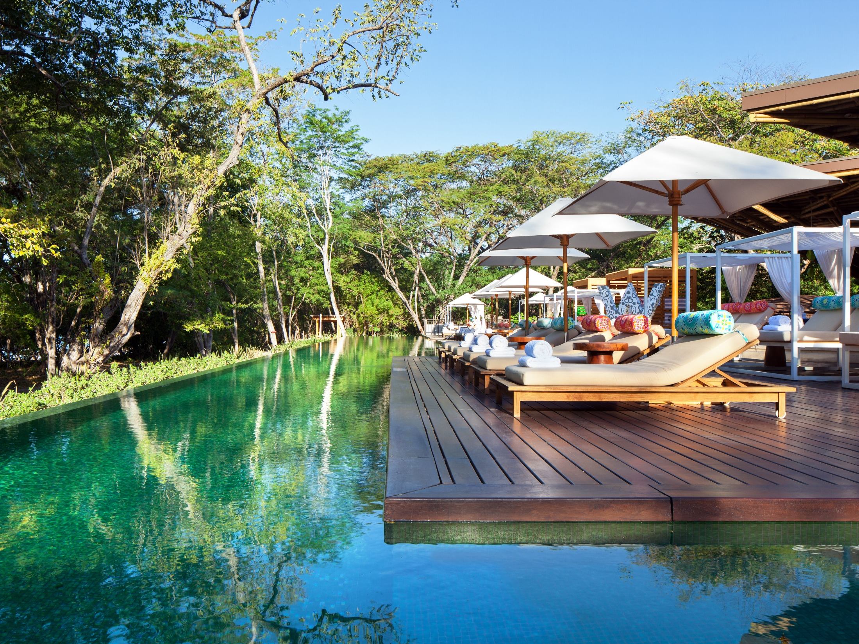

Slide 41
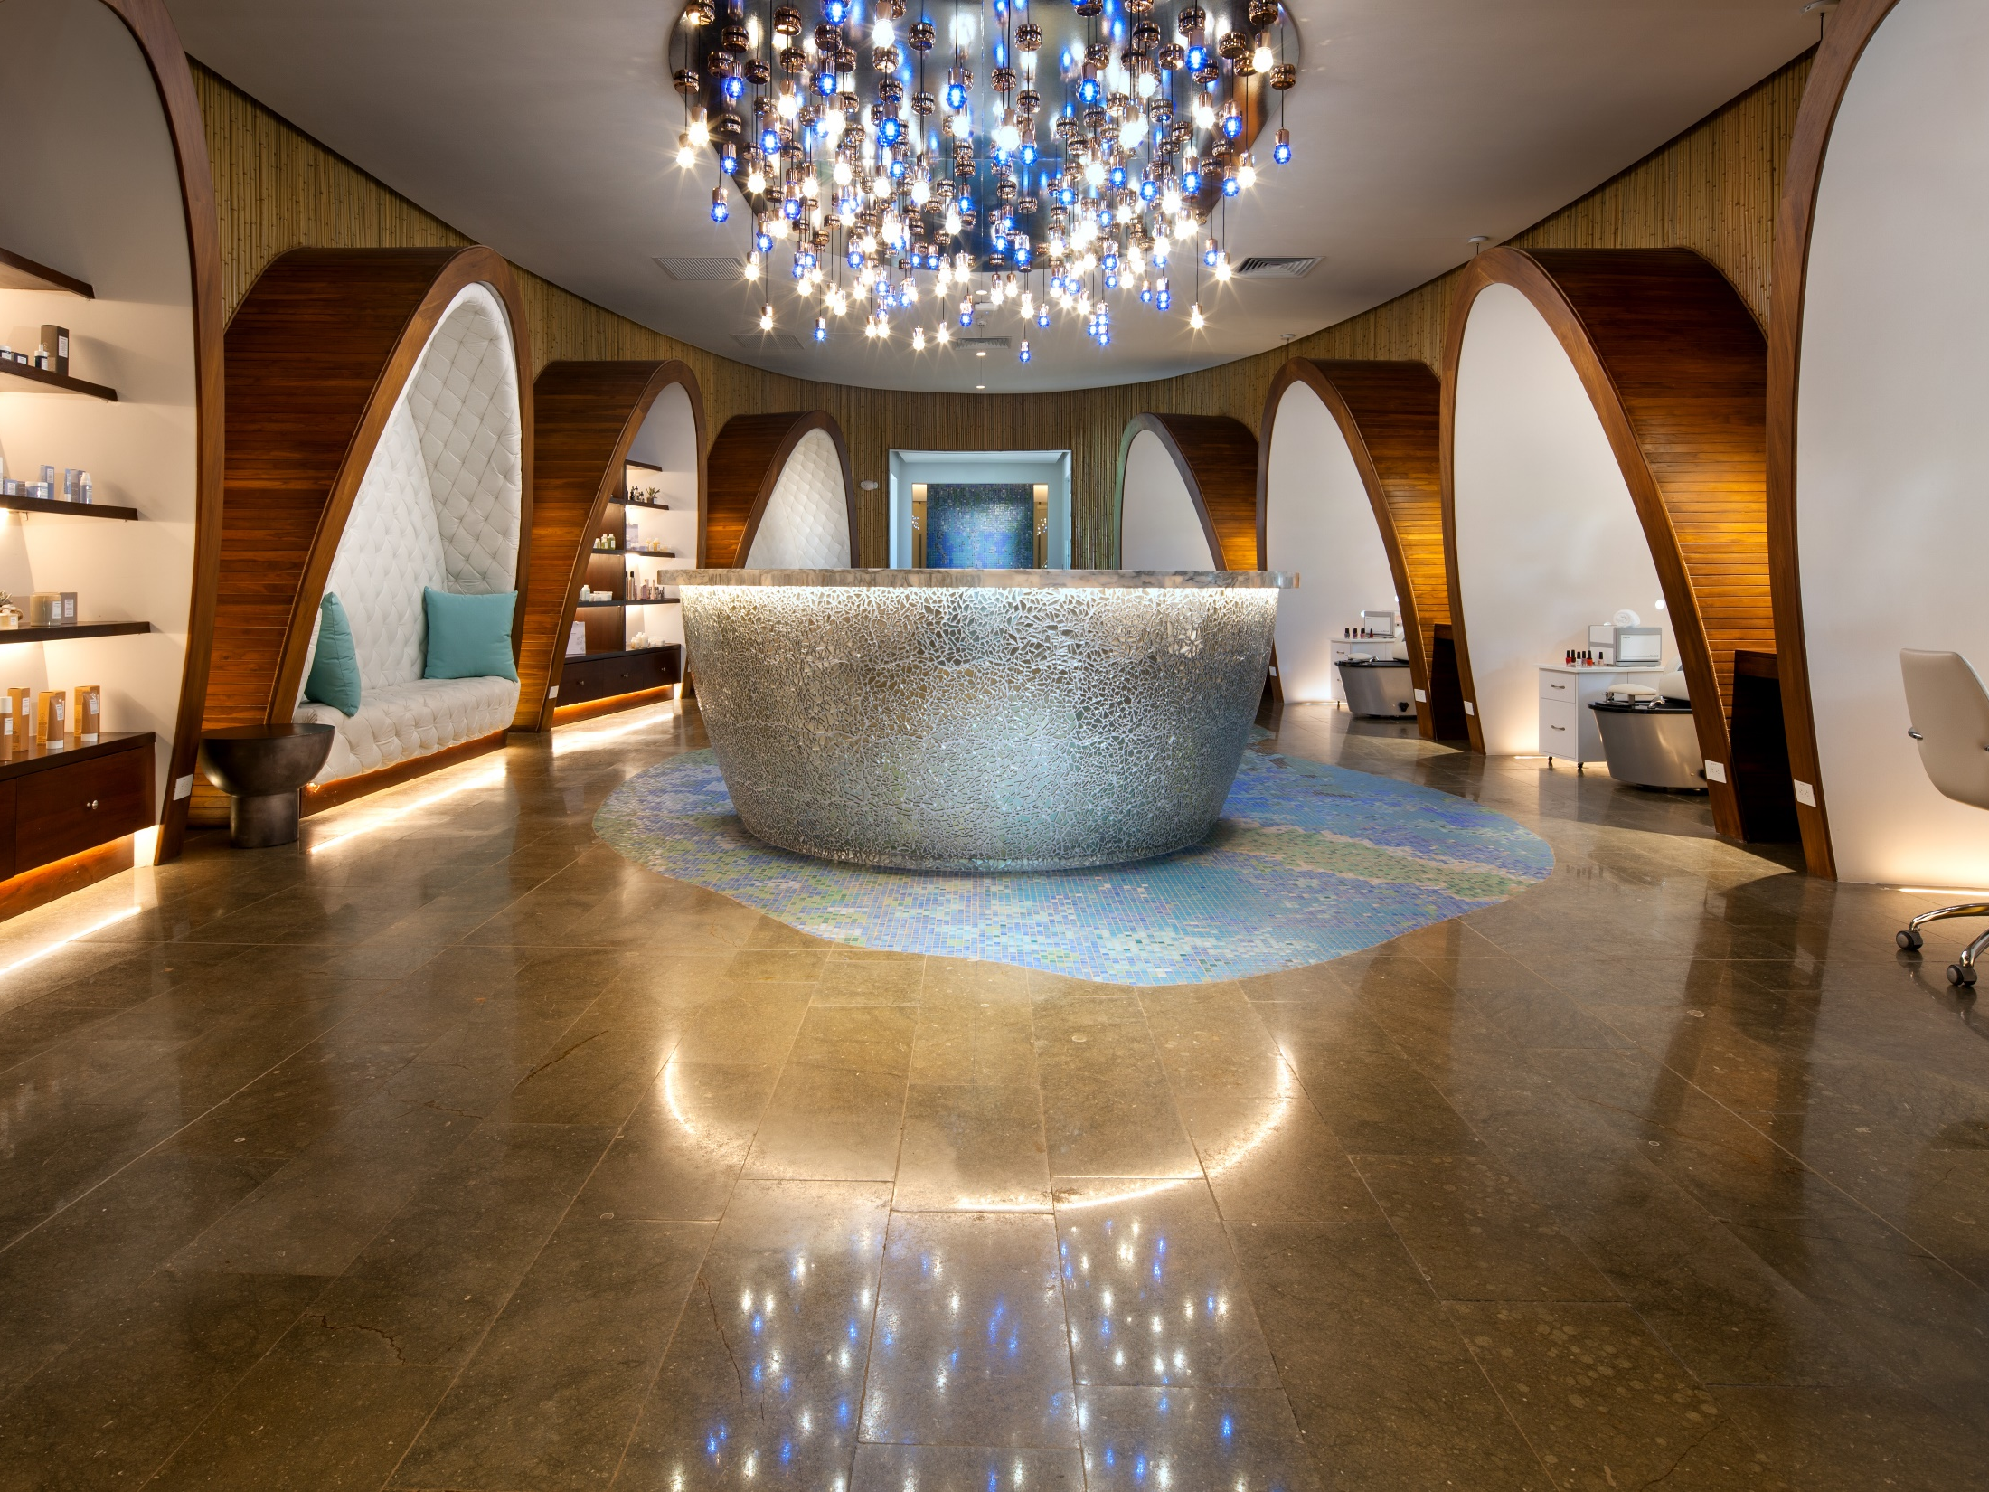
Away Spa

Slide 42
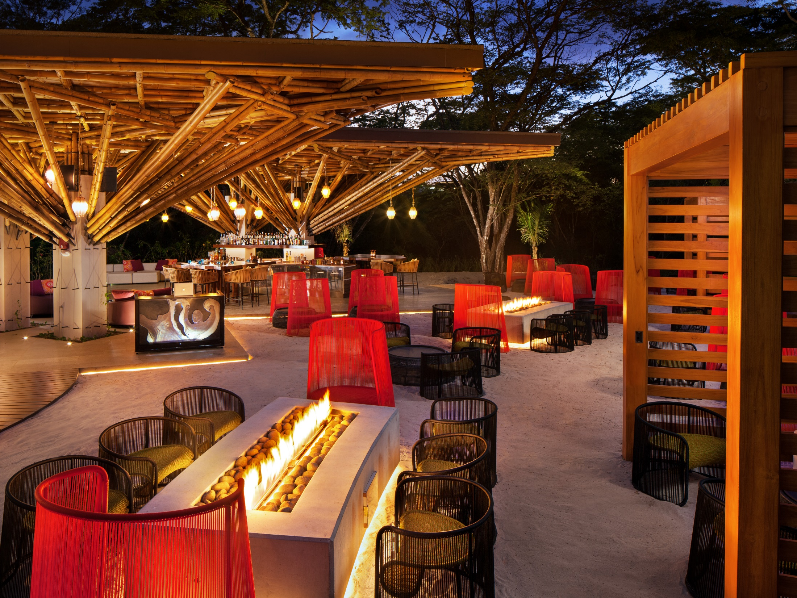

Slide 43
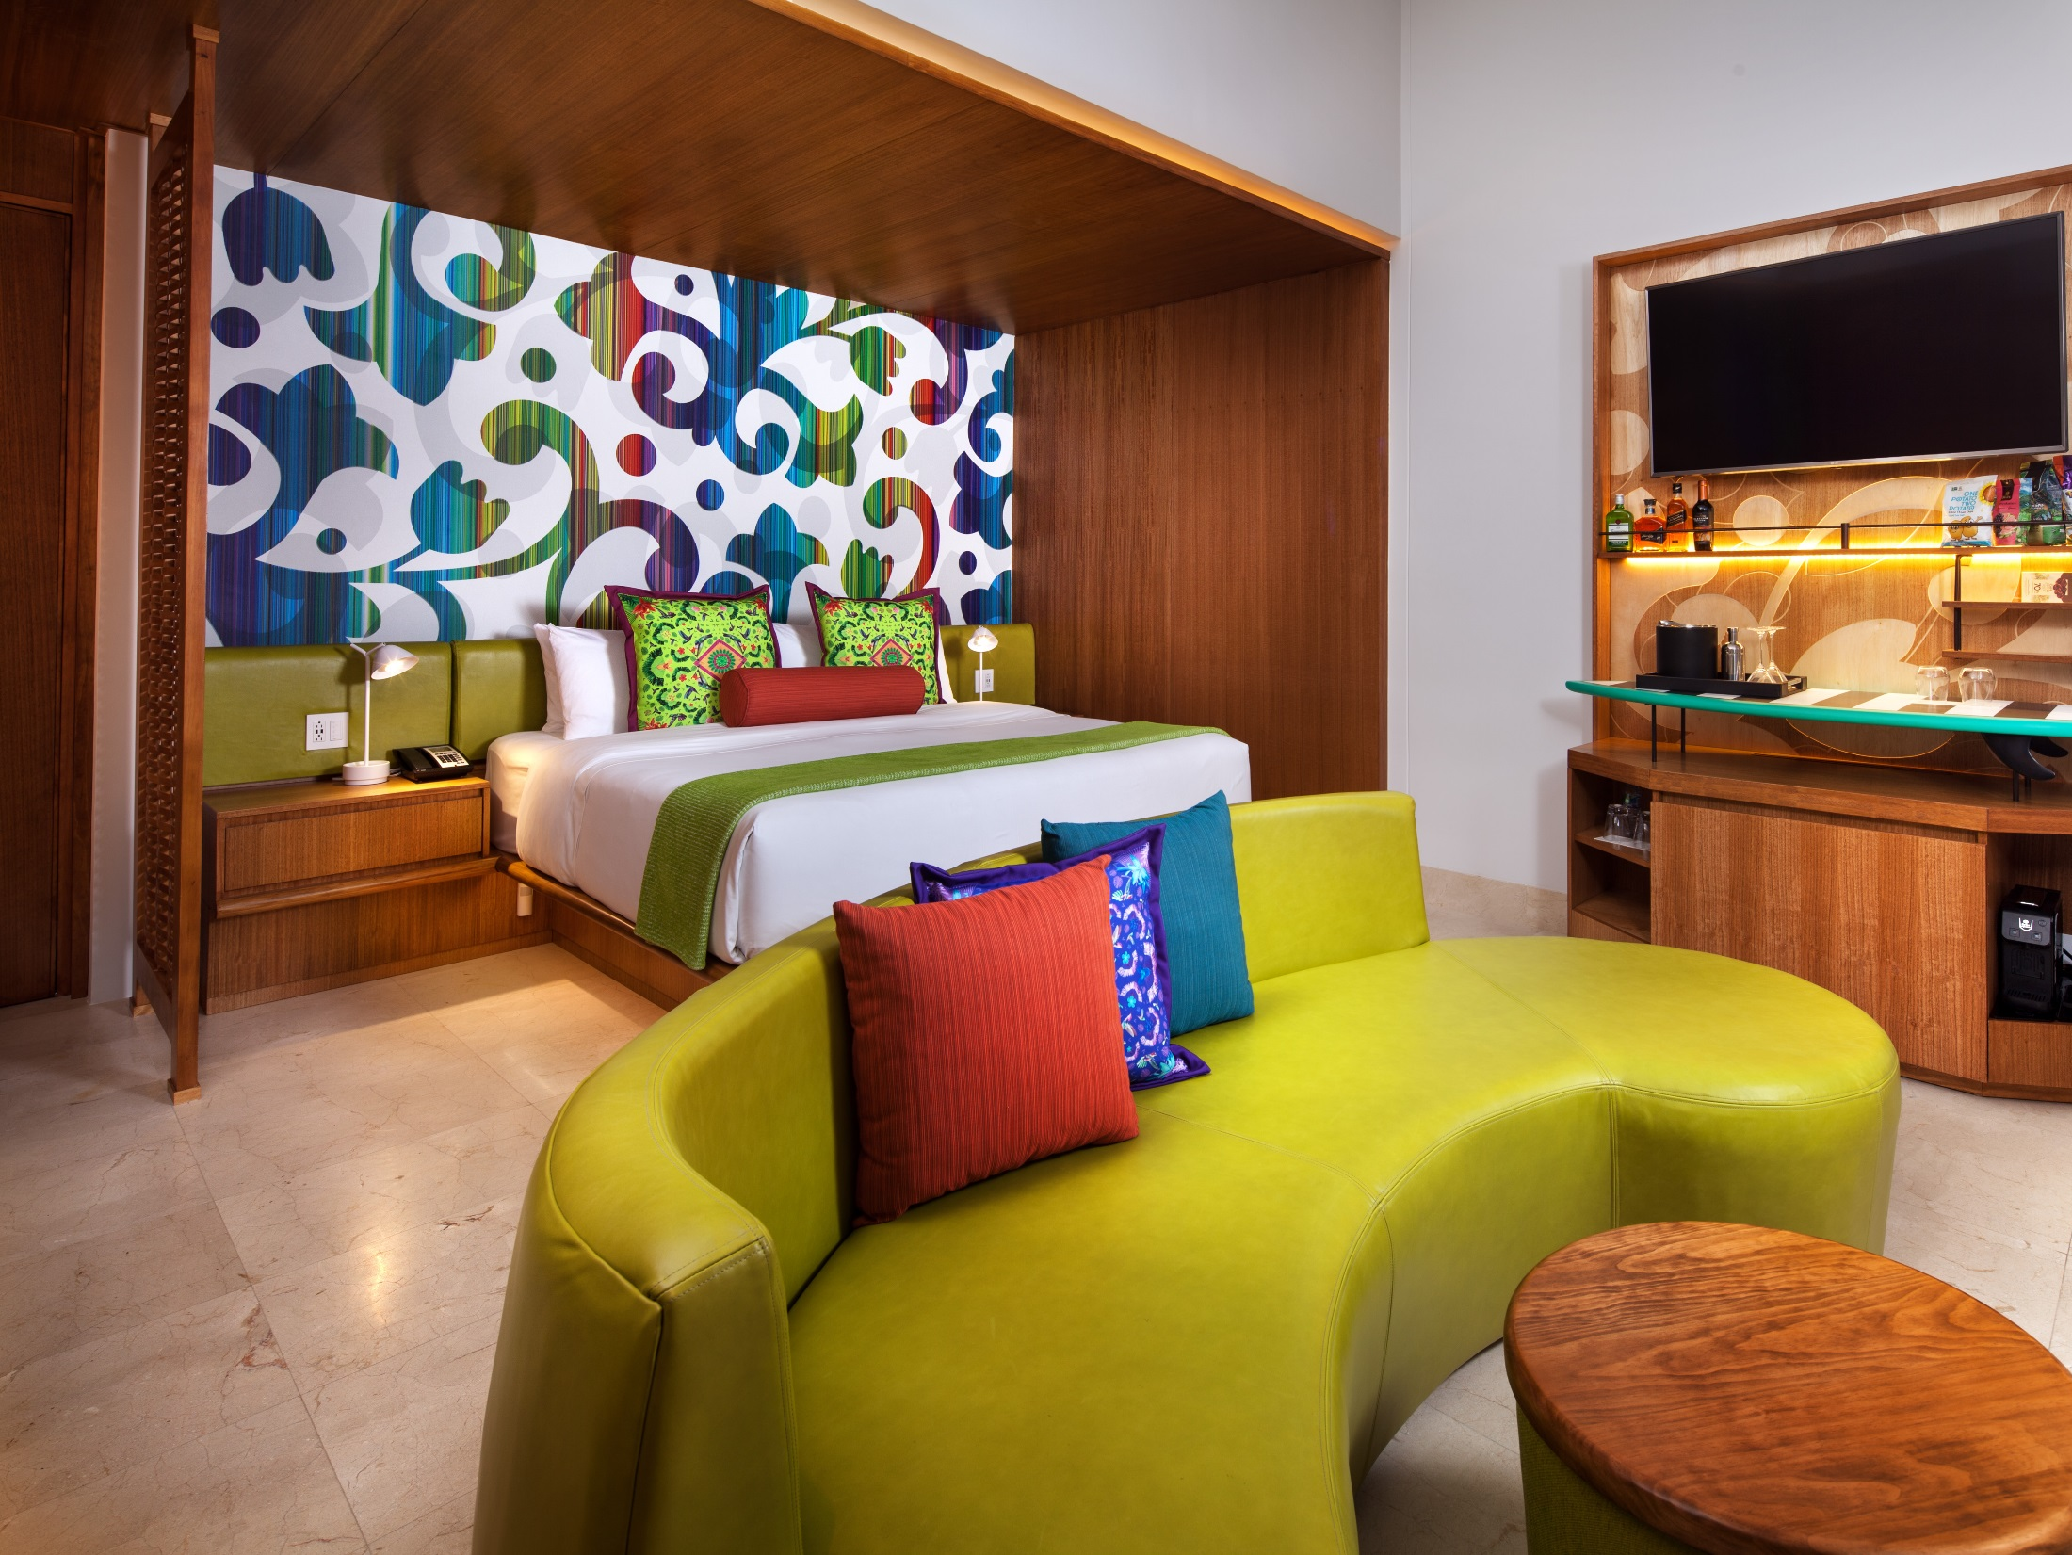

Slide 44
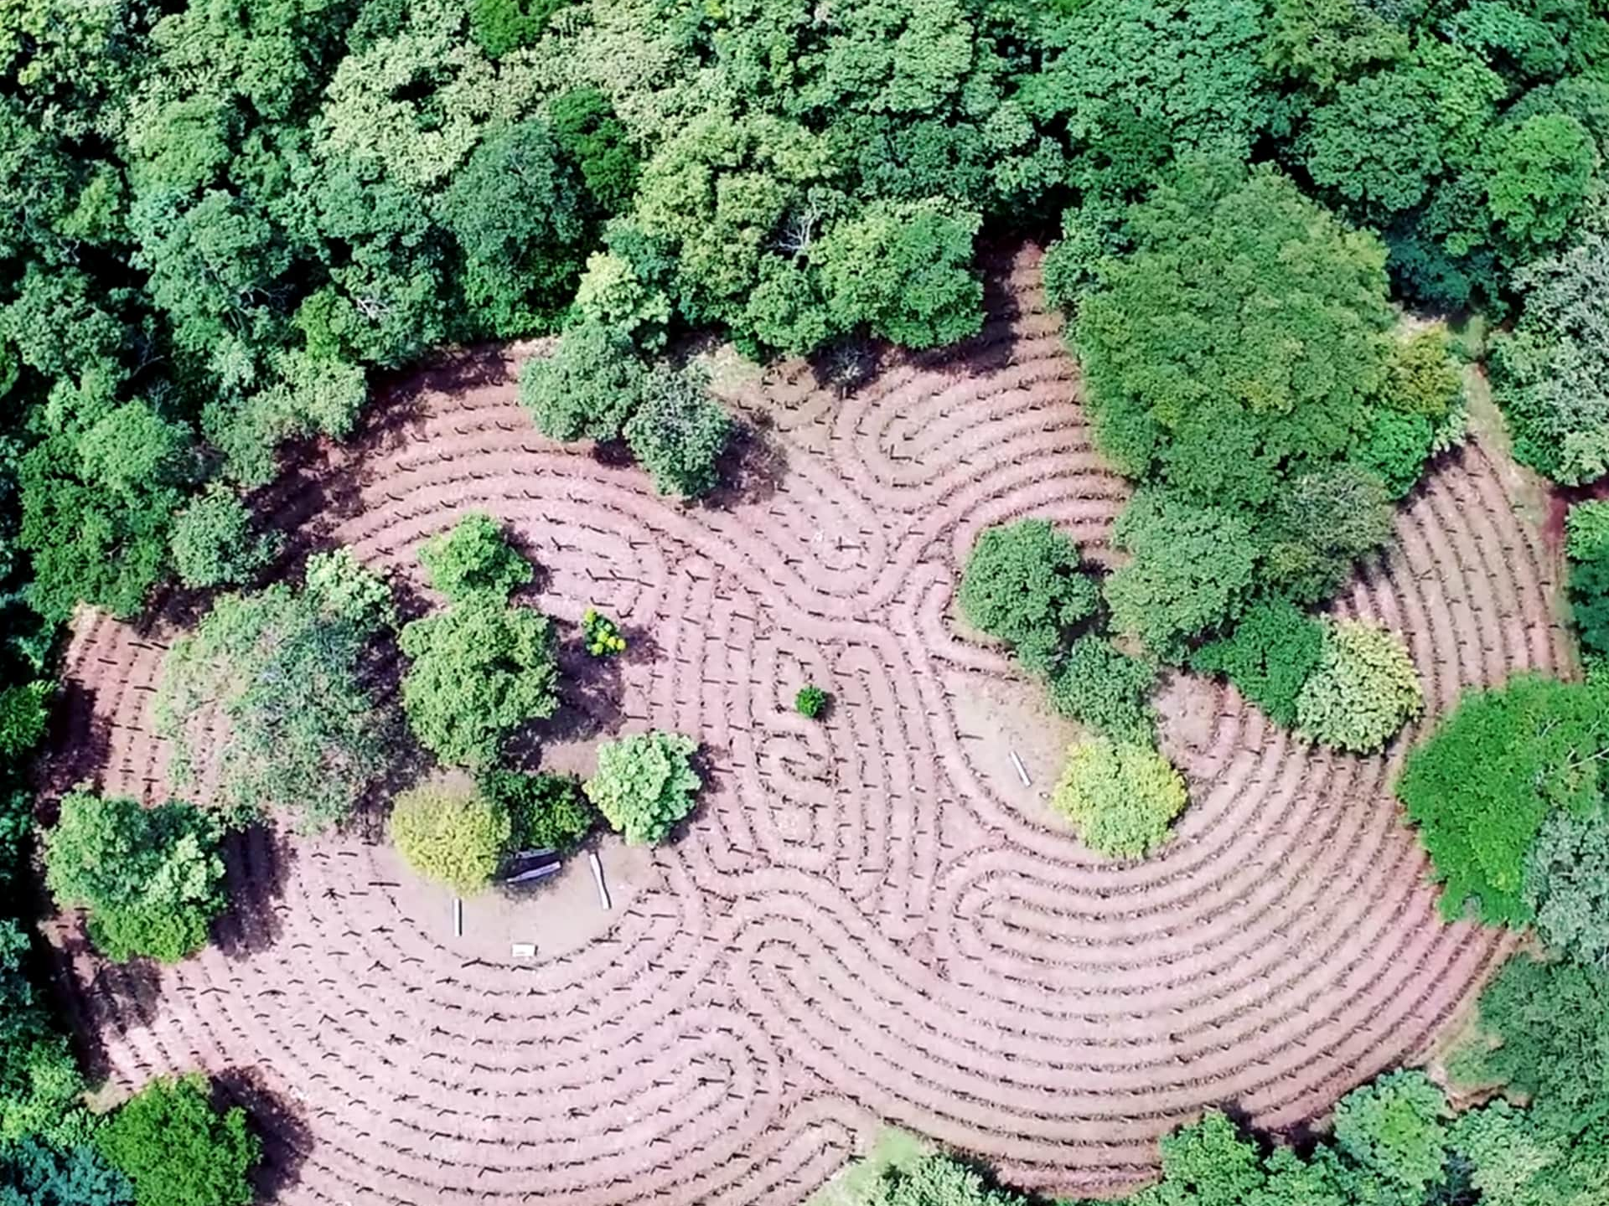
La Senda

Slide 45
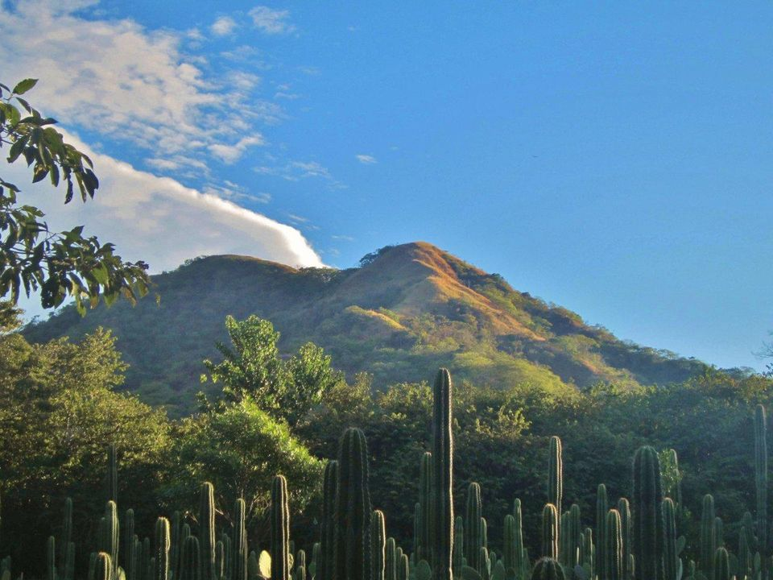

Slide 46

Costa Rica awaits you !!

